Slide 1
On track to the stomach!
Caroline Woon
Clinical nurse Educator
Neurosciences Wellington Hospital

Slide 2
How many patients need to be fed?
1) Elias (2015)

Slide 3
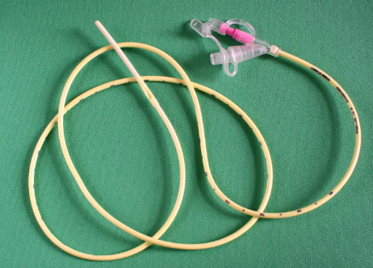
NG feeding – what we know
Feeding
Improve nutritional intake
Administer medications
Notes:
Common in neuroscience
Patients have dysphagia, reduced consciousness and altered cognition although it is not reported much in literature, whereas stroke literature is more common

Slide 4
Complications
Risk of aspiration 17-18% (3)
Misplacement is reported in 5% of nasogastric tubes inserted for stroke patients (2), 1.9% for other patients (4,5)
Pneumothorax (4,5)
Pneumonia (4,5)
Death (4,5)
Delayed feeding
Misinterpretation of x-ray (6)
Reoccurring exposure to radiation (6,7)
Notes:
Misplacement associated with worsening dysphagia
Risk of aspiration is higher in patients with
Delayed feeding 7 hours average

Slide 5
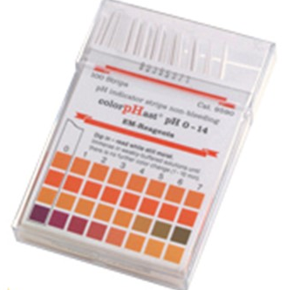
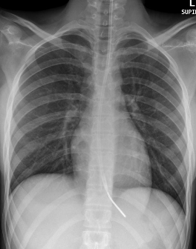
Methods
Notes:
33% of patients in one study and 69% in another study have no aspirate resulting in delayed feeding and some once re-tried would still have no aspirate – 18.4%, plus a patient was 4.5 ph but was actually in the lung, people taking proton pump inhibitors have an average of 4.3PH but are often a ph above 6.

Slide 6
Reference 9

Slide 11
X-ray the gold standard???

Slide 12
National patient safety agency UK 2005-2011
21 Deaths
79 cases of harm
Ng misplacement
Radiological misinterpretation occurred 12/45 cases
Gastric placement with PH accurate in 60% tubes
(Smithard et al 2015, Taylor 2014)

Slide 13
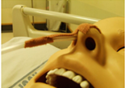
What is the current process?

Slide 14
Xray

Slide 15
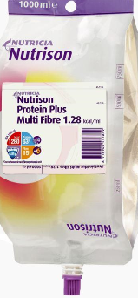
Back on ward

Slide 18
Cortrak
Monitor
Smart receiver unit
Nasogastric tube attached

Slide 19
What does the cortrak do?
https://www.youtube.com/watch?v=nx1CKKzRMMk

Slide 20
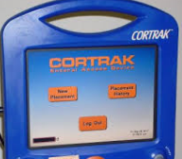
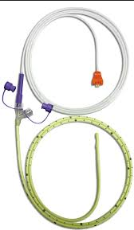
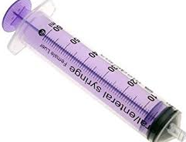
92cm 109cm 140cm

Slide 21
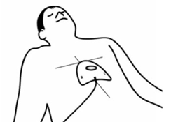
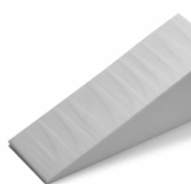
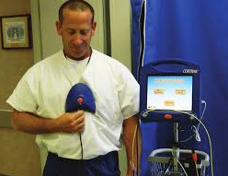
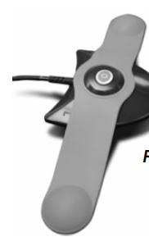
Smart receiver unit placement

Slide 22
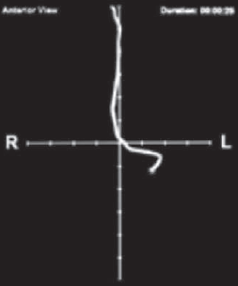

Slide 23
From McCutcheon, Whittet, Kirsten and Fuchs (2018)

Slide 24
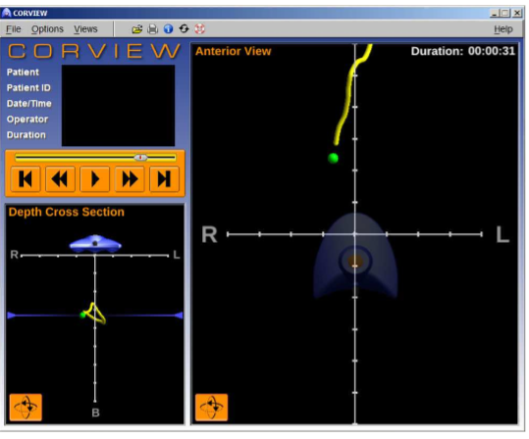
From McCutcheon, Whittet, Kirsten and Fuchs (2018)

Slide 25
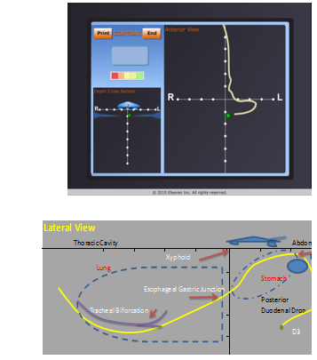

Slide 26
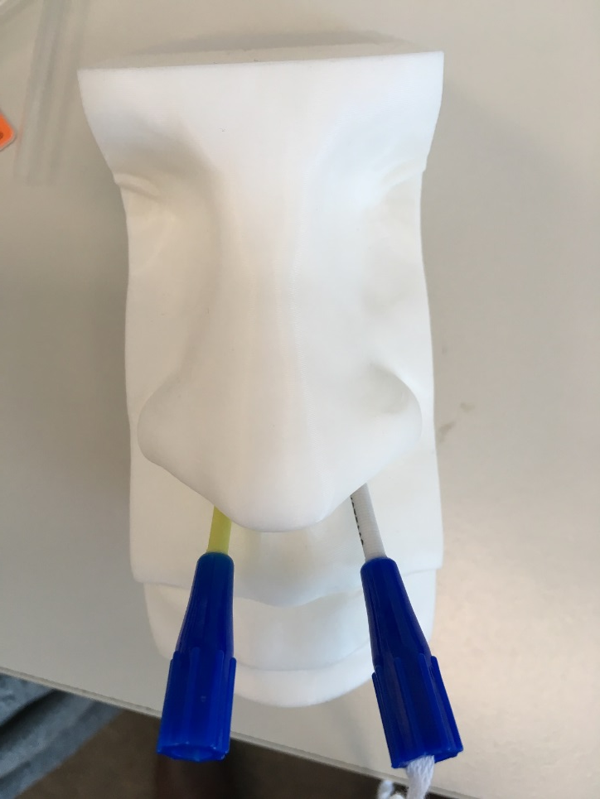
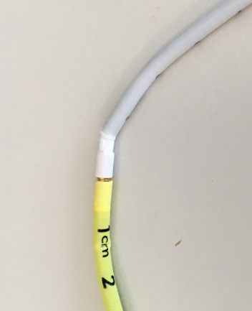
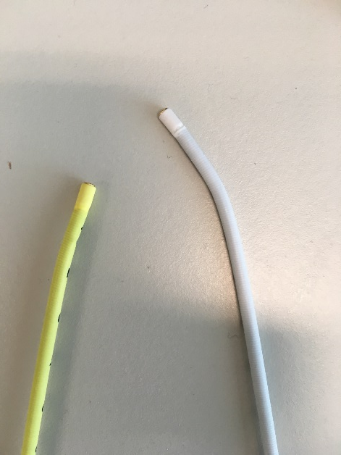
Corgrip

Slide 27
The Trial results
Results
32/39 were in the stomach | 4/39 were further than stomach | 3/39 results were unavailable
Benefits found
Reduces number of x-rays – in department x-ray $200 | Reduces time – up to 1 hour round trip to x-ray for nurse, 10-20 mins for x-ray | Reduces radiation exposure, some patients had 4 x-rays
Cost savings
With cortrak over 1 years cost approx. $42,300 | Without cortrak over 1 years cost approx. $59,160
With cortrak over 3 years cost approx. $66,900 | Without cortrak over 3 years cost approx. $177,480

Slide 28
Comparison
Xray confirmation method
1:30
12 hours
Cortrak placement with corgrip
30 minutes
1:30

Slide 29
Advantages of Cortrak
Easier to pass
Instant recognition of location
Can print out results
If concern over location can recheck
Reinsert same tube
Tube has bigger hole so less blockage
Corgrip prevents tube dislodgement

Slide 30
Well trained team approach!
McCutcheon (2018)
Increases patient safety
Standardises practice
Reduces costs

Slide 31
Important points for use of Cortrak
Accuracy is based on the interpretation
Superusers should be identified and trained
Extensive training is key
Takes time to use corgrip correctly
Research – between 3-10 placements with x-ray confirmation
Smart receiver unit must be in the right place

Slide 32
Some references, should you need!
1) Elia, M. (2015). The cost of malnutrition in England and potential cost savings from nutritional interventions (short version). BAPEN. Available online: www. bapen. org. uk/pdfs/economic-report-short. pdf.
2) Dziewas R, Warnecke T, Hamacher C, et al. Do nasogastric tubes worsen dysphagia in patients with acute stroke? BMC Neurol. 2008;8:28.
3) Ba SC, Ms WX, Ms SC, et al. Risk of regurgitation and aspiration in patients infused with different volumes of
enteral nutrition. Asia Pac J Clin Nutr. 2015;24(2):212Y218.
4) Sparks Da, Chase DM, Coughlin LM, Perry E. Pulmonary complications of 9931 narrow‐bore nasoenteric tubes during blind placement: a critical review. JPEN J Parenter Enteral Nutr. 2011;35:625‐629.
5) Sorokin R, Gottlieb JE. Enhancing patient safety during feeding‐tube insertion: a review of more than 2000 insertions. JPEN J Parenter Enteral Nutr. 2006;30:440‐445.
6) National Patient Safety Agency (NPSA). Patient safety alert: reducing the harm caused by misplaced nasogastric feeding tubes in adults, children and infants. NPSA/2011/PSA002. http://www.nrls.npsa.nhs.uk/alerts/?entryid45=129640. Published March 20, 2011.
7) Bear, D. E., Champion, A., Lei, K., Smith, J., Beale, R., Camporota, L., & Barrett, N. A. (2016). Use of an electromagnetic device compared with chest X-ray to confirm nasogastric feeding tube position in critical care. Journal of Parenteral and Enteral Nutrition, 40(4), 581-586.
8) Nascimento, A., Carvalho, M., Nogueira, J., Abreu, P., & Nzwalo, H. (2018). Complications Associated With Nasogastric Tube Placement in the Acute Phase of Stroke: A Systematic Review. Journal of Neuroscience Nursing, 50(4), 193-198.
9) Elizabeth Puddy, Catherine Hill; Interpretation of the chest radiograph, Continuing Education in Anaesthesia Critical Care & Pain, Volume 7, Issue 3, 1 June 2007, Pages 71–75, https://doi.org/10.1093/bjaceaccp/mkm014
10) Fan, Tan and Ang (2017) Nasogastric tube placement confirmation where we are and where are we heading. Proceedings of Singapore Healthcare. Vol. 26(3) 189–195
11) NICE (2016) CORTRAK 2 Enteral Access System for placing nasoenteral feeding tubes cited at https://www.nice.org.uk/advice/mib48/chapter/summary.
12) Taylor, S. J., Clemente, R., Allan, K., & Brazier, S. (2017). Cortrak tube placement part 2: guidance to avoid misplacement is inadequate. British Journal of Nursing, 26(15), 876-881.
13) Taylor, S. J., Clemente, R., Allan, K., & Brazier, S. (2017). Cortrak tube placement part 1: confirming by quadrant may be unsafe. British Journal of Nursing, 26(13), 751-755.

