Slide 1
Nicola Sutton, Chief Executive
English Language Partners New Zealand Trust
nicola.sutton@englishlanguage.org.nz
www.englishlanguage.org.nz

Slide 2
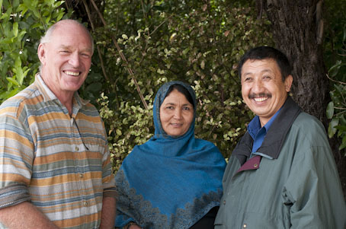
Our vision: “That refugees and migrants …
… have the opportunity to learn English, to pursue aspirations for themselves and their families, and to participate in all aspects of life in Aotearoa New Zealand.”

Slide 3
We believe that language is KEY
to living a good life in NZ (English language) to retaining and sharing cultural identity (mother tongue)

Slide 4
ELP teaches English so learners can …
live confident and independent lives
participate in NZ society
access mainstream services
meet people, make connections, and not be isolated
have the language to get a job
have the language for further study
understand their rights and responsibilities in bi-cultural and multicultural NZ
know how to care for NZ environment
retain and share own cultural identity

Slide 5
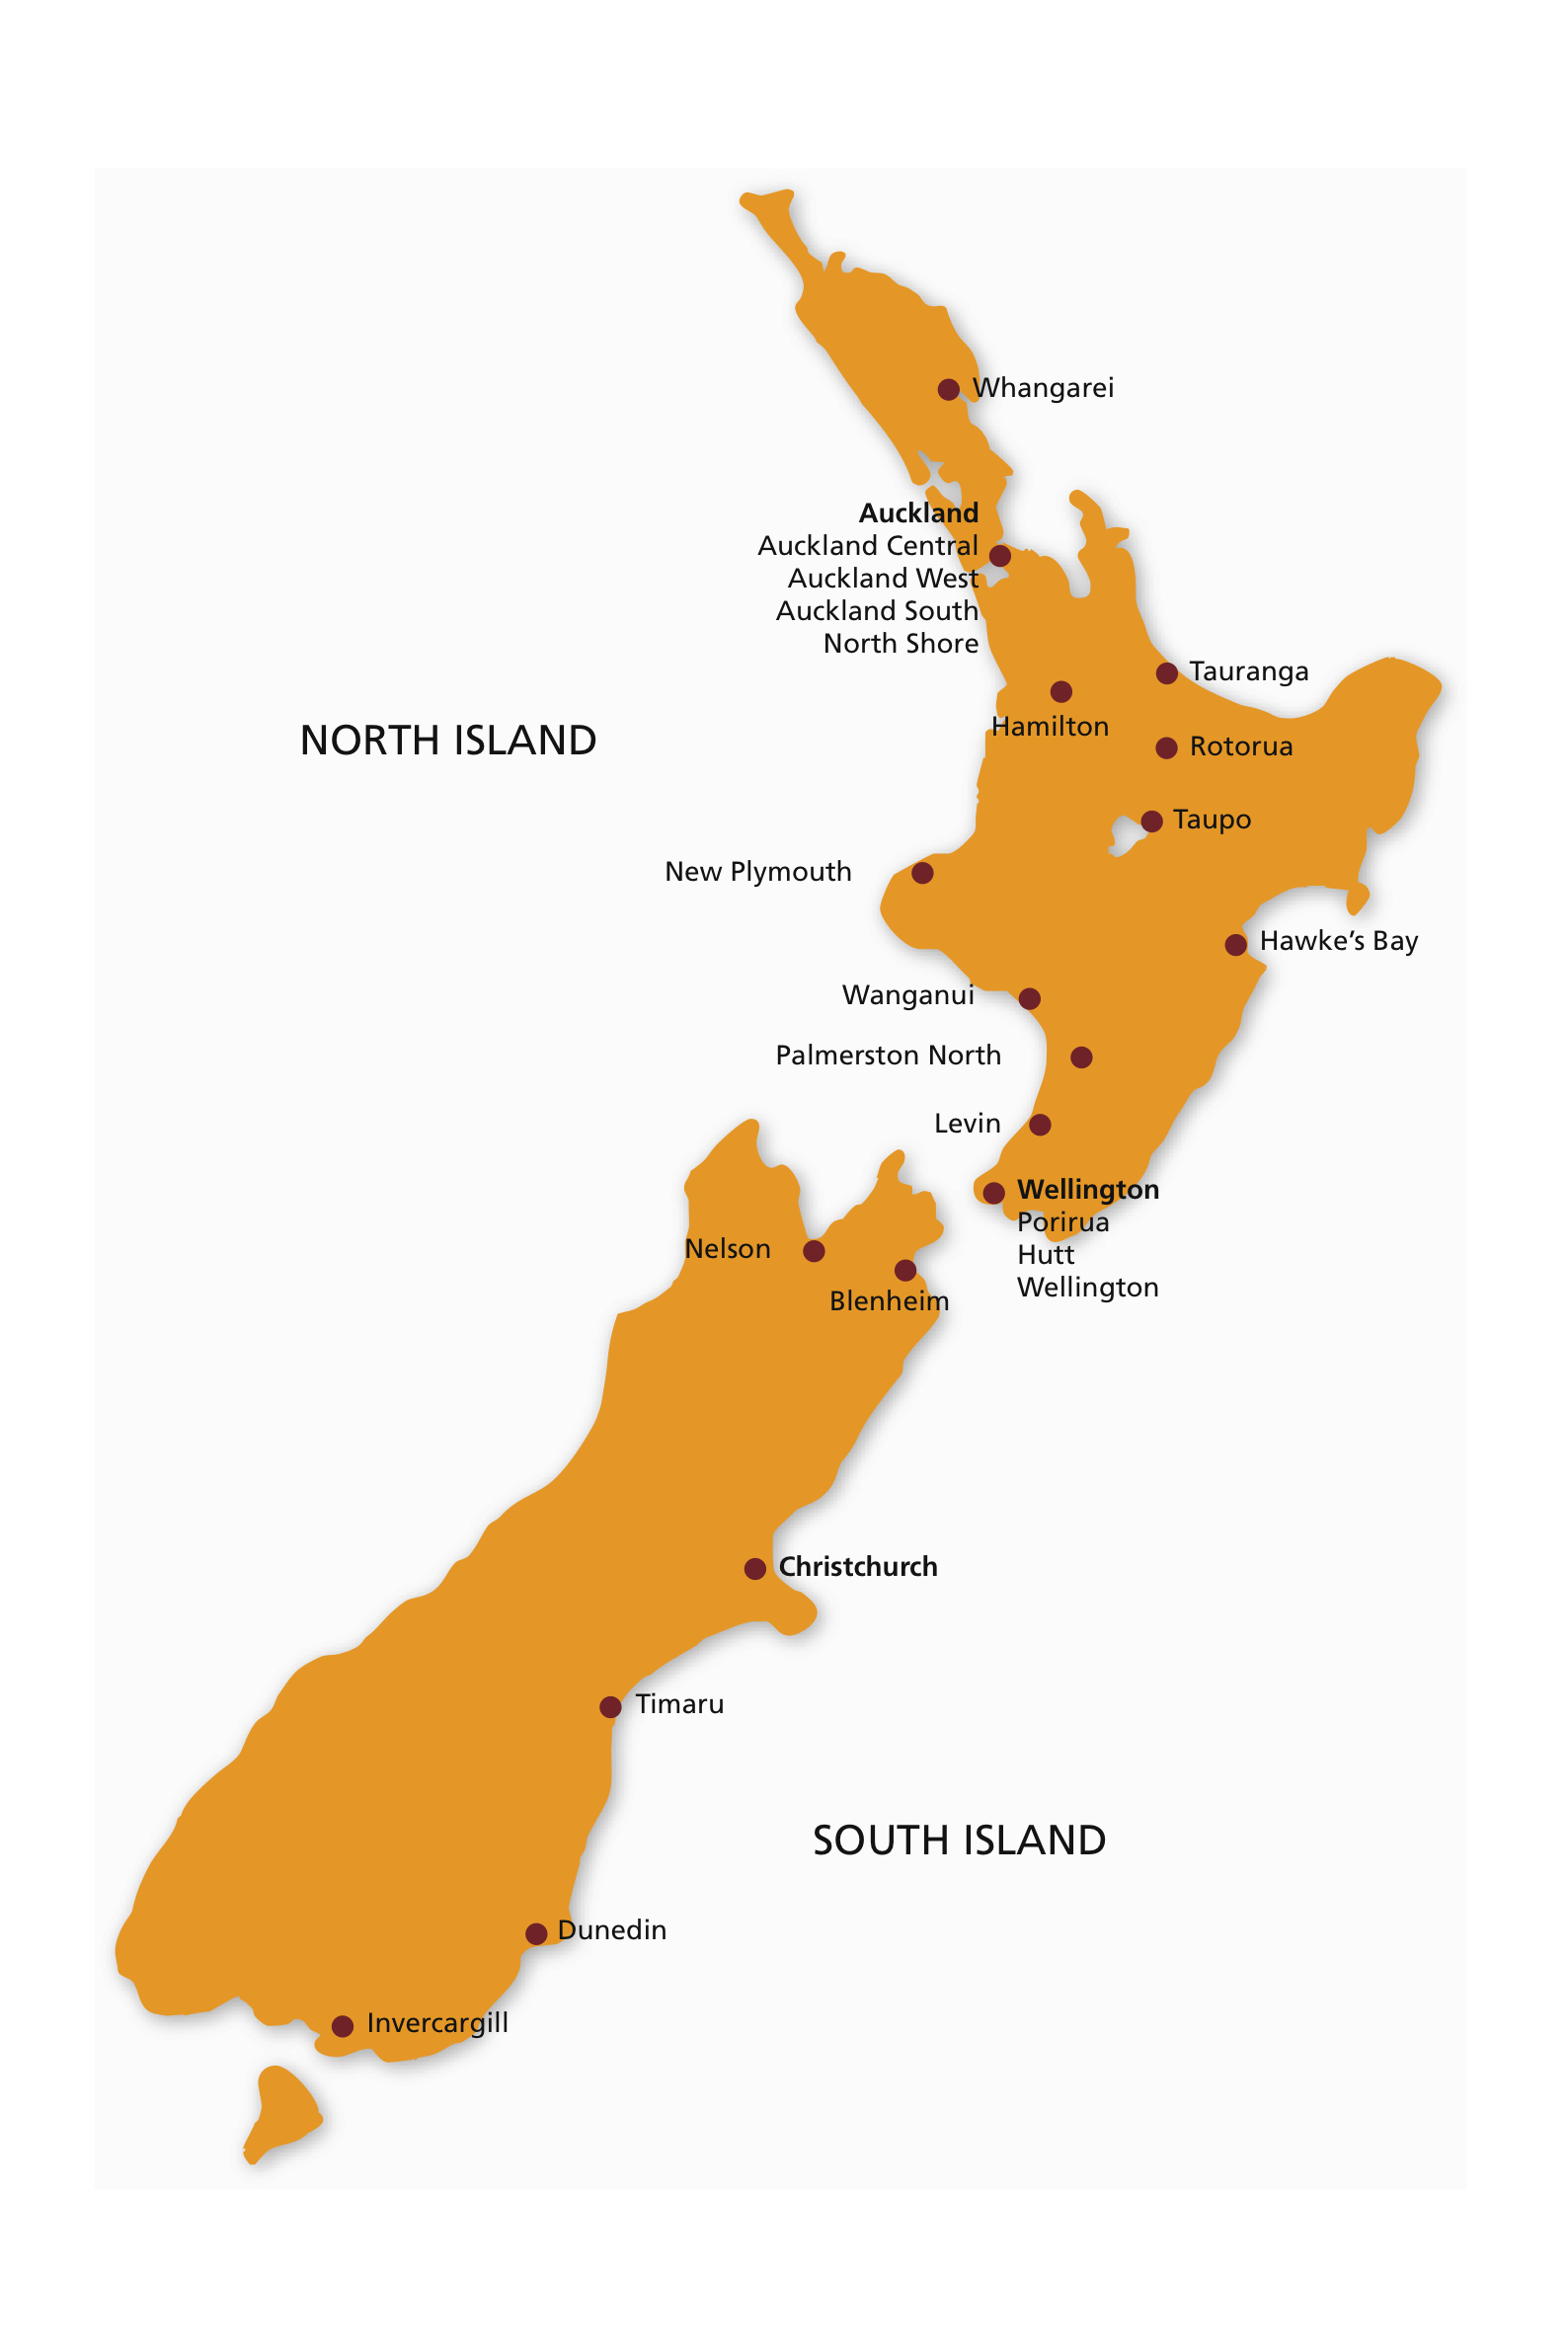
Who is
English Language Partners?
national organisation
23 locations
community based – work in community spaces and homes
non profit and registered charity
registered with New Zealand Qualifications Authority
funded by Tertiary Education Commission
raise local funds from business, individuals, and philanthropic funders to deliver programmes

Slide 6
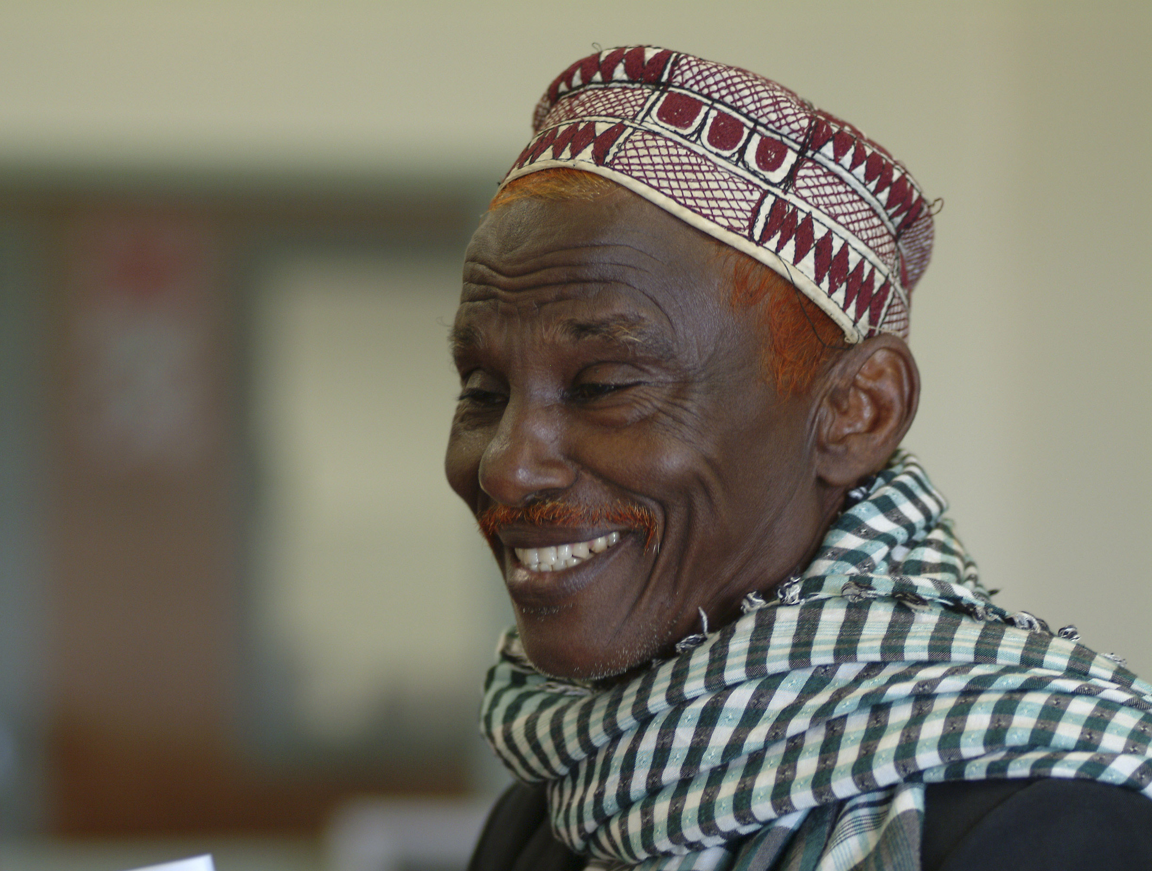
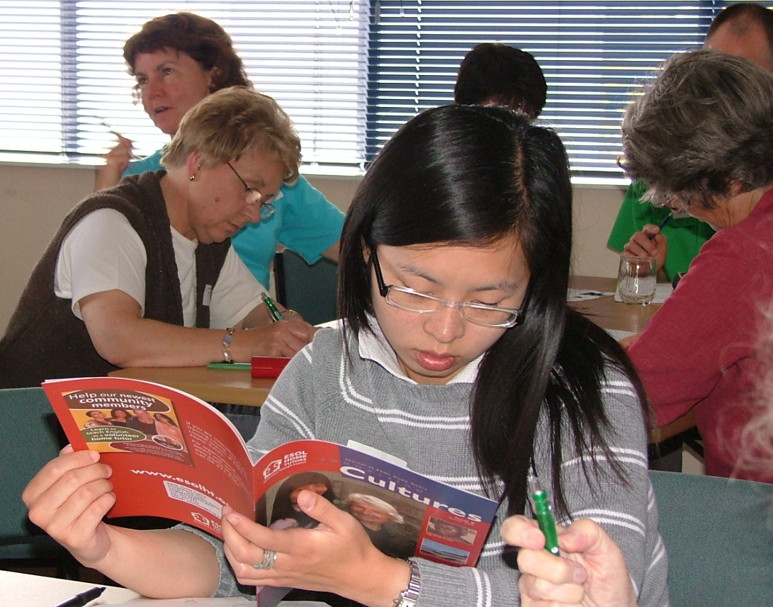
2014 Quick stats
650,000 hours of delivery (approx. )
7,035 learners (20% quota refugees)
2,300 volunteers
700 new volunteers trained
310 staff including 250 teaching staff

Slide 7
ELPNZ’s government-funded programmes
Programmes
English Language Groups (community) 2 - 4 hours per week
ESOL Home Tutoring 1 - 2 hours per week
ESOL-Literacy Groups 4 hours per week
ESOL-Literacy Classes 10 hours per week
ESOL Intensive Classes 250 hours over 6 months
New Zealand Certificate in English Language Level 1 (small number of programmes)
English for Employees 25 hours
English for Migrants pre-paid tuition programme
Certificate in ESOL Home Tutoring 20 hours study to train volunteers (NZQA certificate)

Slide 8
What is meant by collaboration or partnership?
Resource sharing: access to/sharing venues, clients, staff or volunteers, cultural knowledge, new ideas or expertise
Information and referrals: sharing what is going on, promoting each other’s services or shared goals in public forums, referring clients, sharing expertise
Providing references/letters of support: e.g. for funding applications
Input to external evaluation and review (e.g. if an organisation is being evaluated providing input as an external stakeholder to that process)
Shared service or event: e.g. professional speaking course in Southland where ELP provides teachers and expertise, local multicultural council provides advertising (clients) and venue.
ESSENTIAL that collaboration/partnership is genuine.
Let’s not say we are in partnership if all we are doing is networking/being supportive of each other.

Slide 9
How can national NGOs facilitate collaboration and partnership in regions?
Importance of national NGOs holding relationships at national and local levels:
National strategic relationships – regular meeting and information sharing at leadership level (strategic)
Local relationships – local providers working at local level meeting and sharing information that address local needs
Supporting each other’s work nationally and locally: funding applications, service development, information sharing, positive promotion of each other’s services, choosing not to compete
Facilitate national discussions between their local ‘members’ or ‘branches’; this meeting is an example of that
National support for local initiatives if this is needed or national support for implementing a partnership in multiple places

Slide 10
How does ELPNZ view the role of community organisations like Regional Multicultural Councils, Newcomers Networks and Migrant centres?
We are all part of the ‘jigsaw’ picture
We share a common goal (outcome) – refugees and migrants can settle well in New Zealand, can participate in society, and can live successful lives
Our part is English language programmes that supports good settlement outcomes
We can refer learners to your programmes/services and you can refer people to us
Essential sources of information we may not hear about (other perspectives)
Public support for each others programmes/services
Potential partners for formal/organised shared activity together: might be an event, or a service, or a programme, or the sharing of resources like venues
Your ideas? I would love to hear your thoughts on this.

