Slide 1
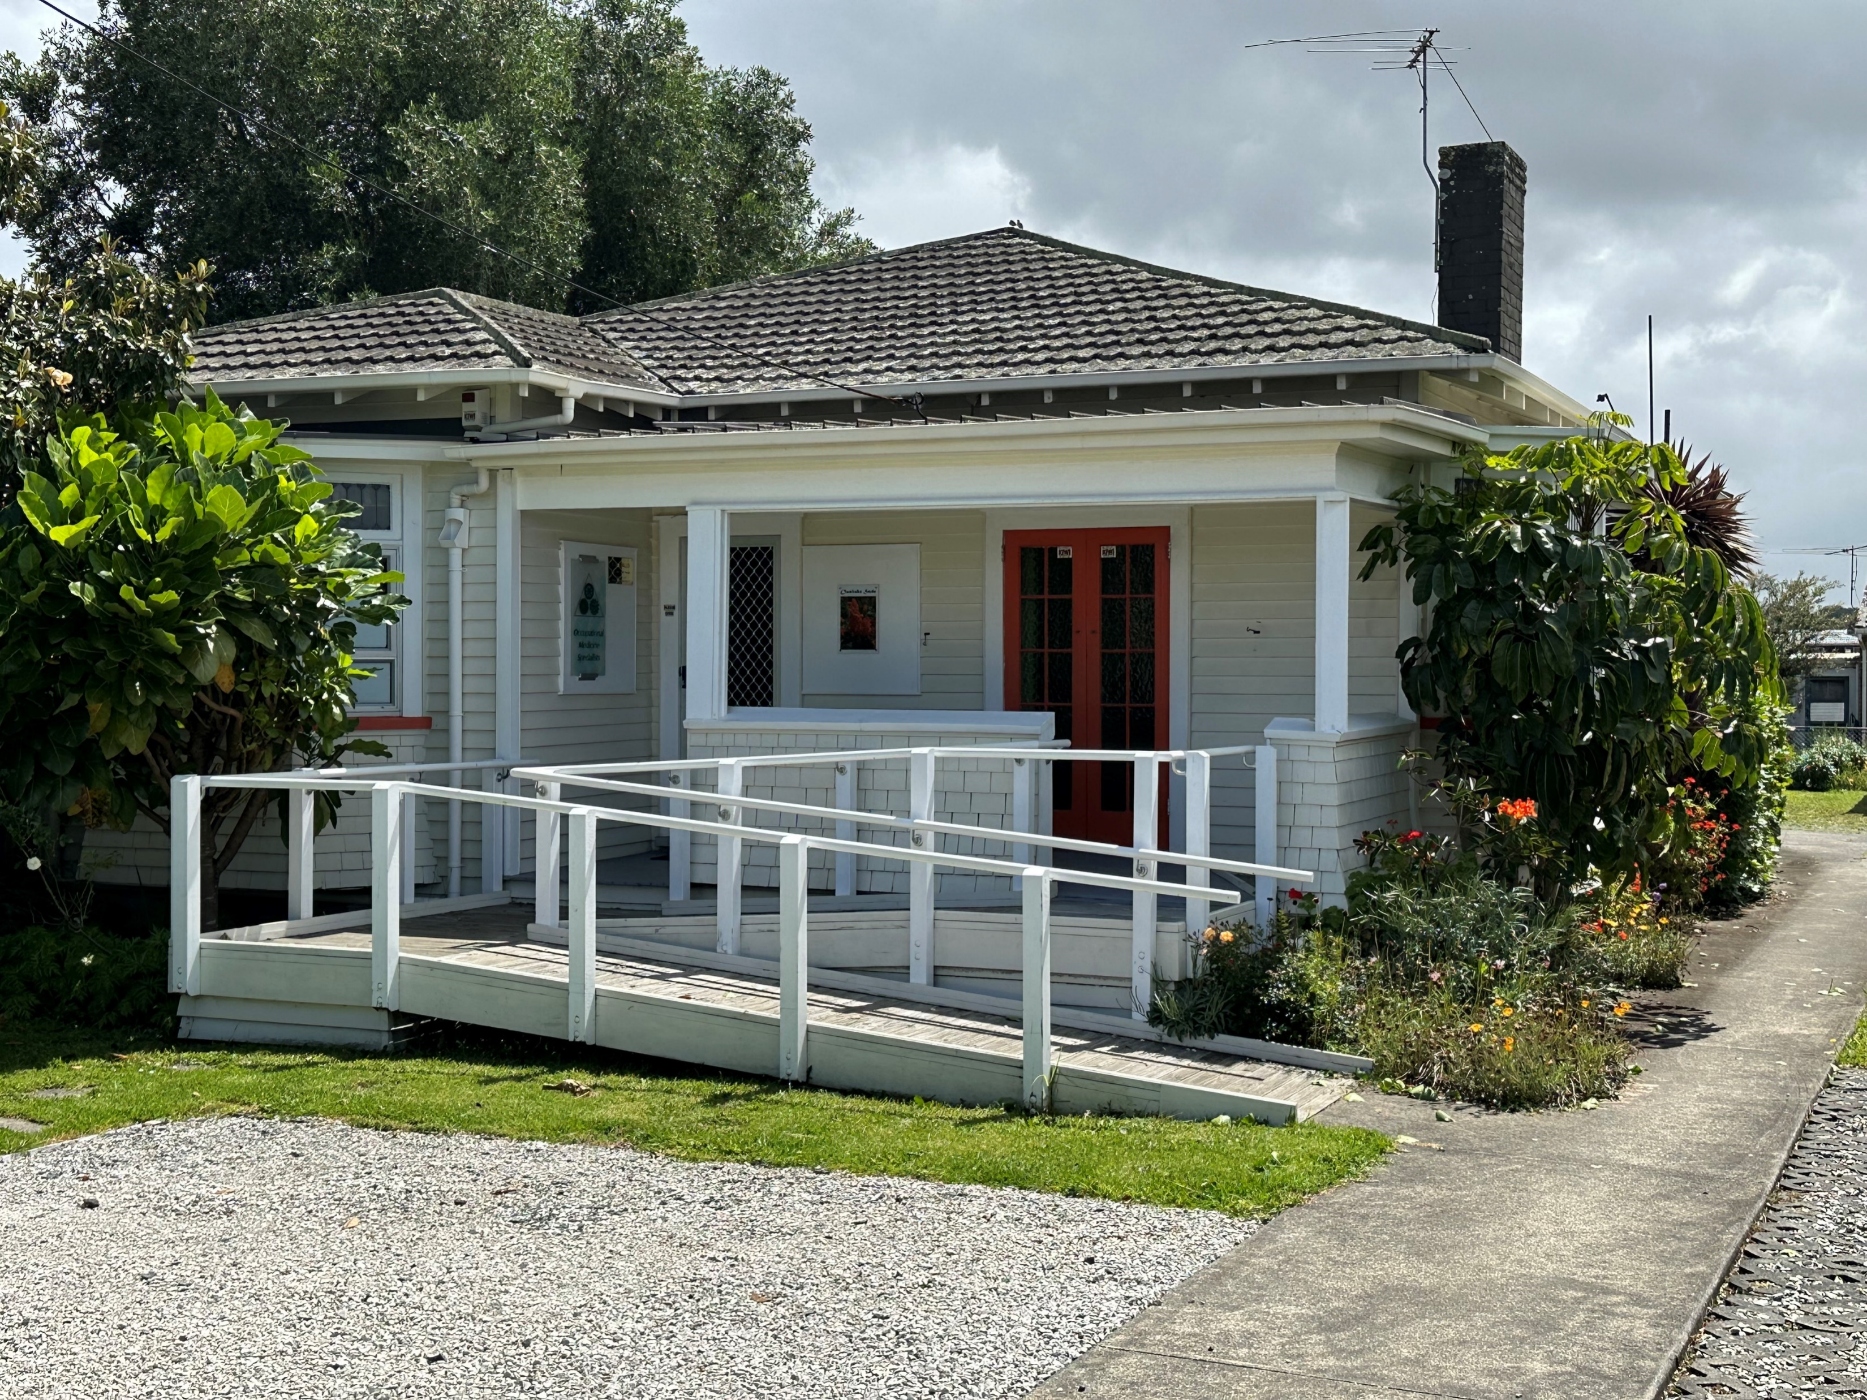
Prevention of Occupational Illness in NZ
Dr Chris Walls
Occupational Physician, Auckland

Slide 2
What is an Occupational Illness
Two main elements are present in the definition of an occupational disease:
the causal relationship between exposure in a specific working environment or work activity and a specific disease; and
the fact that the disease occurs among a group of exposed persons with a frequency above the average morbidity of the rest of the population.
ILO List of Occupational Diseases 2010

Slide 3
Incidence/Prevalence of Occupational Illness in NZ
NOHSAC
(National Occupational Health and Safety Advisory Committee – 2004)
“We estimate that each year in New Zealand there are:
about 700-1,000 deaths from occupational disease, particularly cancer, respiratory disease and ischaemic heart disease
about 100 deaths from occupational injury
17,000-20,000 new cases of work-related disease
about 200,000 occupational accidents resulting in ACC claims, about half of which result in disability, and
about 6% in permanent disability”.
“ New Zealand systems for surveillance of work-related disease and injury are inadequate by international standards, and in many instances the relevant information is not available….”

Slide 4
Government Agencies involved in Occupational Health and Safety issues in NZ
WorkSafe
Inadequate technical (scientific and medical) resources
Accident/ Policy focussed
Removed all practical illness information (how to diagnose, preventive steps etc) from website
ACC
No legislative authority
? Conflict of interest/ aims
Has the $ to mount programmes
Acts as the dominant player in the inter-relationship with WorkSafe

Slide 5
OH&S Hierarchy of Control

Slide 6
Health and Safety Hierarchy of Control
Hazard Identification
Eliminate
If cant eliminate isolate
to specific environments or trained and equipped workforce
If cant isolate manage by
Engineering solutions
Work practice solutions
Personal Protective Equipment (PPE)
Monitor results
Adjust hazard control measures

Slide 7
How much Occupational Disease is there in NZ ?
Who knows ?
Not WorkSafe or ACC
NOHSAC
Diseases of the eye, Diseases of digestive system, Pneumoconiosis, Chronic respiratory disease, Musculoskeletal, Cancer, Mental disorders, Poisoning, Skin disorders, Diseases of ear and mastoid process, Other diseases Coronary heart disease Infectious disease Asthma
My assessment of conditions in decreasing frequency
Dermatological conditions
Musculoskeletal conditions
Mental Health issues (usually more work organisation than work content)
Respiratory
Occupational toxicology
Occupational Cancer

Slide 8
Issues with identifying Occupational Illness in NZ
Complex topic
Rare for a condition to be solely occupational, age, pre-existing illness to impact
E.g. 20% of mesothelioma are not related to asbestos exposure
Government agency antipathy
NZ culture
Employer/ employee indifference until too late
“fighting against the nanny state” followed by “someone should’ave….”
Media influence on popular opinion
Lack of awareness/ recognition amongst NZ doctors about occupational influences
ACC hostility to accepting reasonable cases
In Occupational Medicine there are only very rare black and white cases

Slide 9
NZ Business size influences Occup Health resources/ interventions
Size
“New Zealand is a nation of small and micro businesses representing more than 97 percent of all firms. They account for 28 percent of employment and contribute over a quarter of New Zealand’s gross domestic product (GDP)”.
Medium Business – “more than 20 employees and less than 100 employees. They represent just over two percent of all businesses in New Zealand”
Large Business – “Those with more than 100 employees (or sometimes more than 50). Large businesses represent just 0.5 percent of businesses in New Zealand, numbering about 2,500”.
MYOB
Resourcing issues for “non essential” services.

Slide 10
Occupational Medicine in NZ in 2022
Small Speciality or GP special interest group
Survival of discipline at risk
no official training posts, industry not supportive of training, Government hostile, no training budget
Main source of new physicians is importing from UK, those physicians take some time to understand the nuances of ACC etc
Unusual now to run clinics at the workface/ site
Even more unusual to liaise with other OH&S professionals (e.g. Occupational Hygienists)
Most Occupational Medicine is done unknowingly by the GP practising in the country areas or in the industrial areas of NZ cities

Slide 11
Occupational Illness
Why is it important to recognise ?
Affects the “healthy worker” and converts a pillar of society into an unwell person, often on some sort of benefit
Obvious costs to the health and welfare systems
Illness wont improve (usually) while exposure continues
Prevention should lead to corrective measures to control exposures and in turn protect other workers
Unwell person off work compounds skill shortages
Need greater awareness (of a possible occupational influence) at all levels of health system
E.g. COVID response dictated by people operating at times outside their areas of expertise

Slide 12
Prevention – what is needed ?
Readily available medical knowledge coupled with common sense
Employer and employee co-operation and intervention
The ACC accredited employer programme can produce stereotypic responses to some conditions without adequate consideration of the full information
Medical awareness
Informed General Practitioners
Active training scheme
Government agency involvement/ commitment
Practical Information to employers and employees
Enforcement for identified at risk industries or failures of management

Slide 13
Occupational Medical case
A rather scruffy 40 year old was admitted to hospital with sudden and severe heart failure – “white lung” (profound congestive heart failure) which resolved after 4 days
His life was despaired of in the initial stages of his admission
No cause was found
The gentleman blames the “smoke” at his work
His boss offers the opinion that it is the cocaine the worker uses
The other staff blame the dodgy lunches that are provided
You are asked to investigate and comment and so visit the worksite

Slide 14
The Workplace

Slide 15
The Occupation
The man works as a “camera grip” on a film set in West Auckland
This involves assisting positioning cameras, assisting the cameraman, preparing sets, cleaning up and general duties on the set.
Once film production starts the crews work long days and all the days of the week
The “smoke” is artificial smoke/ fog for scenes
The MSDS (Material Safety Data Sheet) shows this as Monopropylene Glycol & Triethylene Glycol mixed with water
This is approved for use in the USA by the American Actor’s Union (Actors Equity Association) so unlikely to be hazardous

Slide 16
The illness history
Three or four episodes of respiratory embarrassment (wheeze, cough) over the year of filming, random, each more severe than the last, increasingly associated with shortness of breath
His doctors described these episodes as:
Cold then
Severe cold then
Asthma then
Needs admission at once
(an irregular medical verb ?)
Thinks he might have started to react to flatmate’s potplants getting wheezy and coughing at times if in the same room

Slide 17
The worker
“ rude health” – a “westie”
Age 40;
20 Pack year history
Acknowledges marijuana use, denies other substances
Labouring occupational history
Desperate to keep working, great $, mixing with important people, great parties at end of filming etc
Examination normal
Some 6 – 8 weeks from hospital discharge and not returned to work

Slide 18
The Workplace and potential hazards
Sets constructed onsite in a disused warehouse and such construction involves carpentering, plastic cement and paints.
“Solid structures” are made from polystyrene blocks and North American Western Red Cedar framing
WRC known to cause allergic asthma
Old stone work created by “raddling” polystyrene blocks with a heat gun to give rounded aged appearance to stone work
Fume production potentially causing isocyanate exposure
Capable of cause allergic asthma
Ground cover is bark/ wood chip / peat straw
Wetted, painted, scooped from set and stored, then re-used, breaks down with time and creates fine dust

Slide 19
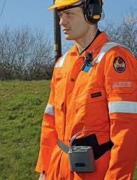
Workplace investigations (Occupational Hygienist)
Personal sampling of breathing zone
did not show isocyanate fume nor WRC dust
did show inspirable/ respirable organic dust (bark ground cover)
Sampling ground cover material showed
Growth of aspergillus and penicillium fungal species
Both capable of causing a condition called Acute Extrinsic Allergic Alveolitis (Hypersensitivity Penmonitis and also known as “farmer’s lung” where there is exposure to mouldy hay)
EAA can cause acute heart failure (rare but reported)

Slide 20
Making the diagnosis and appropriate treatment
Diagnosis
Not possible to be sure
Blood tests for fungal antibodies not conclusive whether positive or negative
Challenge test (re-expose) likely to lead to death
Treatment/ Advice
Inform of putative diagnosis and likely causative exposures
Advice around avoidance
including stopping smoking, smoking is an excellent vehicle to introduce contaminants into the depths of the lungs
Advice employer about alternative products

Slide 21
Outcome
Employer sourced different ground cover (sand)
Cheaper
Took paint better
More easily handled (dried more quickly) and lasted longer (particles didn’t break down in size as quickly)
Patient continued working
No further attacks when last seen some 12 months after admission
Still smoking !

Slide 22
Preventing or reducing Occupational Illness in NZ An old model for a new future ?
Multidisciplinary team providing information, audit and if necessary enforcement
Health and Safety personnel, Occupational Hygienists, Occupational Health Nurses and Physicians
How ?
Lead agency (Worksafe) with H&S experienced staff
Technical (and medical) resources available/ accessible for industry/ worker organisations
Produce practical evidence based advice about hazard identification (including my measurement) and hazard control
Also provide health monitoring baseline standards for employers to consider
Target disease identification (diagnosis) and management information to General Practitioners
Have a practical disease recording/ notification system
Support Occupational Medicine and Hygiene Training
Health Department (DHB inhouse Occupational Medicine services to health staff) / Worksafe / ACC and Department of Defence house Occupational Medicine trainees (Registrars) to meet their own needs and provide service to public (OM outpatient clinic in DHB)
Occupational Hygiene training through WorkSafe

