Slide 1
Maternal birth injury prevention workshop
ACC futures- Wellington 2022
Dr Jackie Smalldridge MBBS, FRCOG, FRANZCOG, Gynaecologist Auckland
Liz Childs BSc, BHSC(phys), DipMT, PCP (Pelvic floor) Pelvic Health Physiotherapist, Wellington

Slide 2
Plan for workshop
Understanding maternal birth injuries
ACC changes
Prevention models
What can we do in NZ?

Slide 3
Some images may be triggering/upsetting.
Mama, birth parents, women=recipients of maternal birth trauma
Obstetric anal sphincter injuries (OASI)= third and fourth degree tears

Slide 4
Urogynaecology- the downstream effects of childbirth
80% of women sustain some kind of perineal trauma with vaginal birth.
1 in 3 women have urinary incontinence following vaginal delivery worldwide.
11% of women will require surgery for pelvic organ prolapse. (In the USA alone 275,000 procedures are performed annually for pelvic organ prolapse).
Faecal incontinence associated with Obstetric anal sphincter injuries (OASI).

Slide 5
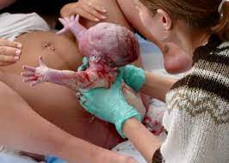
Obstetric anal sphincter injuries (OASI, third and fourth degree tears)
Levator avulsion and prolapse

Slide 6
Obstetrics 101 the 3 “Ps”
Powers, Passengers, Passages
.

Slide 7
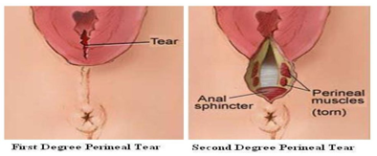
Perineal tears-”minor”
80% women some tearing (RCOG, 2021)
1st degree
  skin
2nd degree
  Skin, superficial PFMs

Slide 8
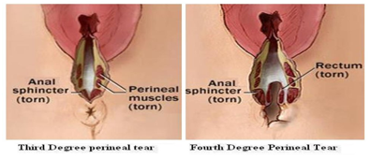
Perineal tears –”Major” OASI injury
3rd degree (OASI)
  Skin, superficial muscles and External anal sphincter
4th degree (OASI)
  as above and Internal anal sphincter,anal mucosa
  OASI up to 10 % vaginal deliveries
  (Abdelhakim et al 2020 – Systematic review)

Slide 9
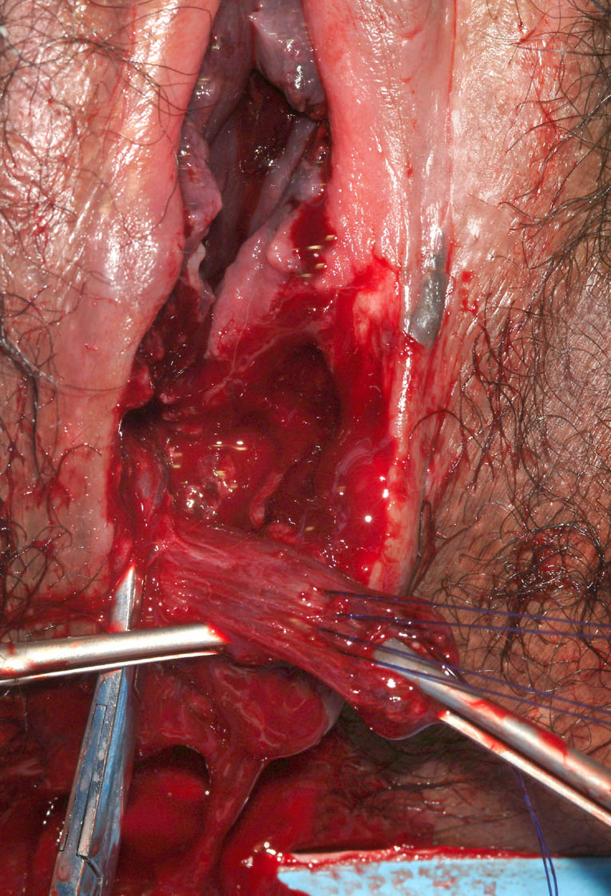
Obstetric anal sphincter injuries (OASI)

Slide 10
Consequences of OASI
Leading cause of faecal incontinence in women (the involuntary loss of flatus or faeces which becomes a social or hygiene problem) .
Even after OASIS repair 15% of women (third degree tear) and 50% of women (fourth degree tear) had symptoms of faecal incontinence.
Symptoms worsen with age.
Needs to be prevented!

Slide 11
Teetering near the edge; Women’s experience of anal incontinence following OASIS
J Tucker, V Clifton et al ANZJOG 2014;54:377-381
Qualitative semi structured interviews between 26-56 years who had OASIS in first pregnancy
3 major themes
Grieving for loss
Silence
Striving for normality

Slide 12
"Struggling to settle with a damaged body"
"From hell to healed"
“Taken by surprise"
“A worse nightmare than expected”
“Why didn’t anyone tell me this could happen?”

Slide 13
For the staff….
The midwives tried to cope with their feelings of guilt and wanted to find reasons why the injury occurred. A fear of being exposed and judged by others as severely as they judged themselves hindered the midwives from sharing their experience. Ultimately the midwives accepted that the injury had occurred and moved on without any definite answers.
Edqvist, M., Lindgren, H. & Lundgren, I. Midwives’ lived experience of a birth where the woman suffers an obstetric anal sphincter injury - a phenomenological study. BMC Pregnancy Childbirth 14, 258 (2014). https://doi.org/10.1186/1471-2393-14-258

Slide 14
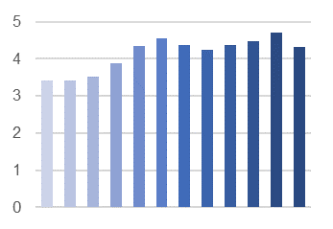
2009-2020 NZ maternity clinical indicator trends
Under estimate- at least 30% missed
Depends how hard you look
Standard primiparae OASI

Slide 15
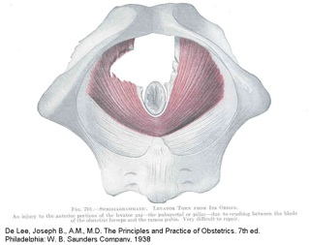
Levator avulsion

Slide 16
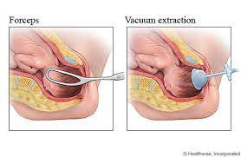
LA rates vs mode of delivery-Levator ani avulsion-a systematic evidence review (LASER)BJOG 2021 Rusavy z, et al
LSCS-1%
Spontaneous-15%
Vacuum-21%
Forceps-52%

Slide 17
Important to diagnose
Risk factor for Pelvic Organ Prolapse x4 (Pelvic floor disorders after obstetric avulsion of LA muscle 2019 Female Pelvic Med Recons Surg. Handa VL et al)
Risk factor for recurrence after surgery (Risk factors for prolapse recurrence: systematic review and meta-analysis 2018 Int Urogynecol J Friedman T et al

Slide 18
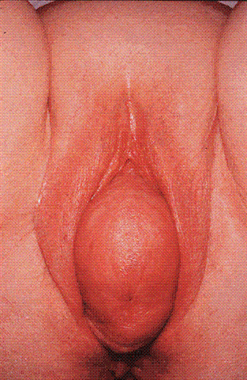
PROLAPSE

Slide 19
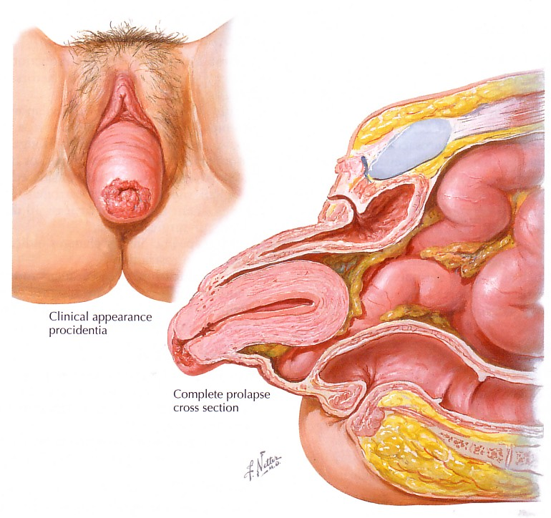
Procidentia

Slide 20
The Emotional Burden of Pelvic Organ Prolapse in Women Seeking Treatment: A Qualitative Study. Ghetti C, Skoczylas LC Female Pelvic Med Reconstr Surg. 2015 Nov-Dec;21(6):332-8
Annoyance, frustration, and irritation
Unhappiness associated with the uncertainty of what was occurring and anger that this was happening to them.
Stronger emotions of depression, anxiety, and sadness were described by some. Feelings of anxiety were often associated with a feeling of uncertainty of “something being wrong”
This study highlights that women experience a broad set of emotions associated with the condition of prolapse including feelings of being alone, isolated, broken, defective and ashamed.

Slide 21
ACC changes

Slide 22
3 types of claim
Primary injuries
Consequential injuries
Treatment injuries

Slide 23
Primary injuries-to be lodged within 1 year of injury
Will be automatically processed through ACC
Anterior wall prolapse, posterior wall prolapse, or uterine prolapse
Coccyx fracture or dislocation
Levator avulsion
Obstetric anal sphincter injury tears or tears to the perineum, labia, vagina, vulva, clitoris, cervix, rectum, anus, or urethra
Obstetric fistula (including vesicovaginal, colovaginal, and ureterovaginal)
Obstetric haematoma of pelvis
Post-partum uterine inversion
Pubic ramus fracture
Pudendal neuropathy
Ruptured uterus during labour
Symphysis pubis capsule or ligament tear

Slide 24
Primary injuries- 3 groups
Symphysis pubis capsule or ligament tear
Coccyx fracture or dislocation
Pubic ramus fracture
Obstetric haematoma of the pelvis
Post partum uterine inversion
Ruptured uterus during labour
Physiotherapy/orthopedics
Usually dealt with acutely while in hospital

Slide 25
Primary injuries
Levator avulsion
Pelvic organ prolapse
Obstetric fistula
Pudendal neuropathy
OASI or tears to perineum, labia, vagina, vulva, clitoris, cervix, rectum, anus or urethra

Slide 26
Consequential injuries-may have other causes and will be considered by ACC
Pelvic organ prolapse
Urinary incontinence
Anal incontinence
Infection and wound dehiscence
Sexual dysfunction

Slide 27
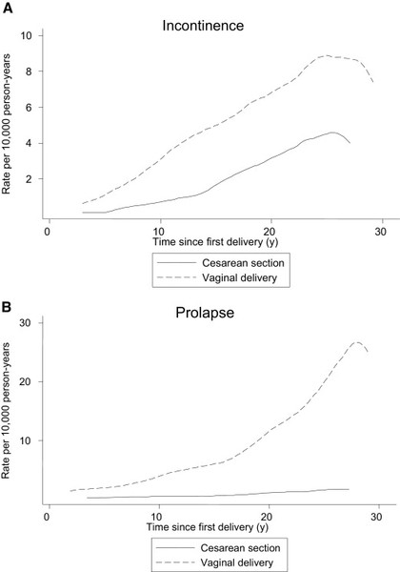
Cohort study from Sweden 2011 All LSCS (n= 33 167 women) vs all vaginal births (n=66229 women)

Slide 28
Treatment injuries from the old model
As we already understand
Patient has to have a treatment (episiotomy, LSCS etc) done to them
Episiotomy with extension of tear etc

Slide 29
Prevention models
Norway
UK
Australia

Slide 30
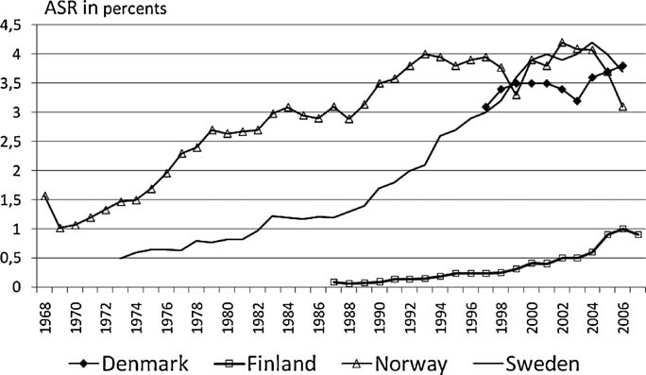
Fig. 1. Incidence of anal sphincter tear is presented as percentages of all vaginal
deliveries, including spontaneous and instrumental deliveries.

Slide 31
2004 Norwegian board of health supervision investigated high rates of OASIS
Criticism of units with high incidence
Ordered to change the trend and provide better results and quality
Started a national debate and initiated National strategy to reduce the incidence of OASIS

Slide 32
Norway:
Hals E et al. A multicenter interventional program o reduce the incidence of anal sphincter tears. Obstet Gynaecol oct 2010;116(4):901-908.
Population based cohort study found their rates of OASIS between 1967 – 2004 had significantly increased from 0.5% - 4.1% in 2004.
Interventional cohort study (2003-2009) included 4 hospitals in Norway
40,152 vaginal deliveries included
In the three years prior to the intervention study Norway’s rates of OASIS at the four hospitals were 4.68%, 4.75%, 4.98% and 3.68%.

Slide 33
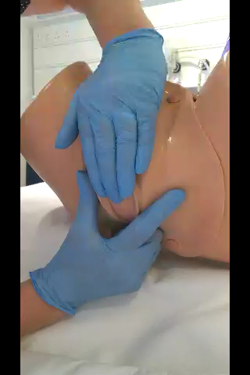
Clinical intervention
1 Education of all staff re OASIS (2-3 day compulsory course)
2. Reintroducing traditional methods of delivery-hands-on
3.Changing the position at birth to allow perineal manoeuvres to take place
4. More liberal use of episiotomy-lateral or mediolateral

Slide 34
Results
Dramatic reduction in rates from 4-5% to 1-2% in all hospitals
No change in the rates of instrumental deliveries in study period
Increase in the rates of episiotomy (up to 25-30% from 10%)
Conclusion-Changing practices around SVD can reduce OASIS rates significantly

Slide 35
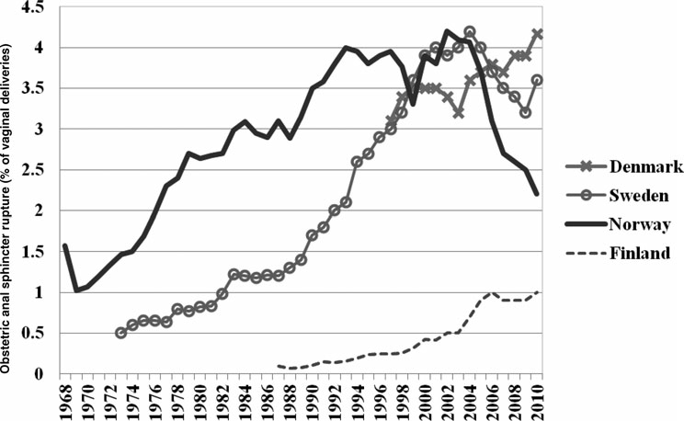
Are OASIS preventable?
Laine K et al 2012

Slide 36
Birth parents are changing…
Age
Raised BMI
Type 2 diabetes and other comorbidities
Expectations

Slide 37
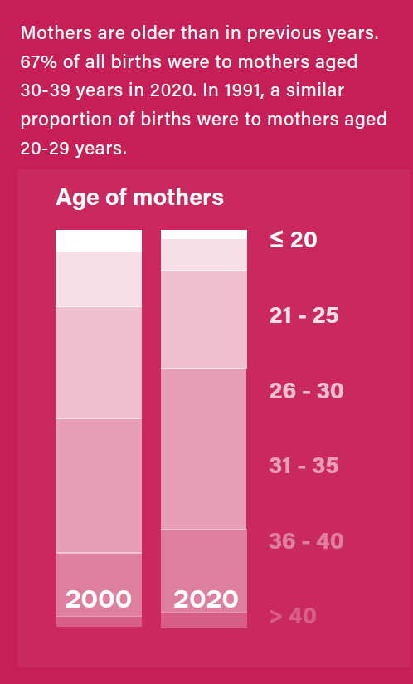
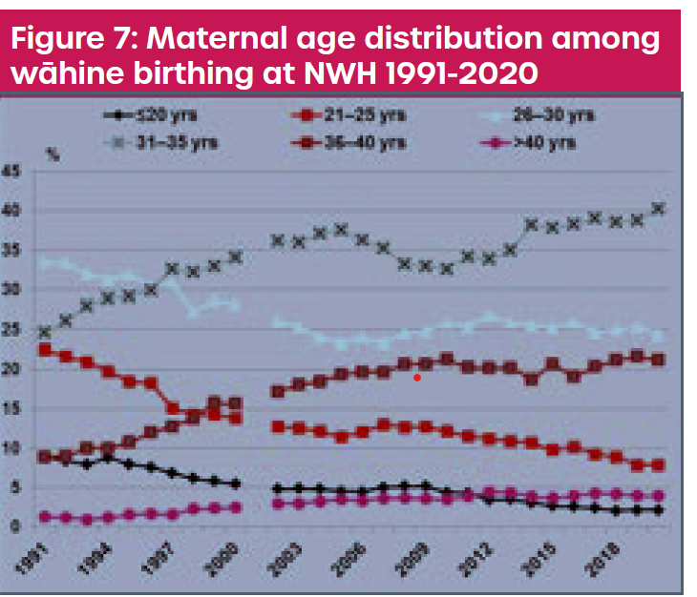
Wwomen Our population is Wgetting Bitholder:

Slide 38
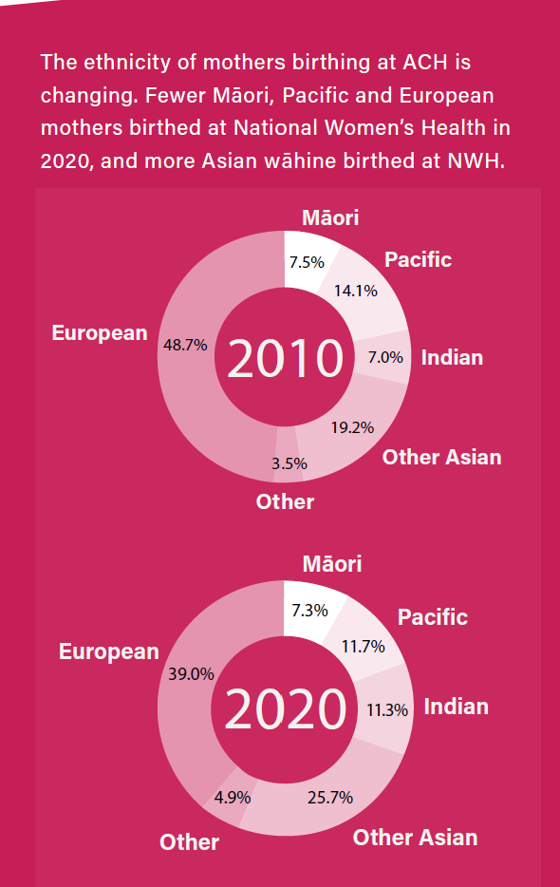
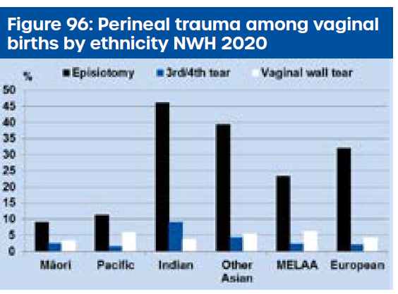

Ethnicity:

Slide 39

NZ practice changes over last 20 years…
Move away from “hands on” to “ hands off” delivery
Changes in episiotomy rates
Changes to perineal suturing
Changes to instrumental deliveries

Slide 40
What is UK current practice?
Trochez R et al. HOOPS. Int Urogynaecol J (2011) 22:1279-1285.
An observational postal questionaire study of 1000 midwives in the UK.
299 (49%) - hands off, 48.6% hands on
Less experienced MW preferred hands off (72% vs 41%)
Higher proportion of MW in hands off group would never do an episiotomy for indications other than fetal distress. (37.1% vs 24.4%)

Slide 41
Midwifery management of second-degree perineal tears in New Zealand: A cross-sectional survey of practice
Robin S Cronin ¹, Minglan Li ², Birth 2018 Oct;31(5):422-429
Midwives who left the last second-degree tear unsutured (7.3%) were more likely to report low confidence (48.9% vs 15.4%, p<0.001) and less recent experience with repair (53.2% vs 24.7%, p<0.001), and were less likely to report a digital-rectal examination (10.6% vs 49.0%, p<0.001), compared to midwives who sutured.

Slide 42
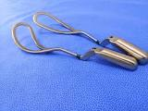
RANZCOG guideline on instrumental birth 2020
The evidence shows that performing an episiotomy in women having their first vaginal birth led to 24% fewer OASI when forceps were used and 16% fewer OASI when ventouse was used and therefore should be considered.
Evidence-based recommendation The choice of either vacuum or forceps for instrumental vaginal delivery will depend on the judgement of the operator and the individual clinical circumstances.
Pressure to keep Caesarian section rates down.

Slide 43
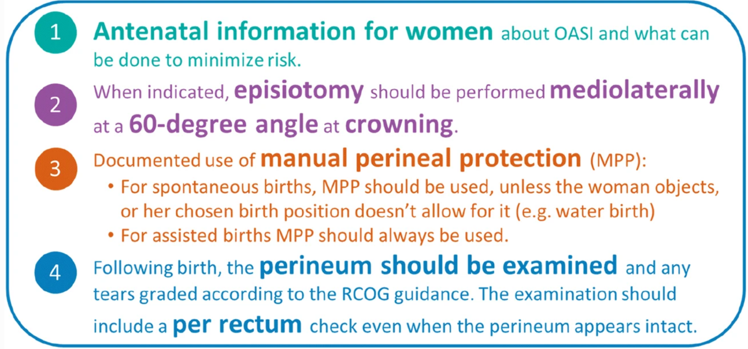
OASI Care Bundle (UK)
Rolled out policy to a further 20 maternity hospitals in Dec 2019.
Glasgow – reduced rates from 4.2% - 1.9%
Four key aspects

Slide 44
. Before starting the program 24% of the midwives, working at the delivery ward were negative towards the supervision and project, while 46% were positive. One year after the program’s start 92% were positive. Negative feedback at the beginning of the intervention came mostly from the media and professional midwifery organizations. The expert midwives felt that doctors were the most challenging to teach. The response from pregnant women was ultimately positive. Eighteen well motivated midwives became highly appreciated experts after an intensive training program and deemed themselves better and more successful professionals than before.

Slide 45
Australia
‘Please Squeeze’: A novel approach to perineal guarding at the time of delivery reduced rates of obstetric anal sphincter injury in an Australian tertiary hospital
Elizabeth Luxford,Lucy Bates,Jennifer King
05 June 2020 ANZJOG
There was a clinically important 20% reduction in the incidence of OASIS across all vaginal deliveries from 3.5% to 2.8% (P = 0.006). In SVD, there was a 20% decrease in OASIS from 2.4% to 2.2% (P = 0.02), and a 14% decrease in OASIS with assisted vaginal delivery from 8% to 7.3% (P = 0.002)

Slide 46
Risk reducing strategies
Antenatal
Pelvic floor muscle training reduces risk of postnatal urinary and faecal incontinence
Perineal massage
Intrapartum
Warm compresses
Perineal massage
Episiotomy
“Hands on” delivery/manual perineal protection

Slide 47
UR-CHOICE: can we provide mothers-to-be with information about the risk of future pelvic floor dysfunction? Int Urogynaecol J 2014
Don Wilson ¹, James Dornan, et al
U-Urinary incontinence before pregnancy
R- Race/Ethnicity
C-childbirth-age of mother at first birth
H-Height
O-Obesity BMI
I- Inheritance
C-how many children planned?
E- Estimated fetal weight

Slide 48
Some NZ figures (MOH)
2020 birth rate 58,670
30% Caesarian births (17,601)
41,069 had spontaneous or instrumental vaginal delivery
Assuming ( conservatively) 5% OASI rate at present
Currently 2053 women/ year having OASI
If we reduced to 1.5% OASI rate
616 women would have OASI
1437 would be prevented/year

Slide 49
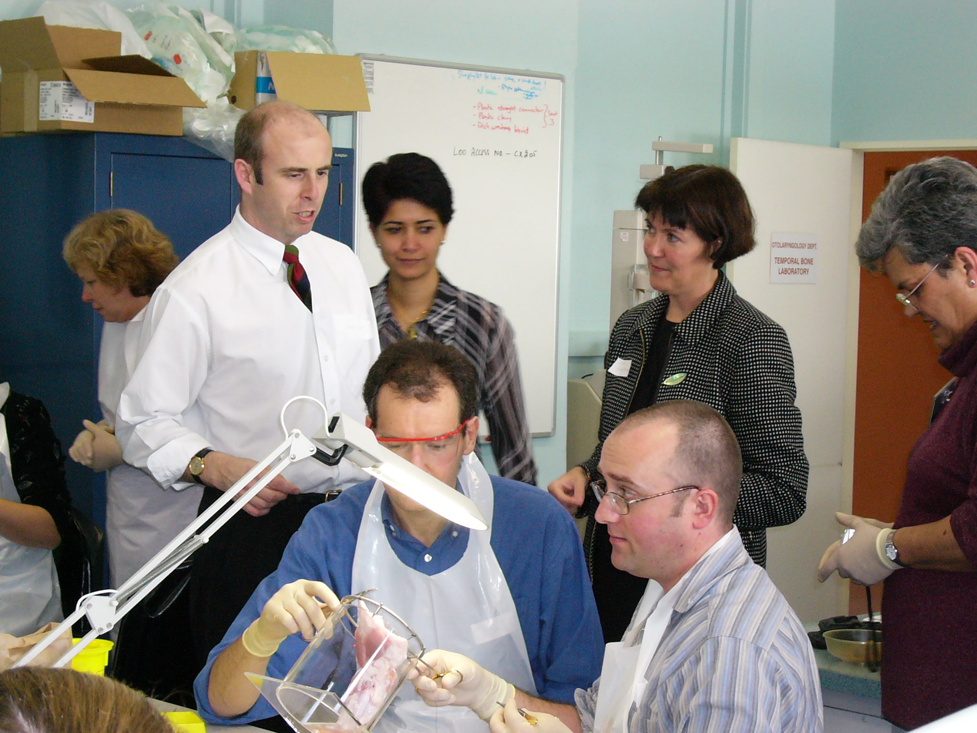
OASIS workshops since 2003

Slide 50

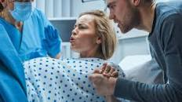

Education
My forceps births never have any injuries
Birth parents
Midwives
Doctors
I deserve a pain free natural birth
Because I know my mama so well, I can direct her to breathe the baby out I don’t need to put my hands on!

Slide 51
What are we waiting for!
NZ context
Equitable access
Cultural factors
Clinical champions (midwifery, obstetrics, cultural) each hospital
Pilot like the UK to iron out the kinks

Slide 52
APHERM advisory group
Advocating Pelvic Health Empowerment and Rehabilitation for Mothers
Multidisciplinary group
Petition / submission July 2021
Asking for review and improved rehabilitation /care pre and post birth
Physiotherapy assessment and treatment
Goals: reduce incidence prolapse and incontinence

Slide 53
APHERM
Education
  Māmā, birthing people & whānau
  Maternity providers
Risk assessment / Prevention
Identification and referral –pregnancy & PN
Treatment of pelvic floor dysfunction following birth
  Reduce the number of people living with these conditions
  Reduce burden

Slide 54
Pregnancy Guidebook - Continence New Zealand
In development
Pregnancy and postnatal advice
Goal: educate and inform Māmā, birthing parents and whanau
  Risk factors
  Pelvic floor muscle training and other care / self help
  Lifestyle modifications
  Knowing when / where to seek help if required
  Exercise advice

Slide 55
Considerations:
Best way of informing our Māmā
Translation
  Te Reo Māori
  Pacifika languages
Shorter version
Resources and funding support

Slide 56
Pelvic health physiotherapy – antenatal
Pelvic floor muscle training in pregnancy:
Lower rates of 3rd and 4th degree tears
Reduced chance of developing urinary incontinence
Perineal massage in pregnancy:
Reduced chance episiotomy
Reduced durution 2nd stage labour
Fewer 3rd 4th degree tears
Shorter 2nd stage
Less perineal pain after birth
Reduced risk anal incontinence

Slide 57

Pelvic health physiotherapy – postnatal
Risk assessment
Rehabilitation
Help prevent longer term problems

Slide 58
We can do more…..
Women need to know
There are modifiable risk factors that can be changed
We can help reduce risk of pelvic floor trauma during childbirth
If an injury has occurred, we can help to prevent problems developing?

Slide 59
Thank you- Questions??
References on request

