Slide 1
Ka mua, Ka muri Looking back to move forward
Addressing Māori inequities in the utilisation of ACC services and injury treatment and rehabilitation outcomes – and some thoughts on Injury prevention
Presentation Dr John Wren / Dr Peter Jansen
Expert witnesses for NZ Māori Council Waitangi Tribunal Claim On Disability and the Accident Compensation Corporation (WAI 2575 Claim and associated claims)
ACC Futures Seminar, 2 December 2022
Notes:
Introduce myself and the title
‘Kia whakatōmuri te haere whakamua. I walk backwards into the future with my eyes fixed on my past’.
This whakataukī speaks to Māori perspectives of time, where the past, the present and the future are viewed as intertwined, and life as a continuous cosmic process (Rameka, L, 2016).
Acknowledgements – see next page

Slide 2
Acknowledgements
Dr Peter Jansen
Co–Expert Witness on Evidence Brief supporting the Waitangi Tribunal Claim
https://www.linkedin.com/in/peter-jansen-a7407215/
AND WOODWARD LAW & PHIL CORNEGE
Counsel Acting: Donna M T T Hall Phillip Cornege | PO Box 30411 Lower Hutt 5010 +64 (04) 560 3680 info@mokoia.co.nz
Notes:
I wish to acknowledge the Rangitira in the audience: in particular
Hon Carmel Sepuloni - Minister for ACC
Hon Steve Maharey - Chair of ACC Board
Hazel Armstrong and Ross Wilson who both agreed to participate in my PhD research all those years ago and who have been so active in advocating for ACC over the years, holding to the Woodhouse vision and championing the voice of users of ACC and workplace health and safety
Donna Hall of Woodward Law, and Phillip Cornege and Lyndon Rogers who are the lawyers acting on the Waitangi Tribunal Claim and have been so gracious in their support.
I would also like to acknowledge:
Dr Peter Jansen, who has been working with me on the evidence brief. Peter has a wealth of knowledge about the topic from a medical service provider perspective and has been a consistent champion for the Māori Voice and ACC for many years
Peer reviewers of the original 2015 ACC Research – Dr Hilary Stace (Victoria University) and Lesley Grey (Otago University, Wellington Public Health)
Peer reviewers of the current evidence brief – Professor Gail Pacheco (AUT) and Assoc-Professor Terryann Clarke (Auckland University)
I also wish to acknowledge my Crown agency employers (MoH and ENZ) for their support.

Slide 3
Overview of our argument: Looking back we argue that on the evidence…
There is an accumulated body of evidence over 20 years that cannot be ignored any longer:
significant inequitable underutilisation of ACC services by Māori in the context of their injury related health need
and
injury related health outcomes
about what the barriers are to Māori accessing ACC services are
about what works for Māori in agency service delivery
and
what they want including ACC
ACC responsiveness over the years has been at best ad-hoc and inconsistent (noting specialist Māori Teams have been established and disestablished at various times under changing ACC Board’s and Snr Management)
The current status of Māori ACC service utilisation and injury (incl. Disability) related outcomes is a breach of the Crown’s Ti Tiriti obligations, and a claim with the Waitangi Tribunal has been filed
Everything starts with a failure of injury prevention

Slide 4
In addition: we argue…
ACC is institutionally racist as currently legislatively designed, and functioning
There are no Ti Tiriti obligations (or reference to Ti Tiriti) in any of the ACC related legislation
The dominant Western actuarial / insurance and banking perspective about what ‘equity’ means is antithetical to a ‘health equity’ lens
from the dominant ACC perspective, no action is required as utilisation is matter of individual choice
equity from this perspective also means ‘same policy/service design’ irrespective of Ti Triti requirements for protection, participation and partnership
ACC is a monopolistic provider set up by the Crown, there is no other choice for Māori – but it is clearly not working for Māori in context of their injury related need
We have noted that Crown Monitoring agencies have been inconsistent in their reporting of the issues
However, in disparities research, ‘same’ does not mean ‘fair’, when responding to significant disparities and inequities in the burden of injury and use of ACC services (Ratima et al. 2007; Mauri Ora & Associates, 2010).

Slide 5
Looking forward: We argue…
ACC legislation be amended to require ACC to comply with the principles of Ti Tiriti, and fulfil established standards regarding protection, participation and partnership
The legislation explicitly include a health equity lens that is given equal status to the dominant Western Actuarial / Insurance / Banking lens when it comes to service design and delivery
Crown Monitoring agencies must publicly report on ACCs progress in reducing the inequities observed
this should include funding and public dissemination of the results from the Otago Uni/ Ngāi Tahu Māori Health Research Positive Outcomes of Injury Study (with a focus on examining health inequities in service utilisation and treatment outcomes (including Disability) for the Māori population with comparisons to Non- Māori)
ACC decisions that affect Māori be measured against outcomes set by Māori organisations with representative mandates

Slide 6
Looking forward: In addition…
ACC undergo significant systemic and cultural change, integrating Māori decision-makers at all levels and funding training and development programs designed by Māori for all staff
ACC be required to form active partnerships with Māori primary healthcare providers and Iwi authorities
ACC commence pilot programmes to convert into long-term service provision, adopting different models in different takiwā
ACC pays for health provider service delivery based on client injury treatment and rehabilitation and cultural needs, and a performance incentive for reductions in inequities in receipt of injury treatment entitlements and injury related health outcomes

Slide 7
What does some of the evidence look like? A quick look through from A chronological perspective

Slide 8
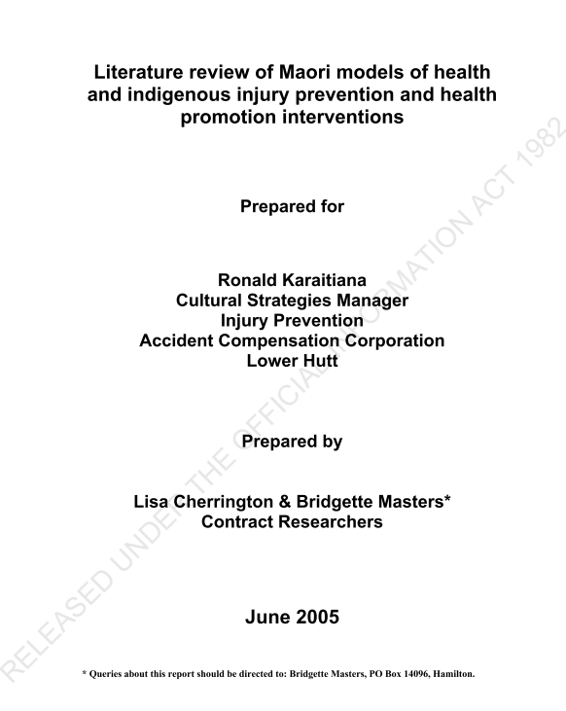
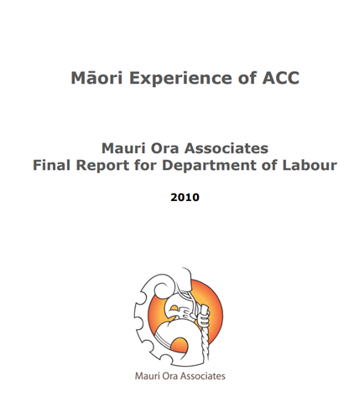
Looking Back: an accumulating body of evidence for significant and substantial inequity in Māori utilisation and injury related health outcomes, the barriers to Māori use of acc services, and evidence for what works
2005 - 2012

Slide 9
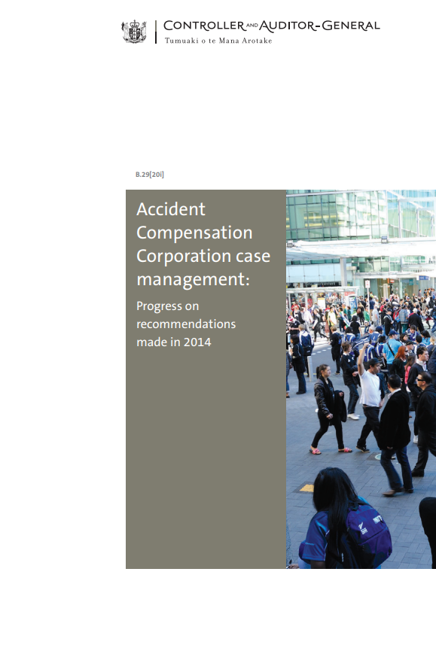
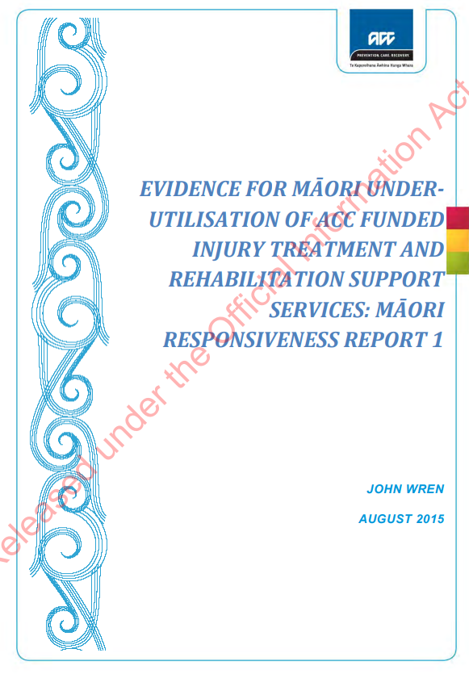
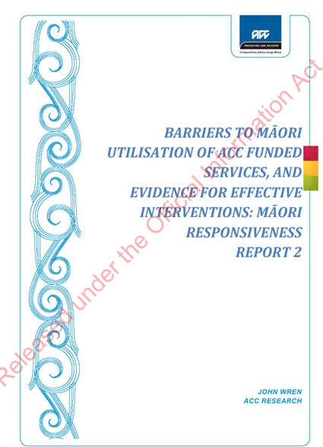
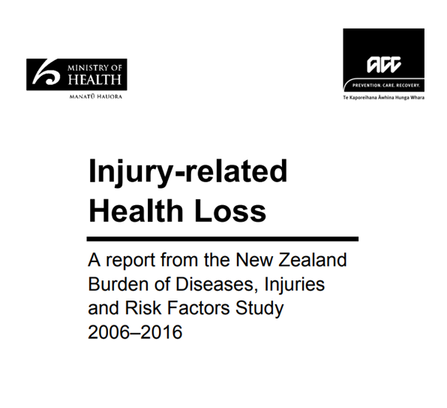
Looking Back: an accumulating body of evidence for significant and substantial inequity in Māori utilisation and injury related health outcomes, the barriers to Māori use of acc services, and evidence for what works
2013 - 2015

Slide 10
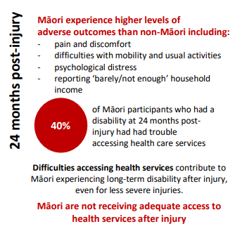
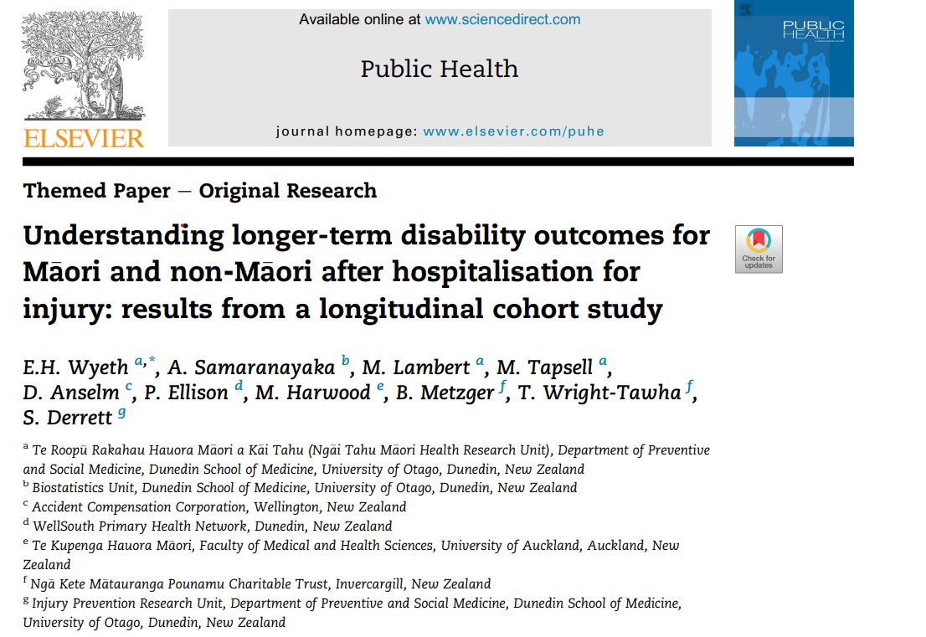
Looking Back: The evidence continues to build for substantial inequity in Māori utilisation and injury related health outcomes
2018

Slide 11
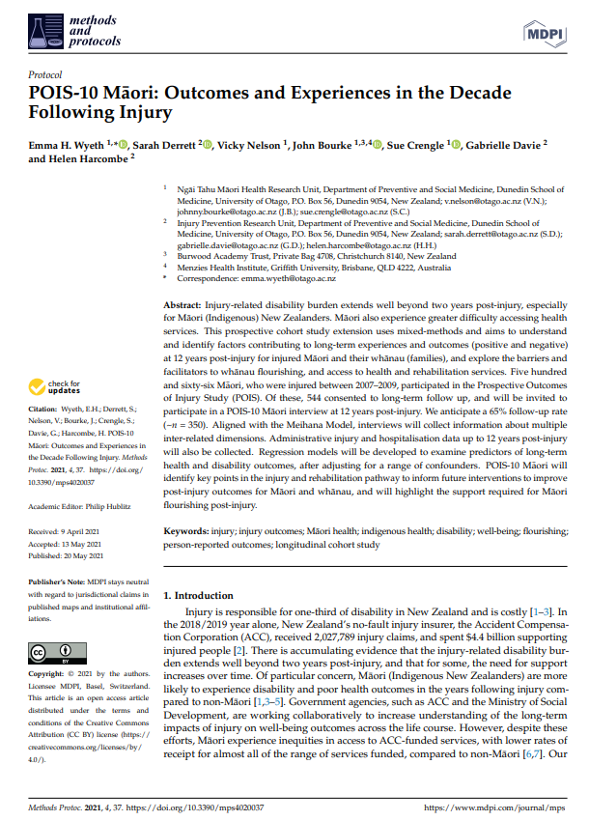
Looking Back: evidence is still accumulating – how much more is needed for action! ?
2021
‘There is accumulating evidence that the injury-related disability burden extends well beyond two years post-injury, and that for some, the need for support increases over time. Of particular concern, Māori (Indigenous New Zealanders) are more likely to experience disability and poor health outcomes in the years following injury compared to non-Māori [1,3–5]…Māori experience inequities in access to ACC-funded services, with lower rates of receipt for almost all of the range of services funded, compared to non-Māori [6,7]’

Slide 12
Finally, An ACC Acknowledgement after 20 years of building evidence…but action?

Slide 13
A quick skip through of the evidence for the argument

Slide 14
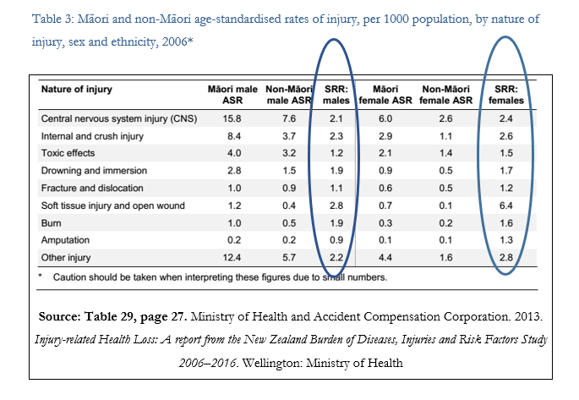
Injury Burden What we know
Māori population health burden of Injury double non-Māori after adjusting for a range of factors
Looking Back

Slide 15
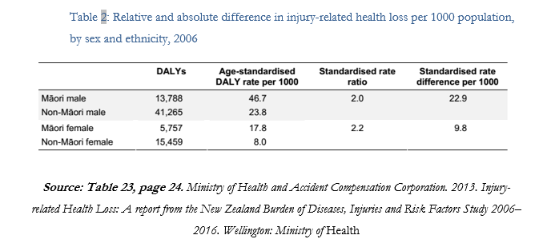
Injury Burden What we know
Māori population health burden of Injury double non-Māori
Looking Back

Slide 16
Injury Burden What we know
Looking Back

Slide 17
underutilisation - What we know
There is good evidence for inequitable utilisation across the range of ACC services:
ACC fails to provide equal services to Māori, and fails to ensure equity of healthcare for Māori, in three main areas:
Home Care and Support Services;
Referrals for elective services; and
Weekly compensation.
Māori express dissatisfaction via not using a service, versus complaining about a service. And when they do complain, they are seen as problematic.
Looking Back

Slide 18
underutilisation - What we know
Internal ACC research studies in the mid-2000s all reported systematic differences in the utilisation of Elective Surgery Services between Māori and non-Māori at each stage of the referral process, and by injury severity and geographic region (Fawcett and Kake 2009; Kake and Dougherty 2010; Kake and Small 2010). Overall, Māori were more likely to receive less referrals at each stage of the treatment supply journey and the differences increased throughout the process.
In terms of Home Care Support Services, internal ACC research in the early 2000s showed observed clear, systematic and statistically significant between Māori and non-Māori. However, from the data and the analysis at the time it was arguably not clear whether the differences represent under-utilisation by Māori or over-utilisation by non-Māori.
Similarly, Wren reports that up to 2015 a number of internal ACC analyses of receipt of Weekly Compensation Claims and Return to Work duration had been undertaken at various time points (Fawcett and Kake 2009; Kake and Allen 2011; Kake and Small 2010). The analyses show systematic differences over time by ethnicity, age, socio-economic status, and geographic region in the use of these services.
Looking Back

Slide 19
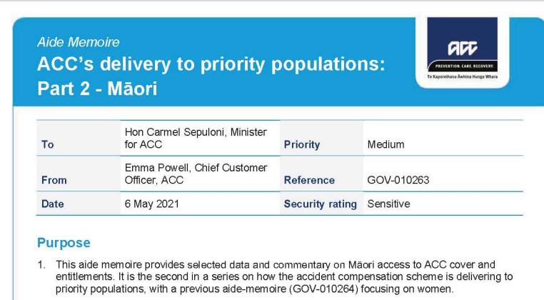
underutilisation - What we know
NOTHING HAS CHANGED SINCE WREN
In May 2021 ACC acknowledged in a briefing to the Minister there was ‘consistent evidence’ that Māori compared to non-Māori for ‘disparity…across the spectrum of prevention, care and recovery’, Māori have poorer long-term injury outcomes’, and that there are ‘inequities’ in Māori use of ACC funded services‘ and that these remained in 2021.
(Accident Compensation Corporation 2021). (Quotes from paragraph 5 of ACC briefing. Paragraphs 5 to 12 outline a range of differences across the spectrum of ACC activities.)

Slide 20
Poor injury treatment and rehabilitation (Incl. Disability) Outcomes - What we know
Historically, there has been very little published academic literature on Māori injury outcomes (Wyeth et al. 2013). However, this is now changing with the publication of a series of longitudinal results from the Positive Outcomes of Injury Study (POIS) at Otago University.
Looking Back

Slide 21
Poor injury treatment and rehabilitation (Incl. Disability) Outcomes - What we know
Results from POIS studies have begun to progressively demonstrate inequities in Māori injury related health outcomes:
Māori are 1.7 times the risk of disability after injury compared to non-Māori (Derrett et al. 2013). Predictors for poor injury outcomes included household income, existence of prior chronic health condition, and ‘accessing healthcare services for injury’ (Wyeth et al. 2017).
In 2019, similar results were reported for Māori health outcomes 24 months post injury (Wyeth et al. 2019). The authors found that the prevalence of disability among Māori at 26% was ‘noticeably higher’ compared to the 10% for non-Māori who were hospitalised for injury. In addition, while there was a similar range of predictors of disability between Māori and non-Māori, there was one significant exception, which was ‘trouble accessing healthcare services for injury’. This exception resulted in increased relative of risk of 2.58 (i.e. 2.5 times higher) of disability 24 months after injury compared to non-Māori. The authors noted the finding was consistent with earlier POIS analyses (Derrett et al. 2012, 2013; Wyeth et al. 2017).
Looking Back

Slide 22
Poor injury treatment and rehabilitation (Incl. Disability) Outcomes - What we know
In 2019 POIS authors said the results:
‘show that Māori, but not non-Māori, who have trouble accessing health care for injury related healthcare services, have poorer outcomes. This finding indicates that there is considerable work to be performed to ensure adequate access to healthcare services for Māori in this sector of the health system to improve postinjury outcomes. We hypothesise that Māori who have trouble accessing healthcare services for their injury initially, continue to do so for injury and rehabilitation services, which therefore impacts on, and prevents, improved post-injury outcomes such as longer-term disability’ (Wyeth et al. 2019).
Looking Back

Slide 23
Barriers to improving service utilisation and outcomes
Why would Māori engage with ACC?
Research over many years has shown that Māori report very consistent experiences over time with utilisation of a wide range of health and government agency (including ACC) services respectively (Palmer et al. 2019; Russell, Smiler, and Stace 2013; Williams and Cram 2012).
The experiences typically are described in terms of difficult to access, unresponsive and alien to the lived experience and value systems of those who do not share the dominant ‘mainstream’ world view represented in many government services (Williams and Cram 2012).
The evidence has continued to build…
Reid P, Cormack D, Paine S-J. Colonial histories, racism and health - The experience of Māori and Indigenous peoples. Public Health 2019; 172: 119-24.
Came, H. (2014). Sites of institutional racism in public health policy making in New Zealand. Social science & medicine, 106, 214-220.
Talamaivao, N., Harris, R., Cormack, D., Paine, S. J., & King, P. (2020). Racism and health in Aotearoa New Zealand: a systematic review of quantitative studies. The New Zealand Medical Journal (Online), 133(1521), 55-5.
Harris, R., Tobias, M., Jeffreys, M., Waldegrave, K., Karlsen, S., & Nazroo, J. (2006). Racism and health: The relationship between experience of racial discrimination and health in New Zealand. Social science & medicine, 63(6), 1428-1441.
Brown, S., Toki, L. & Clark, T. C. (2021). Māori Māmā views and experiences of vaccinating their pēpi and tamariki: A qualitative Kaupapa Māori study. WotMatters Consulting contracted by NZ Work Research Institute, Auckland NZ.
Palmer, S. C., Gray, H., Huria, T., Lacey, C., Beckert, L., & Pitama, S. G. (2019). Reported Māori consumer experiences of health systems and programs in qualitative research: a systematic review with meta-synthesis. International journal for equity in health, 18(1), 1-12.
Lindsay Latimer, C., Le Grice, J., Hamley, L., Greaves, L., Gillon, A., Groot, S., ... & Clark, T. C. (2021). ‘Why would you give your children to something you don’t trust?’: Rangatahi health and social services and the pursuit of tino rangatiratanga. Kōtuitui: New Zealand Journal of Social Sciences Online, 1-15.
Looking Back

Slide 24
Barriers to improving service utilisation and outcomes
ACC customer satisfaction surveys as far back as the early 2000s highlighted that Māori indicated their use of ACC services was inhibited by:
lack of information in the community about the type and scope of services available for injury care
lack of knowledge among treatment providers about ACC’s services and entitlements
physical isolation and lack of affordable transport
attitudes/perceptions of injured people and their communities
financial barriers in particular affordability of a range of primary and allied health care services (e.g. GP, Physiotherapy, Radiology)
Following these reports ACC commenced a public campaign to raise awareness, however it ran into trouble around 2008/09 due to political push back and concerns about rising costs.
Looking Back

Slide 25
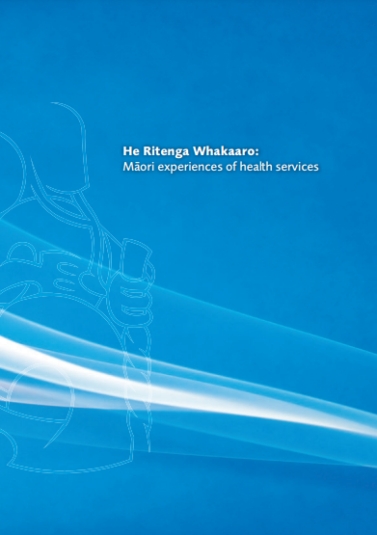
What works
In 2009, the Mauri Ora researchers reported that what Māori want from their service providers, including ACC, was:
to be understood - more time to be listened to
trusting relationships - more time for relationship building
service providers communicate in ways that are clear and understandable by the patient - more assistance to assess technical aspects of their clinical treatment and associated expected outcomes; explanations in clear language about what was wrong, rather than just information on paper and in medical or organisational focused claims management language
better value for their effort (including expenditure) to access and use services
to see themselves in service agencies (they would like to see more Māori in their interaction with agencies and service providers, and people who understand Māori culture).
Notes:
In 2009 ‘He Ritenga Whakaaro: Māori experiences of health services’ was published by Mauri Ora Associates (2009).
The report presents the results of a thorough literature review, survey and a set of in-depth focus group interviews with Māori about their experiences with government agencies and health providers – including ACC.
The report has been widely referenced in a range of health sector reviews and in the health literature.

Slide 26
What works
In 2010 Mauri Ora & Associates in a report for the Dept of Labour on Māori experiences of ACC found that among Māori there was strong support for the Scheme and a fair amount of discontent with the ACC organisation.
Five key expectations that Māori had of ACC were:
Fairness – the system must achieve fair outcomes for Māori and all New Zealanders
Choice – all choices must be fair and open
Improvement of services – disparities must be addressed within both the larger healthcare system and ACC
Kaupapa Māori – Māori world views and values must be included and respected in the design and delivery of ACC services
Consultation and communication – in the absence of genuine interaction and co-development, no changes to ACC will be successful.

Slide 27
What works
Williams and Cram in a 2012 seminal work focussing on government agencies, concluded that there is good evidence across all the areas looked at, and considerable consistency about what works for programmes aimed at responding to Māori.
What works is recognition of the centrality of whānau (Māori family system) as a major influence on individual whānau members, and extending outward to hapū, iwi and particularly to community organisations. Associated with whānau effects was the importance of the kaupapa Māori (by Māori, for Māori) approach to service provision and to understanding what works and how. The authors commented these effects were pervasive across types of intervention and government agency.
The evidence reviewed showed particular success for Māori designed community programmes that were associated with a promise of establishing greater integration with mainstream organisations. A central theme to these effects was recognition of culture and respect for a Māori world view, values and beliefs, the importance of relationships, and acknowledgement of the merit and necessity of enabling some self-determination by seeking more direct involvement by Māori in programmes affecting Māori.
The authors suggested that the challenge for organisations is to integrate a range of leadership and organisational characteristics according to their own contexts, and to continue to develop their operations in evidence-informed ways so that they can ensure their responsiveness to and for Māori is ongoing and sustainable.

Slide 28
Influence of the Dominant Actuarial and Insurance Management Perspective - Blinds it Māori perspectives
However, ACCs dominant western Actuarial / Insurance / Banking approach in the organization makes it institutionally blind to Māori and population level perspectives, and leads to a predominance for blaming the individual for underutilisation
Wren (2015) in his review of internal ACC briefing papers in the early – mid 2000s observed that thinking about the use of ACC services was dominated by a consistent theme that while overall Māori were substantively under-represented in receipt of a range of services in the context of their proportion of the population this was a matter of individual choice and as such not an ACC concern as everybody had access to the same policy settings and services.
However, in making this assessment, the authors assumed Māori had the same injury experience as non-Māori and ignored the substantive available customer satisfaction research (as far back as 2003-2006) showing that Māori had identified a range of barriers to their use of ACC service that was consistent with other similar government agencies research.
However, in disparities research, ‘same’ does not mean ‘fair’, when responding to significant disparities and inequities in the burden of injury and use of ACC services (Ratima et al. 2007; Mauri Ora & Associates, 2010).
An observation

Slide 29
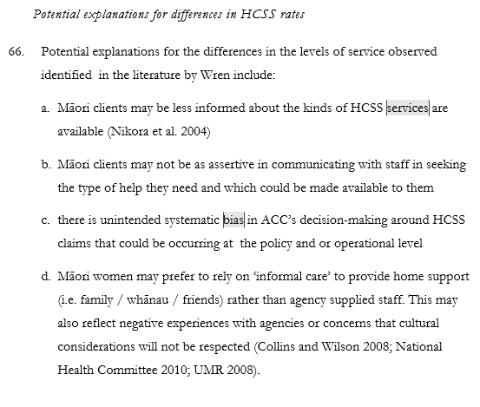
Influence of the Dominant Actuarial and Insurance Management Perspective – leads to blaming the individual
Note phrasing of all these statements points to the individual without seeming to recognise the issue of policy and service design in shaping these perspectives, and importantly there cultural differences about what some of these things mean and how they should be done
Another example:
An observation

Slide 30
Looking forward
The current ACC legislative structure and organization functioning isn’t working for Māori – change is required!
ACC legislation be amended requiring ACC to comply with the principles of Ti Tiriti, and fulfil established standards regarding protection, participation and partnership
The legislation explicitly include a health equity lens that is given equal status to the dominant Actuarial / Insurance / Banking lens to give balance to service design and delivery decisions at Board and Snr Management level
ACC decisions that affect Māori be measured against outcomes set by Māori organisations with representative mandates
Crown Monitoring agencies must publicly report on ACCs progress in reducing inequities
this should include funding and public dissemination of the results from the Otago Uni/ Ngāi Tahu Māori Health Research Positive Outcomes of Injury Study (with a focus on examining health inequities in service utilisation and treatment outcomes (including Disability) for the Māori population with comparisons to Non- Māori)
Given the evidence: Systemic change is required

Slide 31
Looking forward
ACC undergo significant systemic and cultural change, integrating Māori decision-makers at all levels and funding training and development programs designed by Māori for all staff
ACC be required to form active partnerships with Māori primary healthcare providers and Iwi authorities
ACC commence pilot programmes, and converts into long-term service provision promising, Iwi Māori injury treatment, rehabilitation and disability support providers, including adopting different models in different takiwā
ACC pays for health provider service delivery based on client injury treatment and rehabilitation and cultural needs
and a performance incentive for reductions in inequities in receipt of injury treatment entitlements and injury related health outcomes
A serious commitment to Māori injury prevention
Given the evidence: Systemic change is required

Slide 32
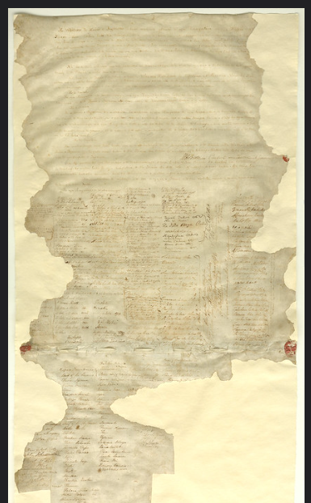
Thank you Questions - What about Injury Prevention and Māori injury prevention?

Slide 33
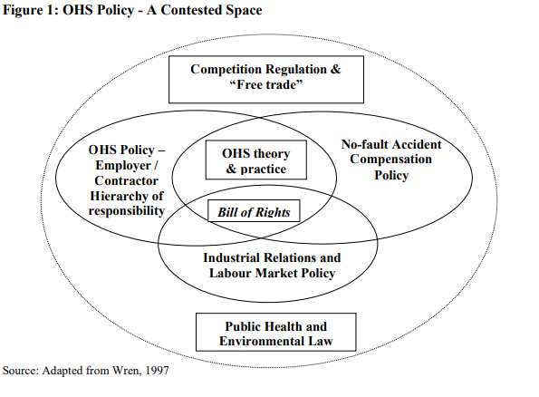
Some quick Observations about injury prevention – Everything I have focussed on in this presentation starts with the Māori experience of injury
The documented epidemiological research of disparities and inequities in Māori experience of injury is not new – it has been well known since the 1990s – particularly in the workplace space.
I am not aware of any evidence that suggests that the disparities in Māori injury rates have changed, I would encourage a replication of the 2013 NZ MOH/ACC Burden of Injury Study be undertaken.
ACC a case study in the failure of injury prevention?
‘Moral Hazard’, Workers Compensation Schemes, Claims Filing and Injuries (Wren, 2008).
To what degree has a comprehensive no-fault workers compensation system in New Zealand created a moral hazard, particularly when the regulatory regime in the business and OHS space has been, arguably, light-handed, and injury prevention in road safety and other public spaces is episodic and tends to still focus on blame the victim and behaviour change? (Wren, 2012 – Private submission to WHS Taskforce)
And, Injury Prevention has never really been a really strong focus of ACC (let alone any sustained Māori response) – just follow the money and put it in the context of ACCs expenditure and costs of injury (have a look at Ian Campbell’s book ‘Compensation for Personal Injury in New Zealand: Its Rise and Fall’ (1996).)
ACC has never been held to account for its Ti Tiriti obligations – till now
Notes:
Wren, J. (2008). Is ‘Moral Hazard’ a sufficient explanation for the increases observed in primary care provision and patterns of utilisation by clients? What effect has the EPN Contract had on Physiotherapy Services Compared to Cost of Treatment? Is there a more plausible explanation for increase in claims volume and cost than general population and economic level change? ACC Research. (18 December 2008). ACC Library
Wren, J. (August, 2012). Issues for Consideration in Strategic Review of New Zealand Workplace Health and Safety System: Private Submission by Dr John Wren to Independent Taskforce on Workplace Health and Safety. Adjunct Research Fellow, New Zealand Institute of Work and Labour Studies, Auckland University of Technology. 24 August 2012.

Slide 34
Some quick Observations about injury prevention
The dominant Actuarial and Insurance banking paradigm I have highlighted in my PPT also flows into the Injury Prevention space in ACC– which in turn leads to a focus on psychological behavioural / attitude / advertising injury prevention approaches that has an individualistic and blame the individual character to it (See Quinlan and Bohle and Lamm for a nice introduction to injury prevention theory and practice).
I would argue there is a wealth of injury prevention literature about all of this, including that this approach is not the most effective, it also completely overlooks a wide range of other causes of injury and means for intervention. They are particularly ineffective when done on a short-term basis, they constantly need redoing to have an effect – there are lessons from the public health literature about advertising that injury prevention could learn from. There only real effect is when done in support of other interventions.
Return on Investment
The ACC investment approach – that insists on a 5:1 or 2:1 return on injury prevention investment (noting these represent a 500% or a 200% return respectively) over relatively short time frames ( 1 to 3 years) seems nonsense to me. Why not a return of 1.2 : 1 (i.e. 20%)? (If my KiwiSaver gave me this I would also be very happy).
I would also suggest that much of what ACC does in the IP space isn’t sustained long enough to be able to demonstrate real changes in behaviour and injury rates – however this is also typical in the health promotion space, except in a few areas. None of this should be taken that there hasn’t been / or isn’t currently good ACC funded programmes – except in the case of Māori injury prevention where I cannot readily think of any.
Notes:
Have a look at Ian Campbell's book "Compensation for Personal Injury in New Zealand"

Slide 35
What really works – and a wero (challenge)
Everything I have seen about what works in the workplace safety, road safety, and many areas of general injury prevention space is that:
the most effective injury prevention interventions are the engineering solutions
I note that modernising equipment in the workplace and vehicles in the road safety space provides real safety gains and much needed productivity gains, and very recently in the case of vehicles – emissions gains (environmental and climate benefits)
The same applies to public safety (barriers and smoke cannons to reduce crime harm).
So my challenge is:
what is the role of ACC in this space?
it is also a challenge to government policy makers to stop seeing things in simple isolation – this stuff has to be joined up (and instead of thinking about some of this is in terms of either / or, but as plus / plus).
Notes:
Have a look at Ian Campbell's book "Compensation for Personal Injury in New Zealand"

Slide 36
Looking to the Future for Effective Māori Injury Prevention
In my view there has been failure by ACC to invest in Māori specific injury prevention activities consistently over the long-term (a few pilots were done in 2005/06). I suggest, this is yet another breach of the Crown’s (and ACC as its Agent) Ti Tiriti obligations of protection, participation and partnership.
To address the Māori injury prevention gap:
ACC needs to actively move to enabling Kaupapa Māori injury prevention initiatives with Māori Iwi authorities, Māori Businesses and Māori communities who have real interests in a range of injury prevention initiatives of importance to them – and accept that these may not always align with ACC injury prevention priorities.
ACC needs to accept that investment will have to sustained and require extra funding in order to build capability and capacity in those communities, Iwi, Businesses.
Recommend that ACC refer to the following for guidance about how to approach working with Māori (it is summarised in my 2015 Report 2 … to ACC) (over the years I keep coming back to this advice):
Ratima, M. (2007). “Māori Experience of Disability and Disability Support Service.” In H. R. Robson B (Ed.), Hauora: Maori standards of Health IV. A study of the years 2000-2005. Wellington, New Zealand: Victoria University, Te Rōpū Rangahau Hauora A Eru Pōmare. (this focuses on health service design, however I think the principles equally apply to injury prevention)
Equal Employment Opportunities Trust (2010) (see pages 18 and 19 ) for advice on working with Māori businesses and encouraging Māori staff within organisations (EEO Trust, 2010). The Trust suggests that in order to work successfully with Māori businesses it is important to understand the ethos driving many of the organisations, which can be described in terms of the ‘Four Ps’:
Purpose
Principles
Practices
Performance measurement.
Notes:
Responding to Māori starts with acknowledging that:
Mainstream programmes on their own are insufficient to address the disparities and inequities observed between Māori and non-Māori population groups.
There is a well-argued case for Māori specific programmes on the basis of fairness and equity, and Treaty of Waitangi obligations for Crown agencies.
Māori specific interventions are likely to need funding at higher levels than non-Māori (i.e. mainstream) programmes given the significant community and workforce capacity gaps that need to be closed, and given the much lower community resource base that any programme will be working in.
Programmes will need to be established on a medium to long-term basis – more than five years, and the success of the programmes measured not only in terms of importance to ACC, but crucially, in terms of community development measures important to Māori.
There is good evidence that an effective organisational response will require clear senior leadership and sustained commitment across the whole organisation about the need for a Māori specific response, and the value it can bring to the organisation (in terms of both trust and confidence and better service delivery such as integrated care services).
As a Crown entity and agent, ACC has a responsibility to actively support Crown obligations under the Treaty of Waitangi, and to respond to Māori. As such, Māori responsiveness should not be seen as the sole responsibility of Maori staff or a dedicated cultural unit. Rather, the organisation as a whole should respond, with specialist support in Māori knowledge and community networks to assist with delivering a credible response to Māori across the organisation.
Development of trusting relationships is important, and the traditional ACC approach of a top-down and short-term focus (less than three years) on return on levy investment, or change in programme priorities, will significantly undermine any Māori specific programmes that may be developed; they require a longer time frame to deliver the outcomes desired.
A Māori strengths based approach is preferable to a deficit model, because such an approach recognises the value, insights and capability that Māori can bring to the design and delivery of health care service provision; this is likely to significantly improve engagement with Māori authorities and representatives, and Māori perceptions of the organisation.
There is merit in beginning a process of engagement with Māori primary health care providers and Iwi Authorities to develop pilot models of Māori specific injury treatment and rehabilitation services – including claims management. ACC can learn from the pilot projects undertaken in 2005/06.
Māori health service delivery should be set within a Māori world view of health if it is to be effective. There are several models available, all of which share common principles that stem from Mason Durie’s Te Whare Tapa Whā model (M. Durie, 2012).
(In Wren 2015, Report 2)

Slide 37
Looking to the Future for Effective Māori Injury Prevention
There is a substantive body of evidence for effective Māori specific health promotion programmes in areas such as alcohol, smoking, violence, drug harm reduction, and Māori women’s health services, which, in my view, can be used to inform thinking about injury harm reduction.
All the evidence clearly shows that effective programmes interweave current scientific knowledge and best-practice about health promotion (injury prevention) and agency service delivery with:
a Māori world view of health
a meaningful partnership approach where the needs of both parties are met
the aspirations of Māori for self-determination and development are recognised
success is measured not only in terms of health (injury health) outcome and the short-term (less than three years), but rather in terms of participation, engagement and wider aspirations for social, cultural and economic development and the long-term
resourcing (financial and people) is appropriate for the task. This is likely to mean funding has to be at levels higher than mainstream programmes given that many of the issues being addressed are long standing and interventions are starting from a position of significant gaps in community and workforce resiliency, capability and resourcing.
Notes:
Everything I have read and observed about what works for Māori in other health / and public health promotion interventions (of which I know quite a bit, and noting I have recently been heavily involved in leading / overseeing the Te Ara Oranga Meth Evaluation, and the third Alcohol Drug Court Evaluation) suggests to me that:
for there to be effective Māori injury prevention interventions then programme designers could / should look to the health promotion / evaluation literature about what works for Māori.
when I look at the health promotion literature about what works, I see very similar themes about what works in the injury prevention literature (there really should be no surprise about this as the same underlying scientific theories about cause and effect exist in both places (a note of caution, this doesn’t mean that there aren’t subtle but important differences that can catch out the unwary).

