Slide 1
From Here to Autonomy
Prepared for

Slide 2
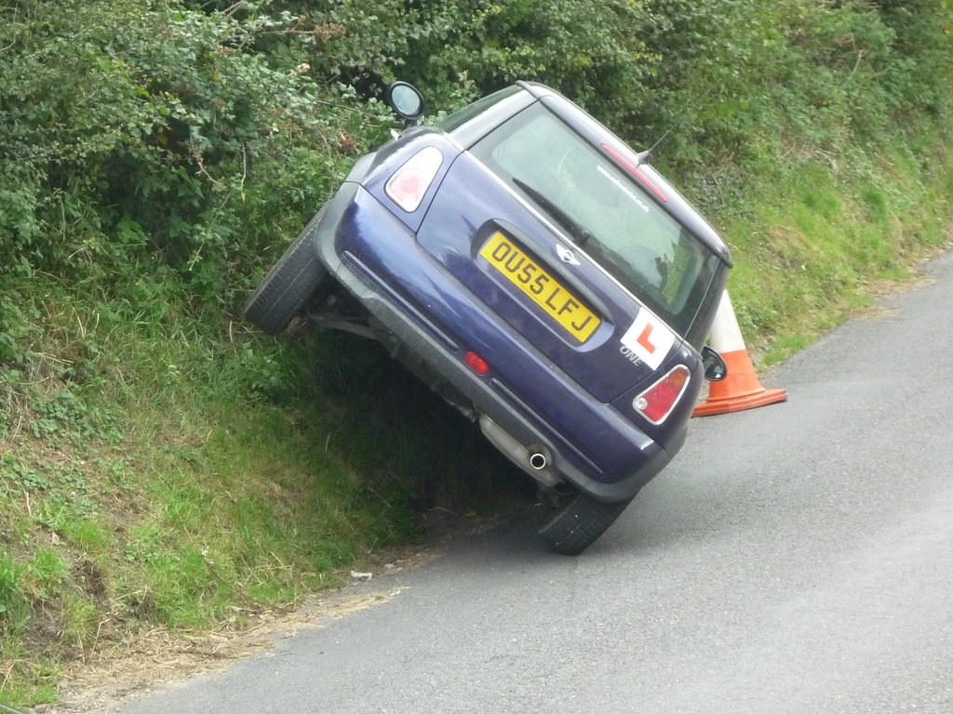
How long since you learnt
to drive - or perhaps even looked at the Road Code?

Slide 3
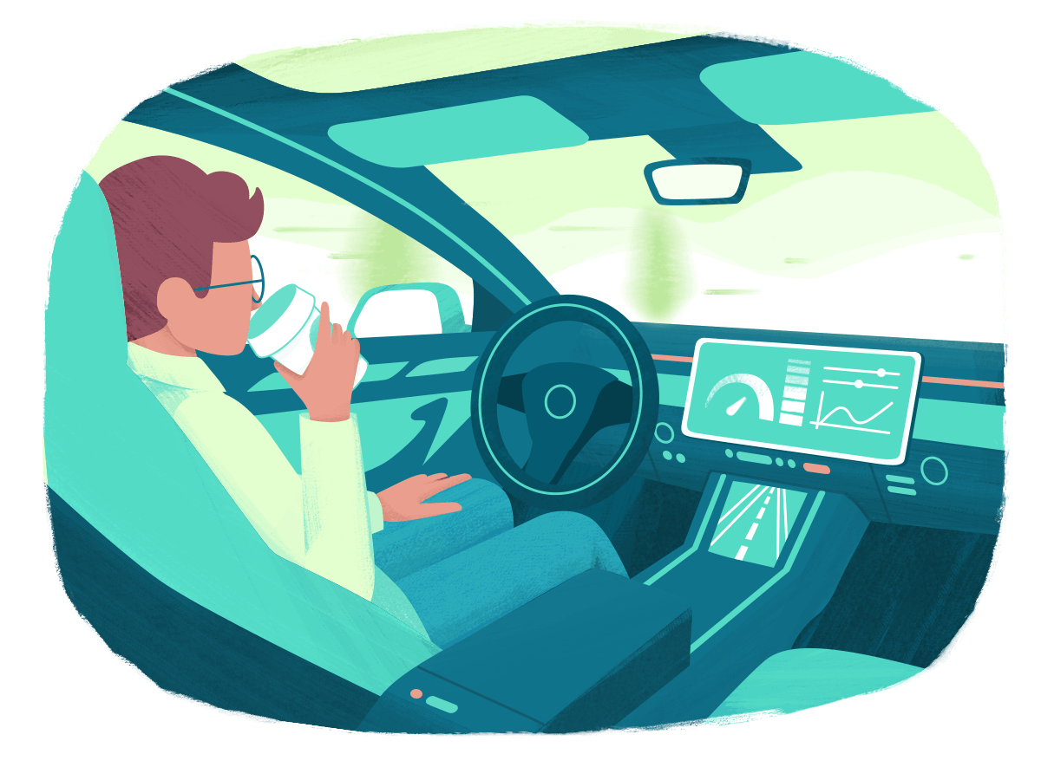
How long will it be before you drive like this?

Slide 4
On a scale of 1-10,
how good a driver
do you think you are?

Slide 5
How do you know?
What makes you a good driver?

Slide 6
Are you better when you leave more time and ring ahead if you’re going to be late?
How well do you anticipate hazards / risks?

Slide 7
Crash Risks - NZ vs Globally
20%
Global
New Zealand
13.2%
9%
New Zealand
Global
2.7%
Low Risk
High Risk

Slide 8
We now know how you feel about your roadcraft ability
We also know what the stats say
So, let's check ...

Slide 9
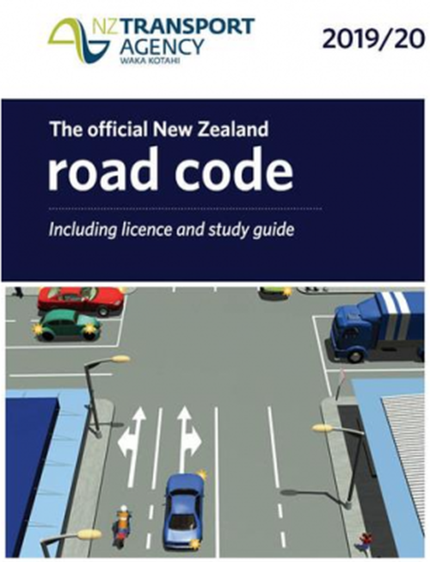
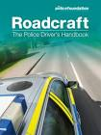
The Theory of it all

Slide 10
Driving Road Safety - iam.org.nz
IAM is a charitable organisation dedicated to:
promoting better driving and riding
enhancing road safety by taking drivers and riders to a level much higher than that required to pass the NZ driving test

Slide 11
Would you pass the full licence test today?
Are you as safe a driver as you can possibly be?

Slide 12
Do you check your driving position before you set out:
Seat
Hands on the wheel
Mirrors

Slide 13
What difference might it make if you were driving
an autonomous vehicle?

Slide 14
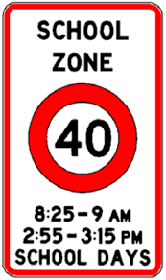

Slide 15
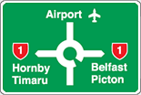
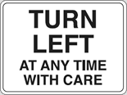
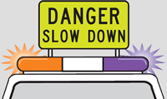

Slide 16
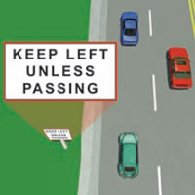
Using lanes correctly

Slide 17
On 4-lane, two-way roads such as some state highways, does the legislation allow you to drive in the right hand or ‘passing’ lane if you wish? (select all that apply)
A. Yes – it’s OK if you are doing the speed limit and not impeding anyone
B. Yes – when the traffic in the other lanes is congested
C. Yes – if you are passing
D. No – you should keep left at all times

Slide 18
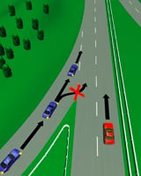
Using lanes correctly

Slide 19
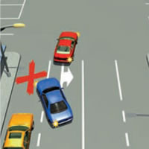
Using lanes correctly

Slide 20
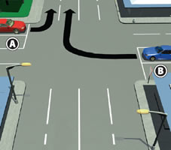
Using lanes correctly

Slide 21
Turning right at traffic lights
What is the correct place for you to wait when the light is green and there is no red right filter arrow?

Slide 22
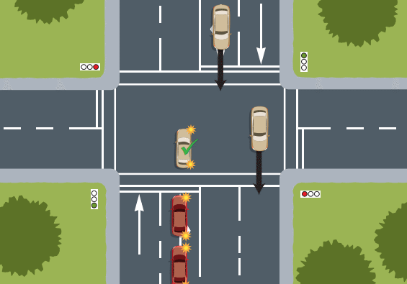
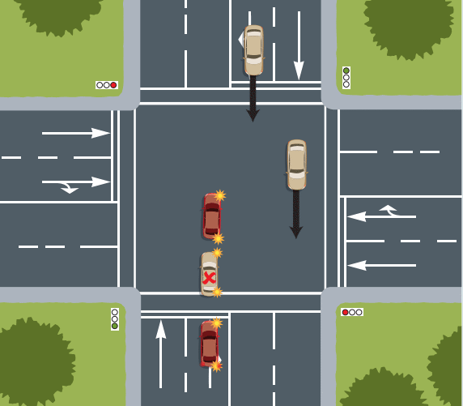
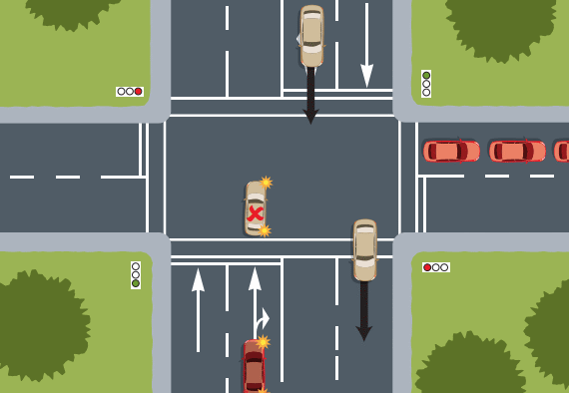
Turning right at traffic lights

Slide 23
Giving signals Shoulder checks

Slide 24
The flashing of the headlights is used for one purpose only
A. To thank another driver for showing courtesy
B. To tell another vehicle to go
C. To direct other vehicles to clear your path
D. To inform other road users of your presence

Slide 25
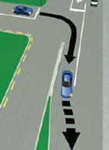
Merging at an intersection

Slide 26
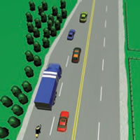
Merging like a zip

Slide 27
Following distances
What is the minimum following distance when travelling at 90 km/hr or more?
A. 25 m B. 28m C. 36m D. 45m

Slide 28
You are going straight through a medium sized roundabout. How should you signal?
A. As you are going straight there’s no need to signal
B. You signal left as you pass the exit before the one you wish to take.
C. You signal left as you enter the intersection
D. You signal right to let people waiting at the first exit that you are going to pass them, then signal left to exit

Slide 29
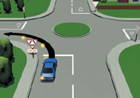
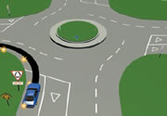
Roundabout confusion?

Slide 30
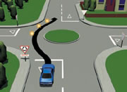
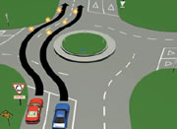
Roundabout confusion?

Slide 31
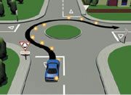
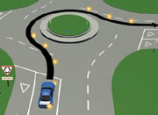
Roundabout confusion?

Slide 32
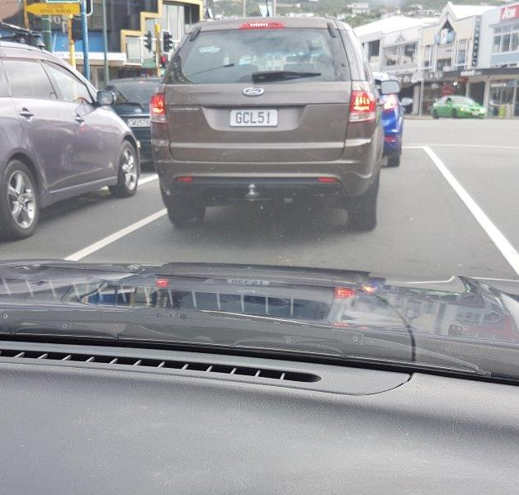
What’s your ‘stationary distance’ like at intersections? Tarmac and tyres or Rubber and road

Slide 33
Can you use a hand held mobile phone to make, receive or terminate a phone call when stationary in a line of traffic waiting for the lights to change?
A. No
B. Yes – it’s fine if you are not moving
C. Yes, but only when calling 111 or *555 and it’s unsafe or impracticable to stop and park
D. Yes

Slide 34
Help is at hand
If you are an AA Member and at least 74 with a valid licence, you are eligible for a free in-car coaching session with an AA Senior Driver before you renew your licence at 75.
https://www.aa.co.nz/drivers/fully-licensed-drivers/aa-senior-driver/

Slide 35
And more help is at hand
If you have been referred for an on-road safety test by your doctor, this site explains the process for booking, preparing for and taking the on-road safety test, what the test covers and what happens afterwards.
https://www.nzta.govt.nz/resources/on-road-safety-test/

Slide 36
And here’s an offer I observe iam RoadSmart Trainee Car Observers. They need to observe the driving of six different drivers (with me in the back seat). If you would like to be one of those drivers, please let me know.

Slide 37
Having had a quick refresher-
What challenges might autonomy have?
Can it do it better than you?
Can we all do better now?

Slide 38
Questions?

