Slide 1
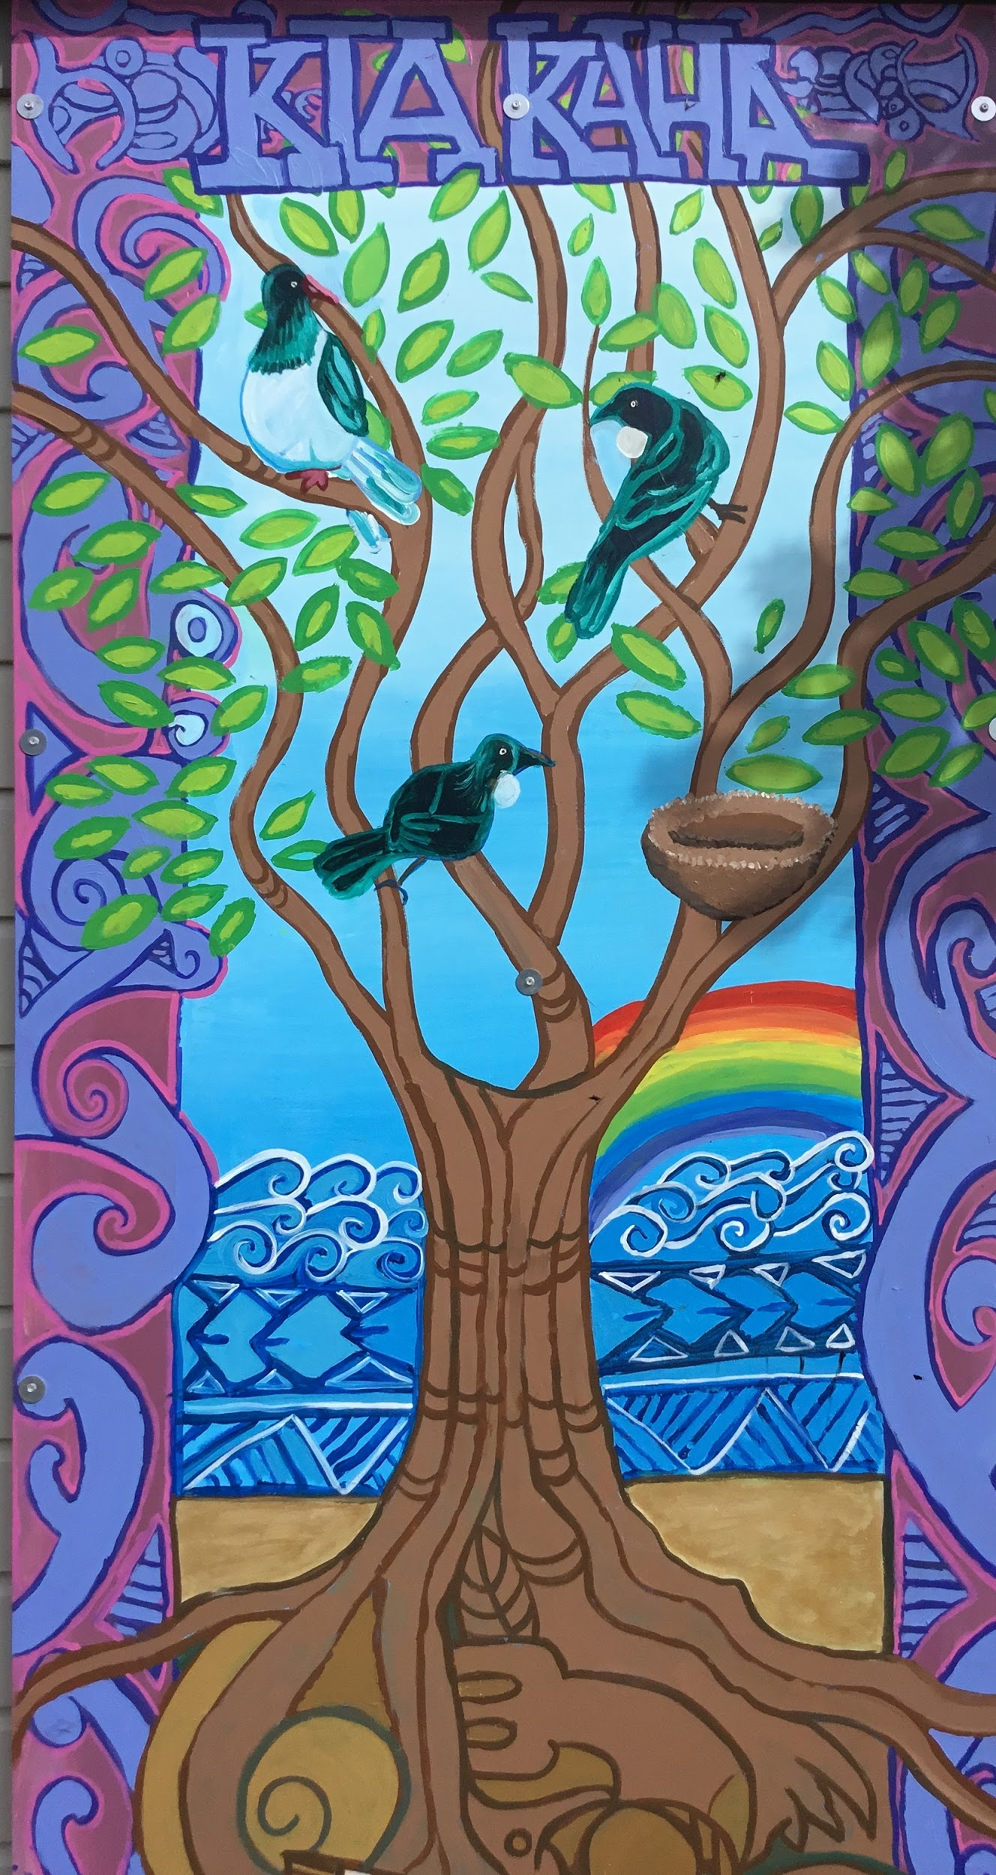
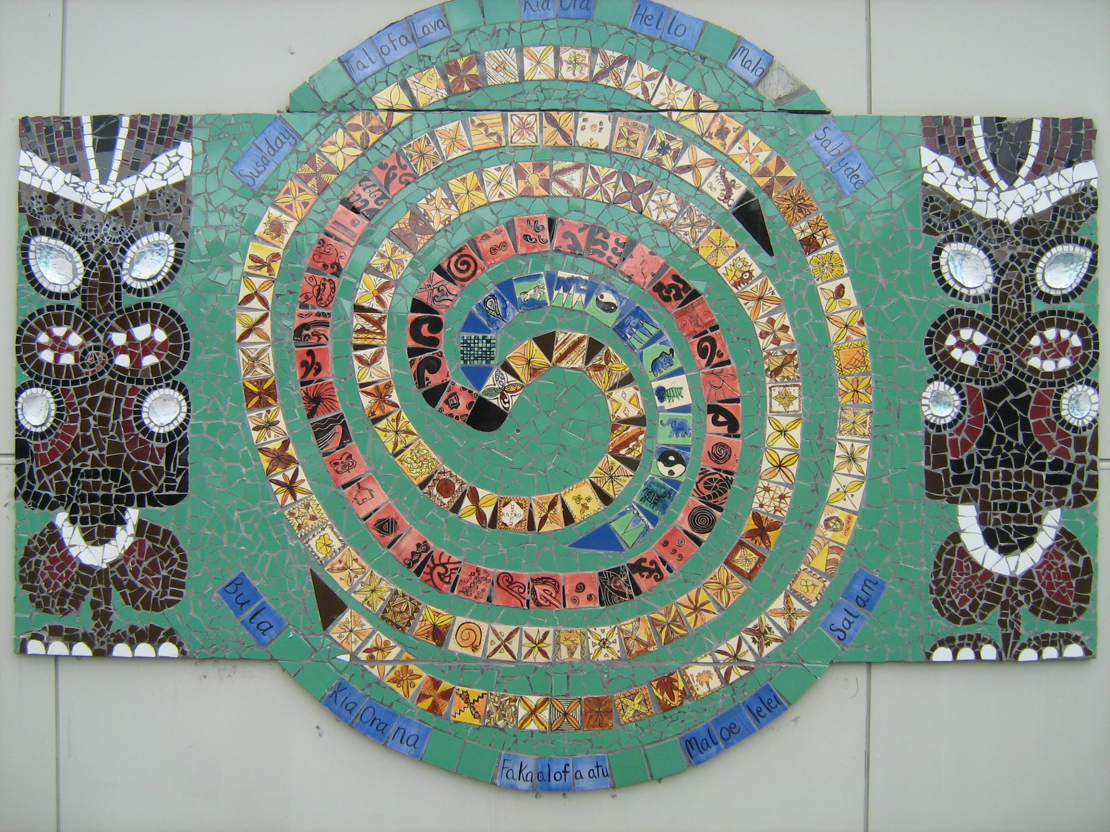
Corinna School
Expect The Best
Notes:
Anahera:
At Corinna School we think, create, act and share our ideas using a range of digital devices. One of our main goals is to be successful in the future. In order to achieve this goal we use a range of digital devices, so that we can explore and access any helpful tools and apps that are relevant to our learning.

Slide 2
V.A.I
Voice
Agency
Identity
Notes:
Jillian:
We are supporting our fellow students to have a VOICE in their learning, take AGENCY over their learning and also express their IDENTITY through their educational experiences. This is the vision for our school and the porirua east kahui ako.

Slide 3
Voice
“Everyone has a voice” “The voice is promoted and protected”
We can articulate, show or demonstrate why we are learning something.
We are clear about our goals and next steps.
We all express our needs and wants, feelings, rights and responsibilities with each other and adults.
Notes:
Anahera:
At Corinna School the use of digital technology helps to amplify our voices. It helps us to gain confidence in ourselves as learners. Digital devices have helped give us a chance to be able to speak our minds and express ourselves through blogger and other useful websites. When we contribute our ideas, beliefs, thoughts or opinions they are always respected and never criticised. We believe that everyone at Corinna School has a right to share their thoughts and also express themselves, freely.

Slide 4
Agency
“Make a difference” “Opportunities for learning are equitable”
We know what to do
We are able to take risks
We are able to get up and try again when we experience disappointment and failure. Failing is a first attempting in learning.
Notes:
Jillian:
Corinna School is a school well known for our cleverness and smarts, being able to handle changes and also for being a great big happy whanau. In our whanau we help each other to get to the same level. We never give up on each other. We have the ability to make our own choices about our learning and digital devices has helped us do so.

Slide 5
Identity
“Value who we are”
We rise to challenging work and we take risks
We all have a place in our group, class, school, whānau and world.
We are comfortable in ourselves and our relationships with a range of people.
Notes:
Prestigious:
Here at Corinna School we value who we are. Our strengths, qualities, weaknesses, culture, family, gender are just some of the many things that represent us not only as learners but as citizens of Waitangirua or people in general.

Slide 6
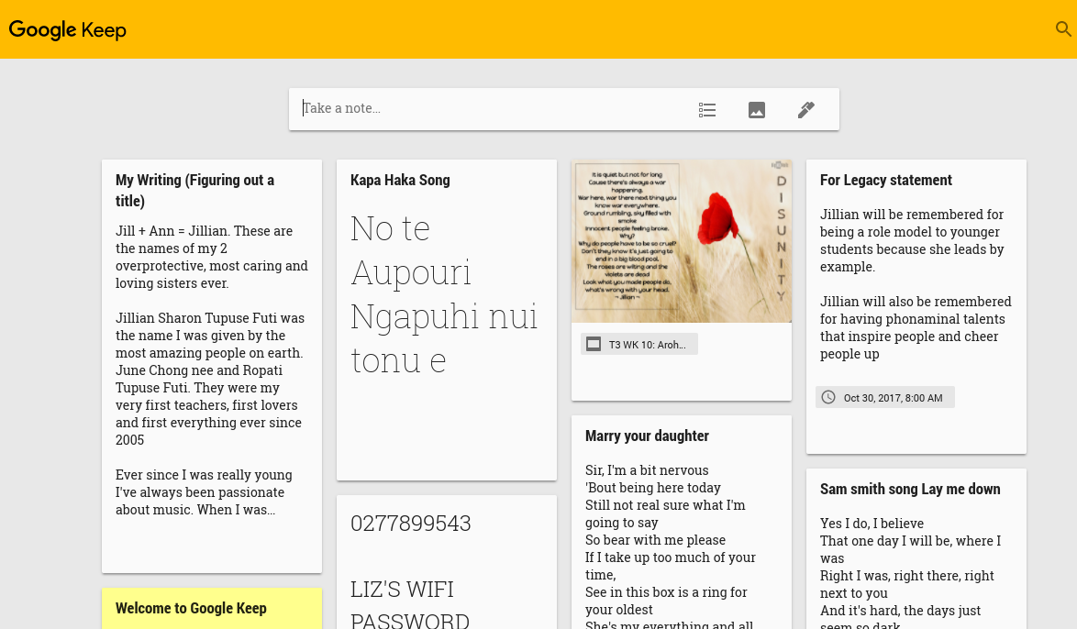
Digital Devices/Tools We Use...
Learning Blog
Screencastify
Google Keep
Notes:
Hillary:
We use lots of different online learning tools. Google apps are one of the most useful apps that help to record and produce our learning, effectively. The apps include Google Docs, drawing, and presentations. Screencastify and podcast are other helpful tools that help to record our learning. We also use a variety of other websites, apps and tools such as 3D modelling apps, movie making tools and Scratch which helps us to practise coding. There is so much learning and exploring we do on our chromebooks!

Slide 7
Eva’s Podcast
Kastro's ScreenCastify
Notes:
Eva:
These are an example of our podcasts and screencastify. The podcast was a dialogue that was written to entertain our audience. Screencastify is used to help us reflect on our learning by being able to see what we do well and what we need to improve on. Podcasting is yet a similar tool that we use to share our learning to others. Here is an example of my Podcast and Kastros Screencastify. My podcast is a demonstration of myself acting as a various amount of characters.

Slide 8
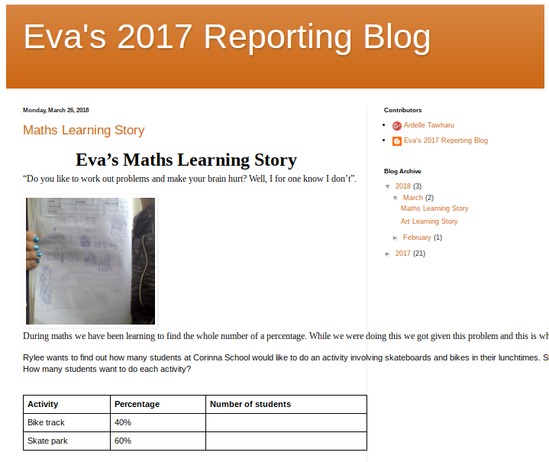
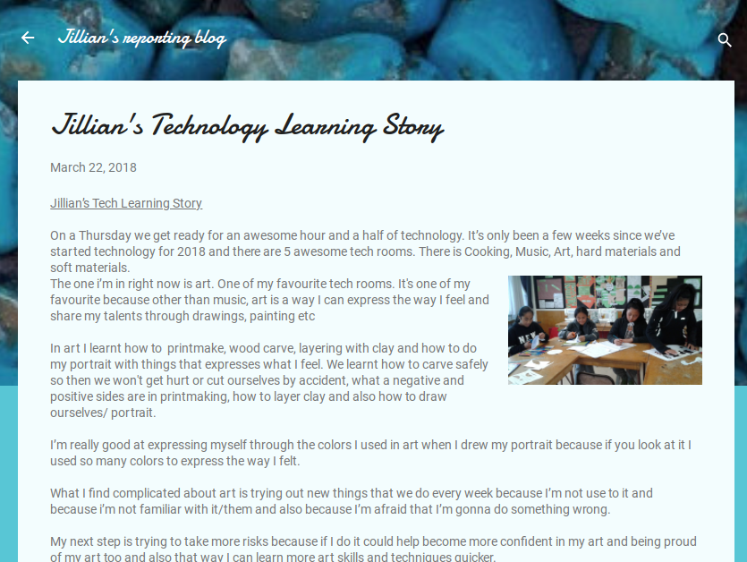
Student Reports
B L O G G I N G
Notes:
Prestigious:
Our blogs are evidence of the learning we do in our classrooms. We share these with our peers, parents and staff members in our school. We get informative feedback to help us improve our learning. It’s also a really cool record of us as learners during our time at Corinna School. Here is an example of our learning blogs. Our blogs contain learning stories. Learning stories are basically reflections of our learning. We discuss our strengths, struggles and improvements needing to be made based around the subjects of each learning story.

Slide 9
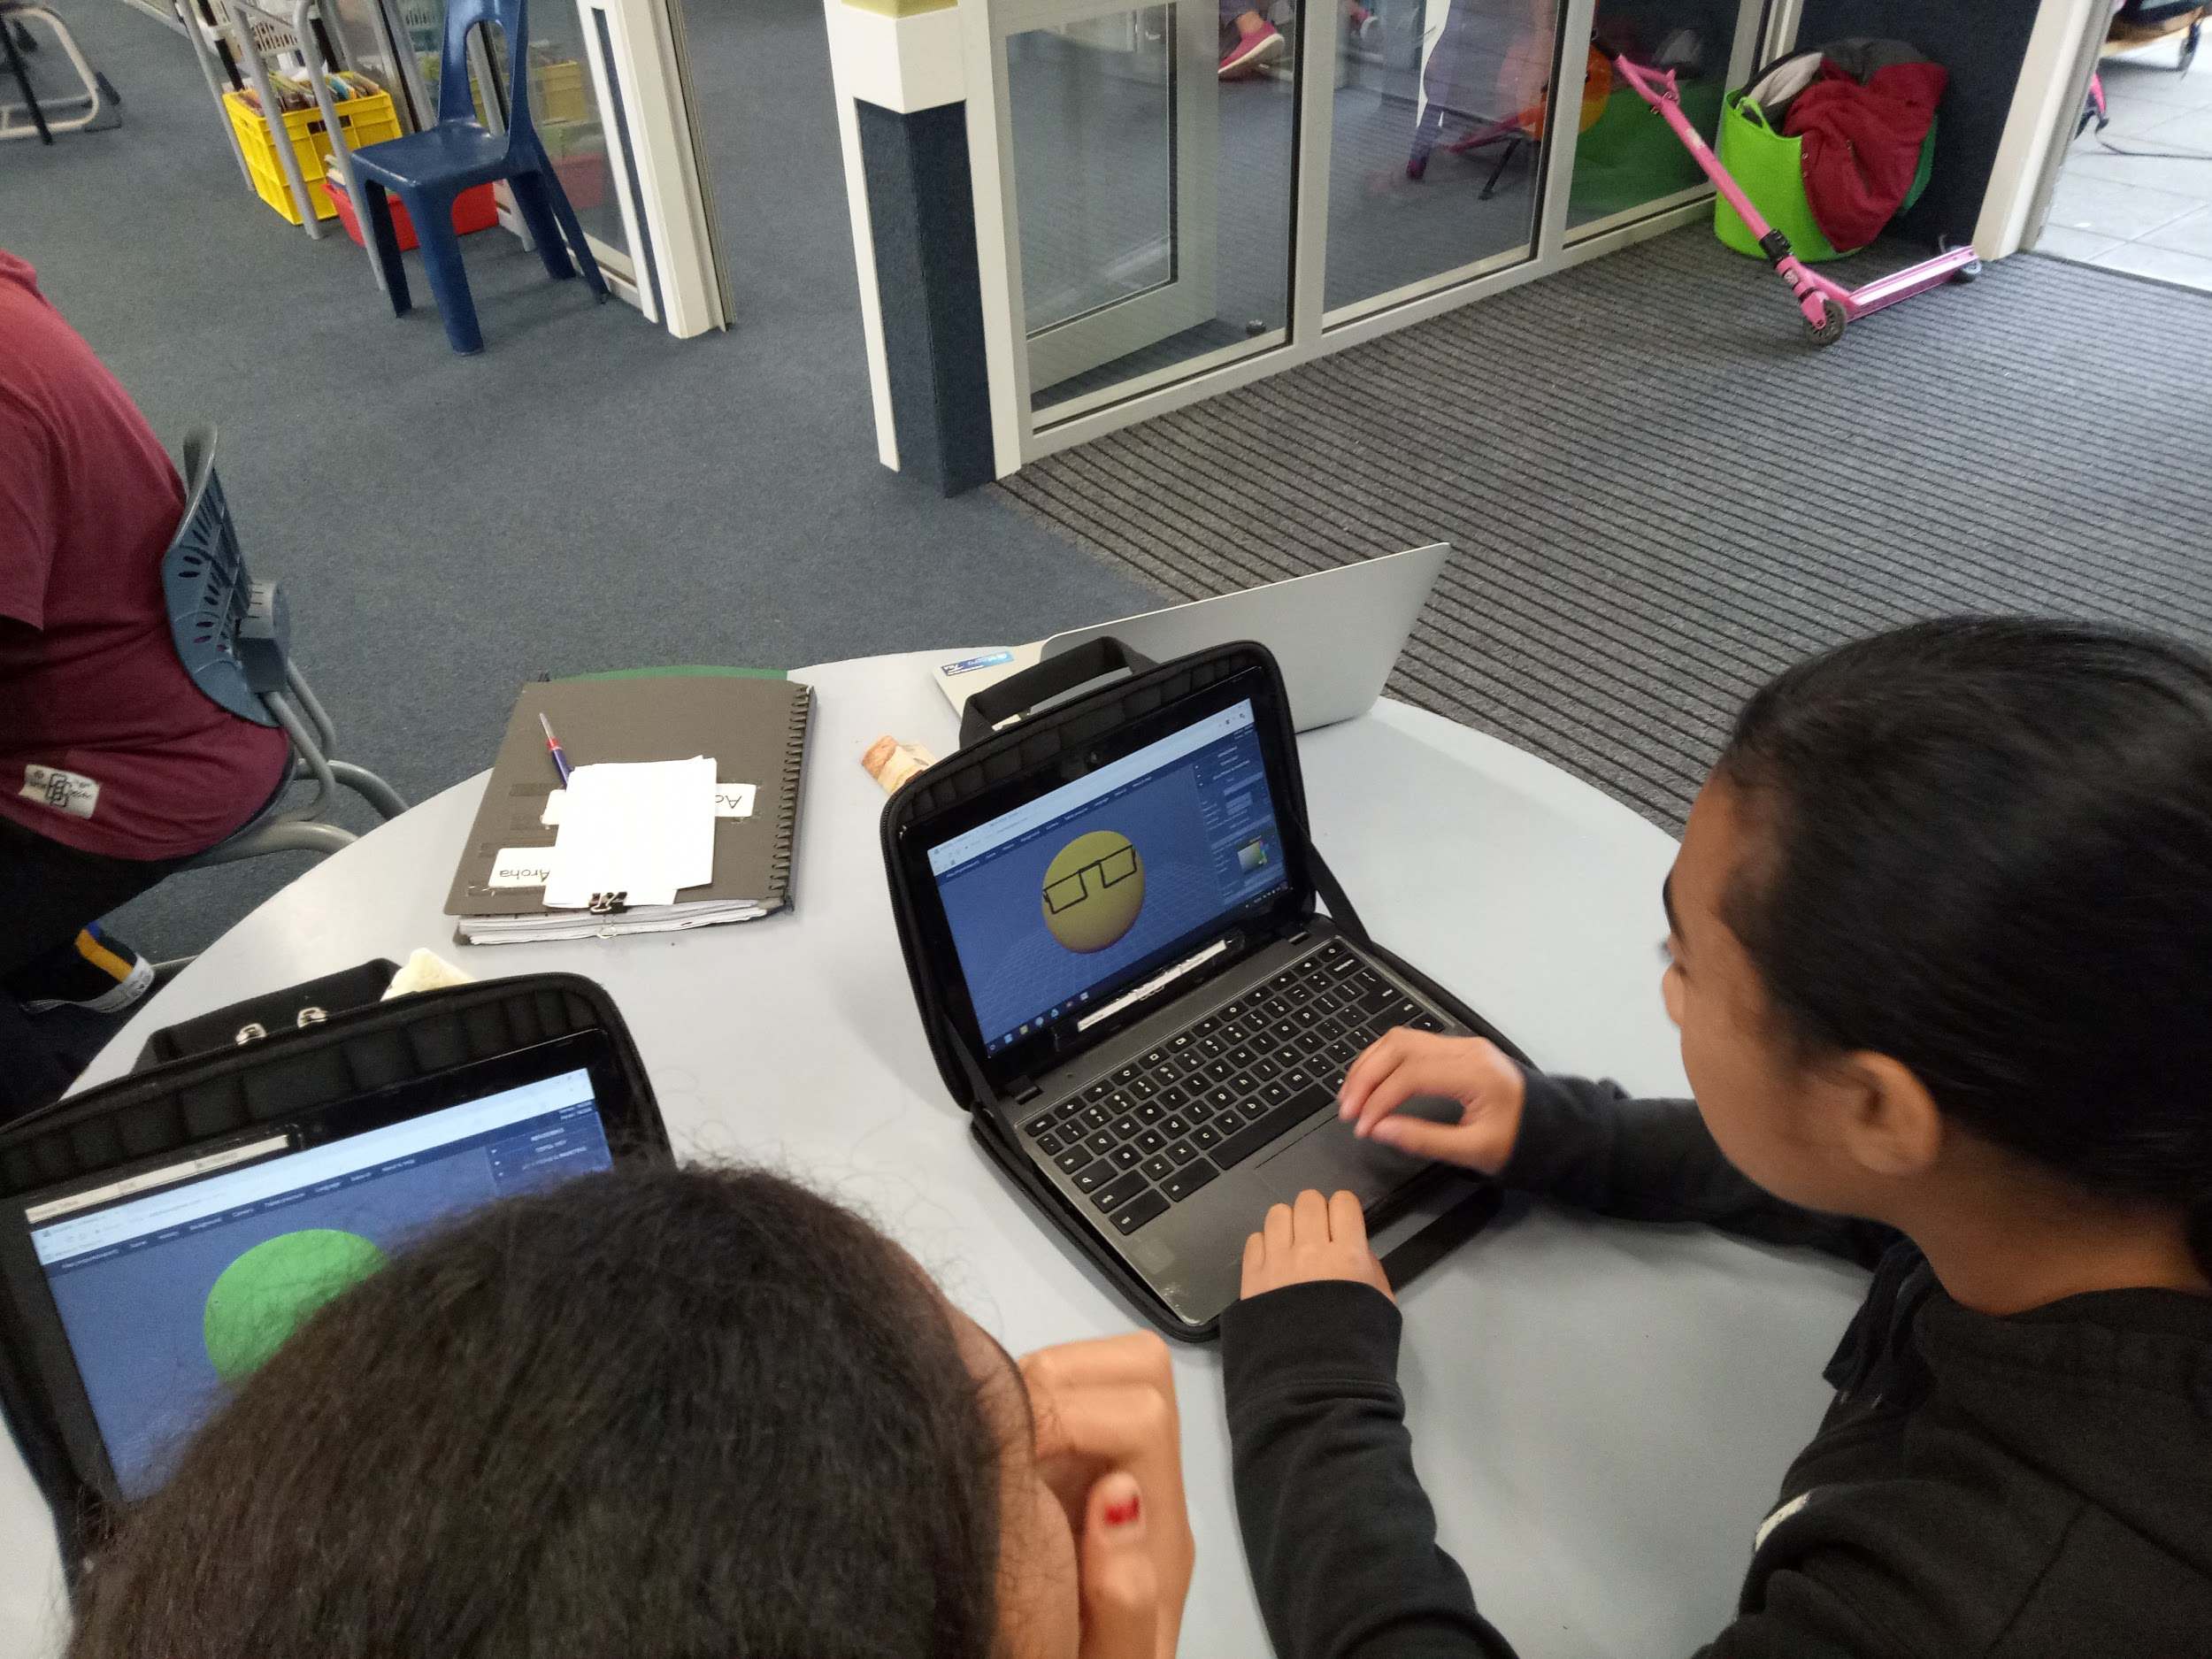
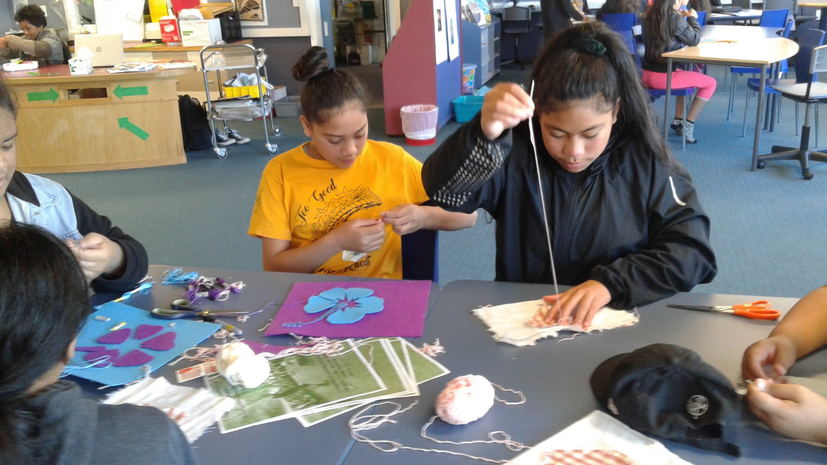
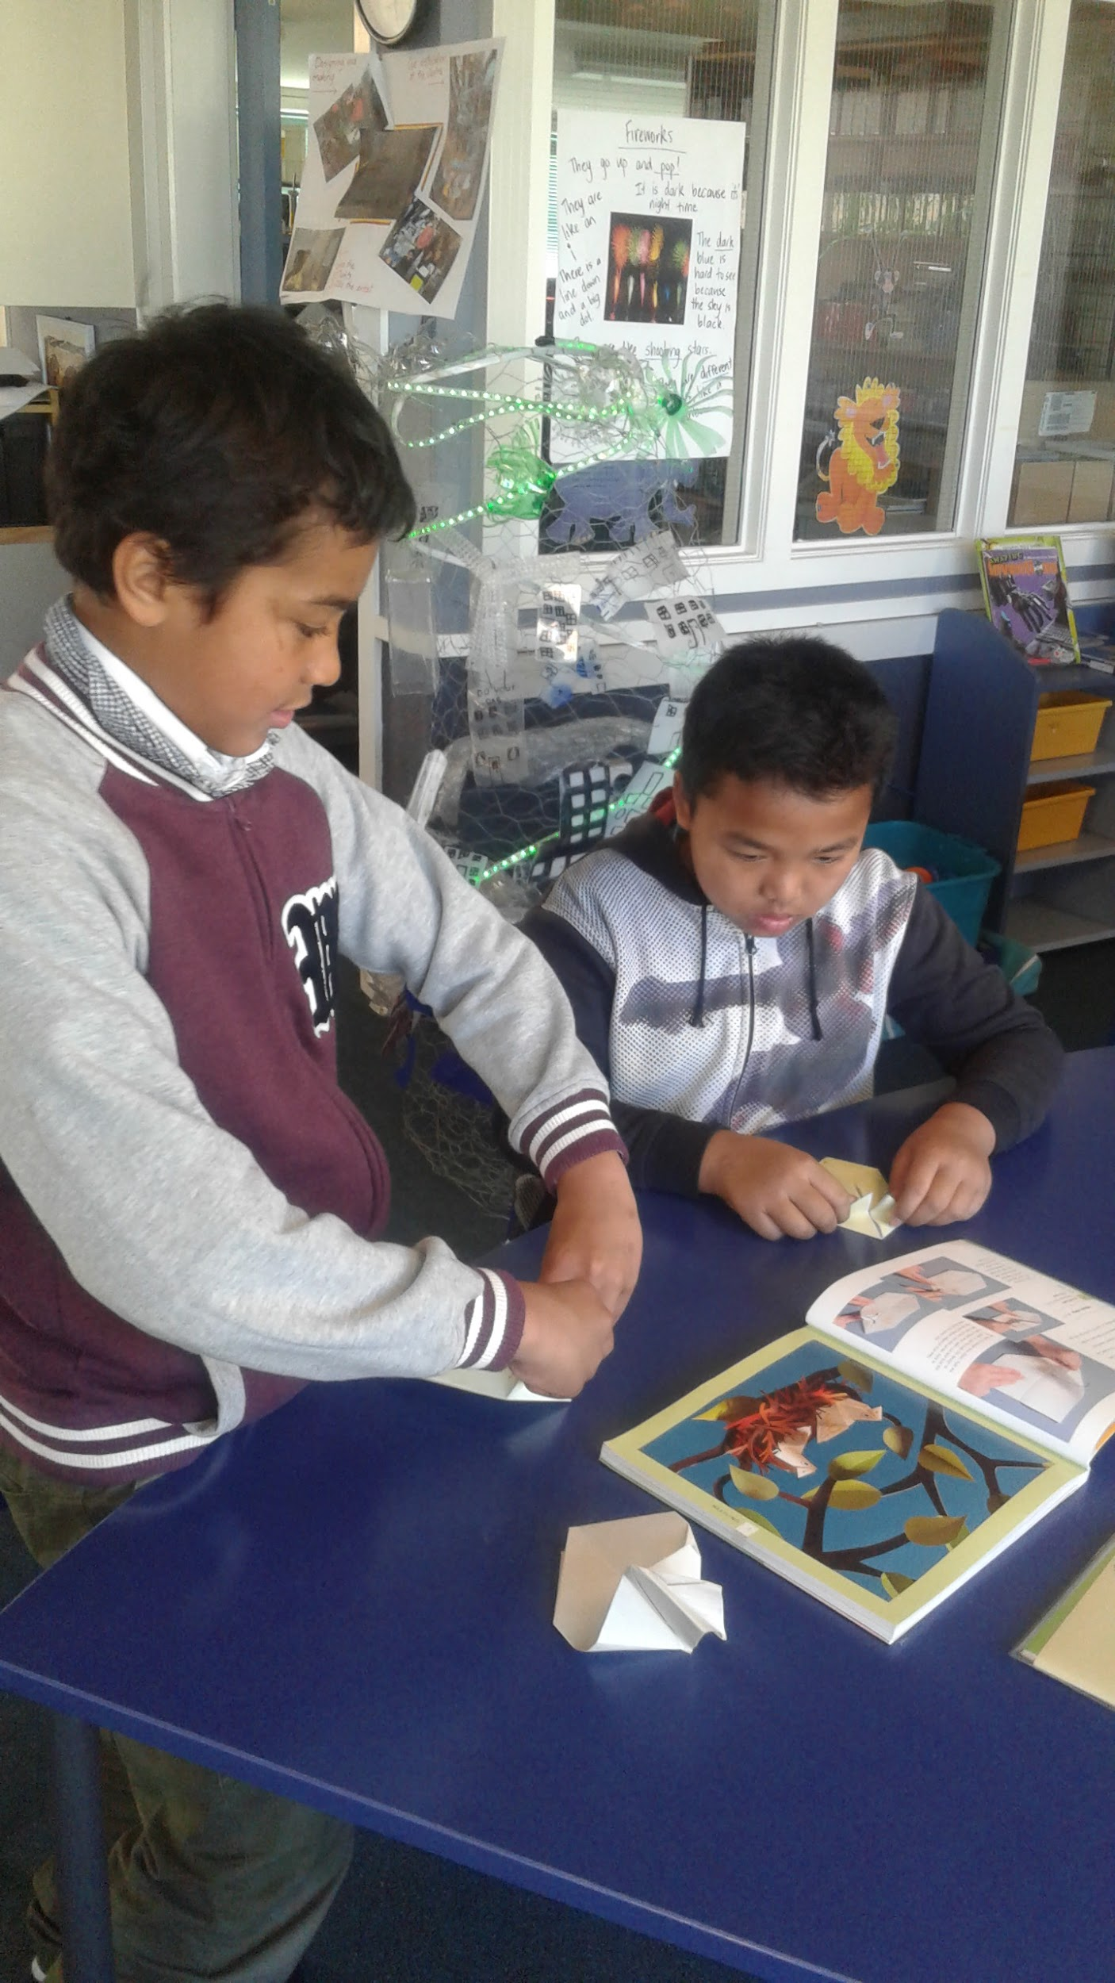
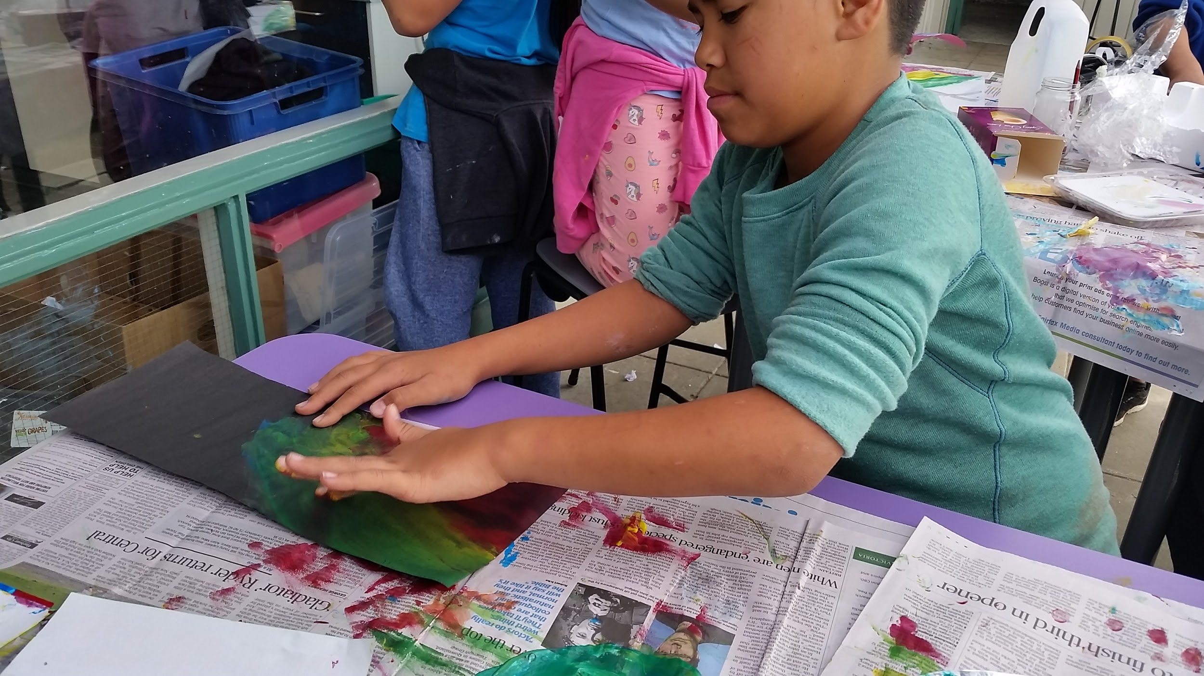
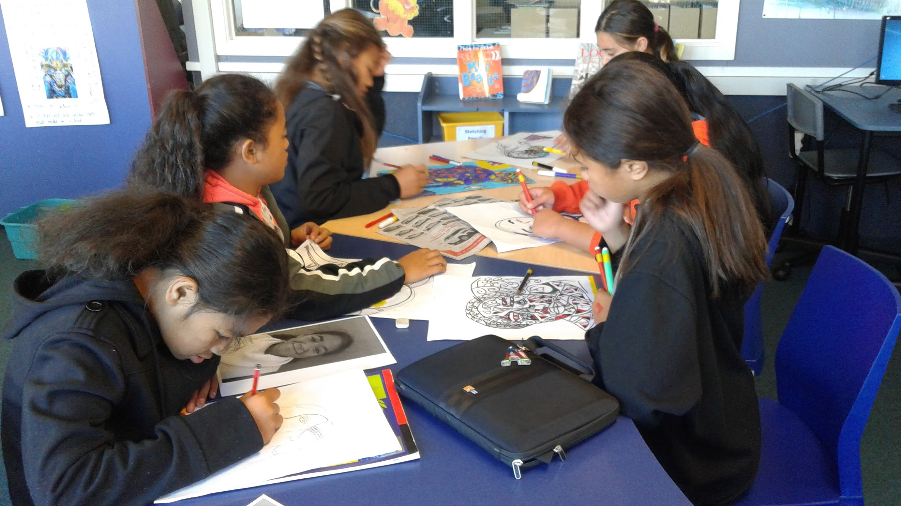
Creativity
Notes:
Jillian:
Creativity is a large part of our identity. It helps our imaginations come alive. Using chromebooks helps us to gain ideas and to build on these. Since we introduced chromebooks it has helped our students to develop certain skills around writing. We have high results now.

Slide 10
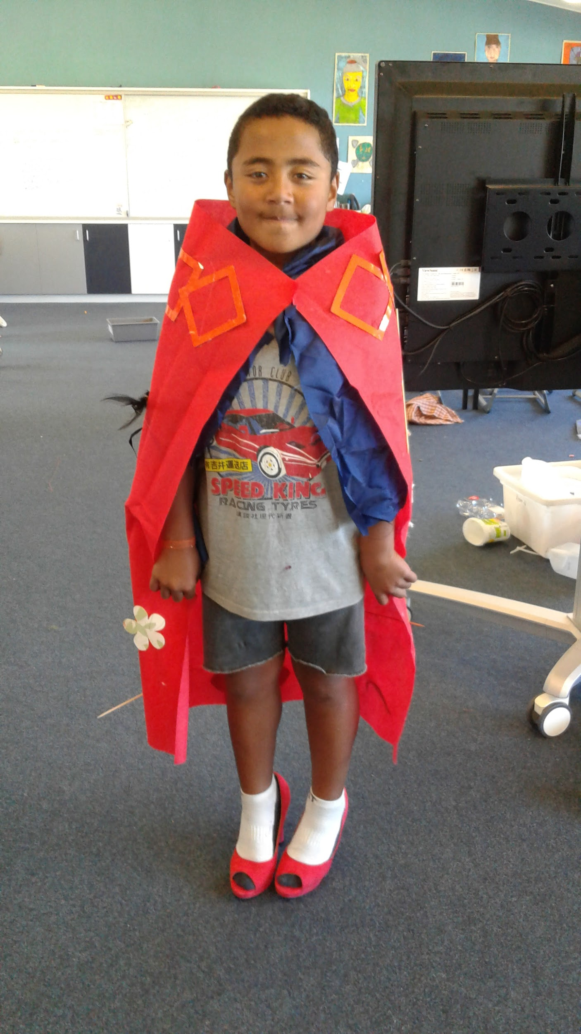
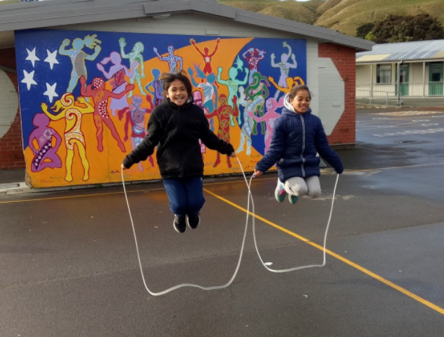
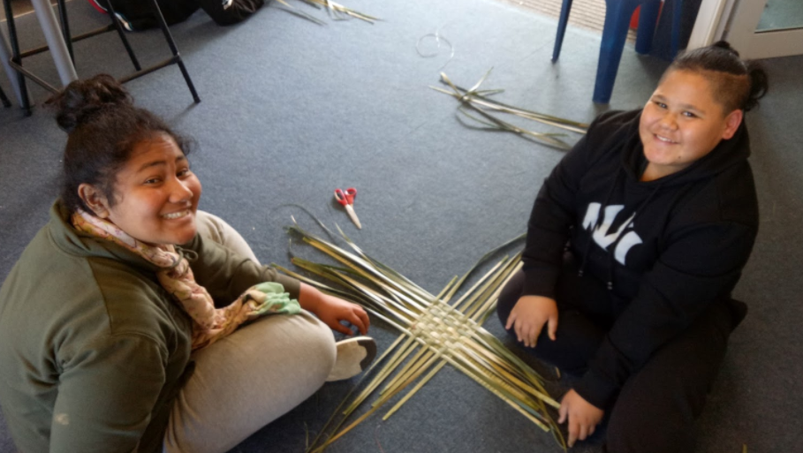
Play Based Learning
P = Passion, Project, Problem, Peer, Play
(P.B.L)
Notes:
Eva:
When we are doing Play based learning we have the ability to do anything within our learning. The p can represent many things like passion, project, problem, peer and play based learning. During this period of time we learn and improve lots of our skills. ‘Play based learning’ is a more creative way for us to express our passion. We use apps & tools online to help us answer these questions. If we want creative learners we must first give them time to play.

Slide 11
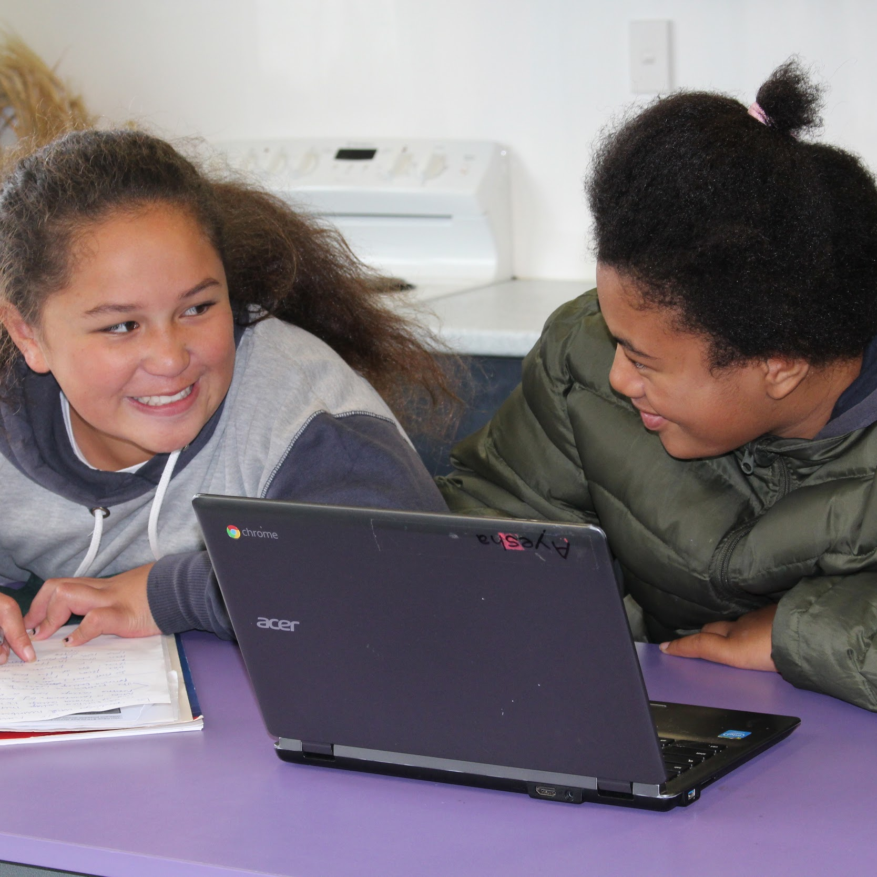
Collaboration
Notes:
Kastro:
We collaborate with our fellow students and teaching staff on different projects we do together to gather information and share our ideas. Using our devices makes it easier to achieve our learning because we can do it at school as well as at home. We can share our docs, presentations, drawings etc with our buddies and we have the ability to work with them in any time of the day they are free. It also makes it easier to get feedback from our teachers and peers so we can improve our word.

Slide 12
What is the Kawa Of Care?
We have a responsibility to take care of our chromebook (e.g) No food near our chromebooks, Don’t go on inappropriate websites that you know that is not part of learning, Send our classmates learning emails and Show our parents (Caregivers) what we are doing on our chromebooks, always be supervised by a adult when your on your chromebook.
Our parents, teachers and principal have agreed on the Kawa Of Care Trust. Most people are allowed to take their chromebook home, but those who have broken the trust will have to leave their chromebook at school.
Notes:
Eva:
A kawa of care is an agreement between our parents, teachers, the principal, and of course us the students. It’s sort of like a business contract. You agree on things then sign it. But the important thing is you have to be committed. So you have to remember to do the right things so you stay safe and are a responsible chromebook and internet user.

Slide 13
What our parents think?
We are having a new life in technology. It is easy to look up a question and find an answer. It helps us discover new words we aren't familiar with.
We have the ability to share our work to our teachers, The teachers can comment on our work for feedback. We can share our learning with classmates to give them ideas for their work too so they can be on the right track like us.
Notes:
Jillian:
When we ask our parents what they think about our chromebooks, they say that chromebooks are very helpful when it comes to researching questions to help us find out more information and words we aren’t quite familiar with, it also helps improve our spelling.

Slide 14
Thank you, do you have any questions?
Notes:
Anahera:
Our future is yet to come. There are still more technology yet to be invented. We can teach the families of Corinna School all about the chromebook usage and the rules too (e.g.) why it is so helpful, and what it has done to improve our learning techniques and skills. Thank you for listening, do you have any questions?

