Slide 1
Shine Literacy Project
Thank you for attending tonight’s first feedback meeting

Slide 2
Shine Literacy Project
Thank you these agencies who have provided funding and support: Infinity Foundation Pub Charities Porirua Foundation Mana Community Grants TG McCarthy Trust Gilt Edge Publishing, MJA Publishing FRESCO

Slide 3
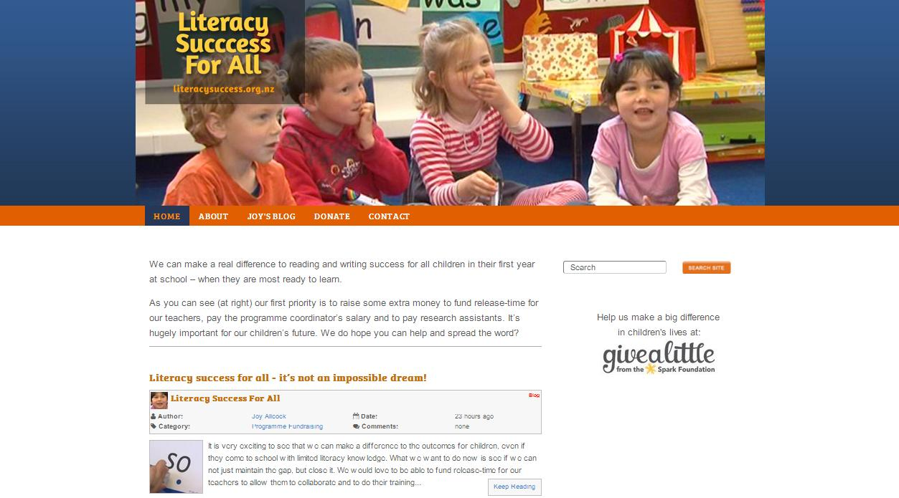

Slide 4
How the Project Started
Percentage of Titahi Bay School students achieving at or above National Standards in 2012 *** Three years of integrated literacy instruction Years 1-3 ** Two years of integrated literacy instruction Years 2 & 3
* One year of integrated literacy instruction – Year 3
 | Reading | Writing
Year 3*** | 79% | 91%
Year 4** | 85% | 89%
Year 5* | 62% | 71%
Year 6 | 49% | 60%

Slide 5
The approach used teaches foundation literacy skills in an integrated way
Core elements of the approach are:
Teaching from words to sounds to print. Using children’s oral language to learn about the alphabetic code –teaching from the known to the unknown.

Slide 6
Core elements of the approach are:
Teaching children how the alphabetic code really works – that letters are used to record sounds in lots of different ways.

Slide 7
Core elements of the approach are:
Learning to write as a platform for learning to read.

Slide 8
Core elements of the approach are:
Using assessment data to track progress and to tailor instruction to meet learning needs.

Slide 9
Achievement Profiles
Pattern A Pattern B Pattern C
Reading Achievement
A – Increasing achievement gap (Matthew Effect) B – Decreasing achievement gap (compensatory model) C – Stable achievement gap

Slide 10
Shine Literacy Project
Assessments Used

Slide 11
Assessments Used
Vocabulary Knowledge British Picture Vocabulary Screen Measures receptive vocabulary

Slide 12
Assessments Used
Knowledge of Letter Names Upper and lower case

Slide 13
Assessments Used
Clay Word Reading Reading 15 high-frequency words

Slide 14
Assessments Used
Phonological Awareness Skills Sutherland Phonological Awareness Test - SPAT Syllables, rhyming, blending, segmenting, deleting sounds

Slide 15
Assessments Used
Knowledge of Letter Sounds Upper and lower case

Slide 16
Assessments Used
Sound to Letter knowledge The ability to write every sound of English

Slide 17
Assessments Used
Invented Spelling Writing 18 words (a total of 54 sounds)made up of most of the sounds of English

Slide 18
Shine Literacy Project
Cohort Characteristics

Slide 19
Cohort Characteristics
Size The cohort size is 259 children. 112 (43.2%) are boys 147 (56.8%) are girls Trial group size: 138 71 Decile 9-0; 67 Decile 1-4 Comparison Group size: 121 69 Decile 10; 52 Decile 1-3

Slide 20
Cohort Characteristics
Ethnicity 28 different ethnicities were recorded. These have been grouped into: Pakeha 46.3% Maori 21.2% Pasifika 18.5% Asian 11.6% European 1.5% Other 0.8%

Slide 21
Cohort Characteristics
Decile Ranking 1 19.7% 2 15.1% 3 7.3% 4 3.9% 9 3.9% 10 50.2%

Slide 22
Cohort Characteristics
Deciles by Ethnicity
Deciles 1 & 2 Deciles 3 & 4 44.4% Pasifika 41.4% Pakeha 26.5% Maori 31% Maori 11.1% Pakeha 13.8% Pasifika 10.3% Aisan 3.4% Other

Slide 23
Cohort Characteristics
Deciles by Ethnicity
Deciles 9 & 10 70% Pakeha 9.3% Maori 2.9% Pasifika

Slide 24
Shine Literacy Project
Results

Slide 25
Results
British Picture Vocabulary Screen There was no significant difference between the results for Comparison and Trial cohorts. Comparison Group Mean: 98.64 Trial Group Mean: 99.75

Slide 26
Results
There were significant differences comparing high and low decile groups in the Comparison and Trial cohorts: Comparison High Group Mean: 103.96 Comparison Low Group Mean: 91.58 Trial High Group Mean: 106.23 Trial Low Group mean: 92.26

Slide 27
Results
Results are now grouped in the following way: 1. Items where there was no change between Time 1 and Time 2 - Letter name knowledge (upper and lower case letters) - Clay Word Reading

Slide 28
Results
Letter Names: Upper Case /26
 | Comparison | Trial | Significance
Time 1 | 16.12 | 14.70 | Sig (comp)
Time 2 | 23.27 | 21.36 | Sig (comp)
 | Comparison | Trial | Significance
Time 1 | 16.12 | 14.70 | Sig (comp)
Time 2 | 23.27 | 21.36 | Sig (comp)

Slide 29
Results
Letter Names: Lower Case /28
 | Comparison | Trial | Significance
Time 1 | 15.17 | 13.37 | Non Sig
Time 2 | 23.80 | 21.84 | Sig (comp)
 | Comparison | Trial | Significance
Time 1 | 15.17 | 13.37 | Non Sig
Time 2 | 23.80 | 21.84 | Sig (comp)

Slide 30
Results
Clay Word Reading /15
 | Comparison | Trial | Significance
Time 1 | 1.53 | .92 | Non sig
Time 2 | 6.90 | 5.86 | Non sig
 | Comparison | Trial | Significance
Time 1 | 1.53 | .92 | Non sig
Time 2 | 6.90 | 5.86 | Non sig

Slide 31
Results
Results are now grouped in the following way: 2. Items where there was a change in results with significantly higher results in Time 1 ceasing to be significant in Time 2. Sound-letter knowledge Letter sound knowledge (upper and lower case) Invented Spelling

Slide 32
Results
In this category, the Trial group made statistically significant gains in progress for: Letter sound knowledge (upper and lower case) Invented Spelling SPAT

Slide 33
Results
Sound to Letter /45
 | Comparison | Trial | Significance
Time 1 | 16.12 | 14.70 | Sig (comp)
Time 2 | 23.27 | 21.36 | Sig (comp)
 | Comparison | Trial | Significance
Time 1 | 9.13 | 6.29 | Sig (comp)
Time 2 | 25.60 | 24.02 | Non Sig

Slide 34
Results
Letter Sounds: Upper Case /26
 | Comparison | Trial | Significance
Time 1 | 11.45 | 7.50 | Sig (comp)
Time 2 | 19.58 | 18.48 | Non Sig
 | Comparison | Trial | Significance
Time 1 | 11.45 | 7.50 | Sig (comp)
Time 2 | 19.58 | 18.48 | Non Sig

Slide 35
Results
Letter Sounds: Upper Case - by Decile Groups
 | Comparison High | Trial High | Significance
Time 1 | 15.42 | 10.99
Time 2 | 23.27 | 21.23
 | Comparison Low | Trial Low | Significance
Time 1 | 6.17 | 3.39
Time 2 | 14.58 | 15.38
 | Comparison High | Trial High | Significance
Time 1 | 15.42 | 10.99
Time 2 | 23.27 | 21.23
 | Comparison Low | Trial Low | Significance
Time 1 | 6.17 | 3.39
Time 2 | 14.58 | 15.38

Slide 36
Results
Letter Sounds: Lower Case /28
 | Comparison High | Trial High | Significance
Time 1 | 15.42 | 10.99
Time 2 | 23.27 | 21.23
 | Comparison Low | Trial Low | Significance
Time 1 | 6.17 | 3.39
Time 2 | 14.58 | 15.38
 | Comparison | Trial | Significance
Time 1 | 10.65 | 7.05 | Sig (comp)
Time 2 | 20.22 | 18.48 | Non Sig

Slide 37
Results
Letter Sounds: Lower Case –by Decile Group
 | Comparison High | Trial High | Significance
Time 1 | 15.06 | 10.44
Time 2 | 24.08 | 21.85
 | Comparison Low | Trial Low | Significance
Time 1 | 4.81 | 3.04
Time 2 | 15.00 | 15.45
 | Comparison High | Trial High | Significance
Time 1 | 15.06 | 10.44
Time 2 | 24.08 | 21.85
 | Comparison Low | Trial Low | Significance
Time 1 | 4.81 | 3.04
Time 2 | 15.00 | 15.45

Slide 38
Results
Invented Spelling /54
 | Comparison | Trial | Significance
Time 1 | 7.28 | 3.54 | Sig
Time 2 | 28.33 | 28.49 | Non sig
 | Comparison | Trial | Significance
Time 1 | 7.28 | 3.54 | Sig
Time 2 | 28.33 | 28.49 | Non sig

Slide 39
Results
Invented Spelling – by Decile Groups
 | Comparison High | Trial High | Significance
Time 1 | 11.17 | 5.61 | Sig
Time 2 | 34.59 | 32.61 | Non sig
 | Comparison Low | Trial Low | Significance
Time 1 | 2.16 | 1.18 | Non sig
Time 2 | 19.86 | 24.56 | Sig (Trial)
 | Comparison High | Trial High | Significance
Time 1 | 11.17 | 5.61 | Sig
Time 2 | 34.59 | 32.61 | Non sig
 | Comparison Low | Trial Low | Significance
Time 1 | 2.16 | 1.18 | Non sig
Time 2 | 19.86 | 24.56 | Sig (Trial)

Slide 40
Results
SPAT: Sutherland Phonological Awareness Test
 | Comparison | Trial | Significance
Time 1 | 12.75 | 11.23 | Non Sig
Time 2 | 21.62 | 22.17 | Non sig
 | Comparison | Trial | Significance
Time 1 | 12.75 | 11.23 | Non Sig
Time 2 | 21.62 | 22.17 | Non sig

Slide 41
Results
SPAT: Sutherland Phonological Awareness Test - by Decile Groups
 | Comparison High | Trial High | Significance
Time 1 | 16.61 | 13.94 | Non Sig
Time 2 | 26.89 | 26.23 | Non Sig
 | Comparison Low | Trial Low | Significance
Time 1 | 7.78 | 7.96 | Non sig
Time 2 | 14.49 | 17.31 | Borderline sig (Trial)
 | Comparison High | Trial High | Significance
Time 1 | 16.61 | 13.94 | Non Sig
Time 2 | 26.89 | 26.23 | Non Sig
 | Comparison Low | Trial Low | Significance
Time 1 | 7.78 | 7.96 | Non sig
Time 2 | 14.49 | 17.31 | Borderline sig (Trial)

Slide 42
Shine Literacy Project
Questions and Comments

Slide 43
Summary: Achievement Profiles
Pattern A Pattern B Pattern C
Reading Achievement
A – Increasing achievement gap (Matthew Effect) B – Decreasing achievement gap (compensatory model) C – Stable achievement gap

Slide 44
Shine Literacy Project
Ongoing Funding

Slide 45
Funding
We have launched a Givealittle page to raise funds for the continuation of this project. Please let your school communities know about this via your newsletter. www.givealittle.co.nz/literacysuccess
Thanks to Fraser Carson of FRESCO for setting this up for us.

Slide 46
Contact
If you have any questions, comments or want to discuss the project further, please contact Joy: sus@ihug.co.nz 235 6864
www.literacysuccess.org.nz

Slide 47
Shine Literacy Project
Thank you for attending tonight’s presentation

