Slide 1
ACC re-envisaged for the 21st Century
The immediate changes we need
Hazel Armstrong

Slide 2
The Woodhouse principles
The guiding principles which formed the bed rock of the accident compensation scheme
The principles are commonly called the Woodhouse principles after the Chief architect of the scheme: Sir Owen Woodhouse
The principles are:
Community responsibility
Comprehensive entitlement
Complete rehabilitation
Real compensation
Administrative efficiency

Slide 3
Sir Owen Woodhouse
His war time experience
in the Royal Navy saw him transporting injured partisans across the Adriatic.
James Caffin, in the book “Partisan” records: “the black bearded officer’s flotilla of gun boats had been doing much for the Partisan cause by protecting supply lines and chasing E boats”.

Slide 4
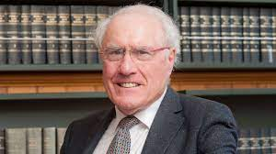
The right to sue abandoned replaced with a comprehensive no fault scheme for personal injury
Sir Owen returned to the law in Napier, and he became convinced of the need to abandon the right to sue for personal injury compensation.
In 1966 he was asked to chair the Royal Commission on personal injury in NZ.
Former Prime Minister Sir Geoffrey Palmer, for whom Woodhouse was a mentor and friend, stated that he "was a man of astonishing intelligence and wonderful humanity”.

Slide 5
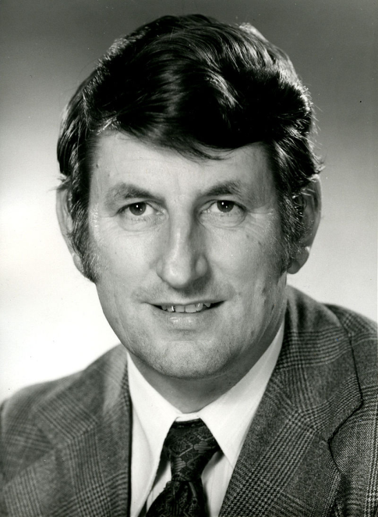
Neoliberalism
The founding principles have come under huge and enduring pressure from the neo-liberal attacks of the 1980’s and 1990’s.
The Woodhouse principles are not compatible with neo -liberalism
Neo-liberalism is a political approach that favours free-market capitalism, deregulation, and reduction in government spending.
Neoliberalism has not been purged from the scheme.
In May 1998, Hon Bill Birch, Minister of Finance, announced that private insurance companies would be allowed to compete with ACC starting in July 1999.

Slide 6
The 1999 election
ACC has been declared a "line in the sand election issue" by Accident Insurance Minister Murray McCully.

Slide 7
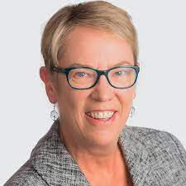
The 2001 Act
Labour was elected and formed the Government.
The Accident Compensation Act 2001 was passed which stated in its purpose – the Act ..
“…is to enhance the public good and reinforce the social contract represented by the first accident compensation scheme”…
ACC was restored as the sole provider.
But the spectre of privatisation lurks beneath the surface.
An example of which is the accredited employer scheme.
Hon Ruth Dyson became Minister for ACC from 2002-2007

Slide 8
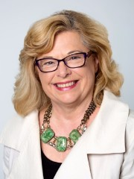
A decade later- the 2009 election
In 2009, ACC again became an election issue
Labour loses the election.
National’s Hon Nick Smith becomes Minister for ACC.
He appoints a new Board – in 2012 Paula Rebstock is appointed, she remains on the Board for 9 years.
His priority is cost control
Insurance principles are reinforced.
The breadth of cover is tightened
The way rehabilitation is managed means
It is more restrictive
Less discretion is exercised
Providers are contracted to deliver limited services
KPIs are driving decisions about rehabilitation and about how long people remain on weekly compensation
Tools such as vocational independence are used as weapons against the claimant
the accredited employer scheme remains

Slide 9
ACC Futures is formed in 2009
The aim of ACC Futures
To build cross-party support for retaining the status of ACC as a publicly-owned single provider committed to the ‘Woodhouse Principles’, with a view to maintaining and improving the provision of injury prevention, treatment, rehabilitation and ‘no fault’ compensation social insurance system for all New Zealanders.
ACC Futures runs a successful campaign against privatisation
The next slide shows some of the issues we focused on in our campaign
The insurance market was not interested and the economics did not stack up
The scheme was not privatised- but the Woodhouse principles are overwhelmed by the insurance approach

Slide 10
Labour’s manifesto 2020
Labour wants to address the changes National made when last in office, which unfairly disadvantaged tens of thousands of New Zealand people (the Nick Smith 2010 changes)
Labour will consider the range of conditions ACC covers and taking an evidence based approach to updating the list of chronic illnesses caused through workplace exposure to harmful environments
As part of the welfare overhaul, Labour will examine inequities between support through ACC and the welfare and health systems for disabled people and people with health conditions.

Slide 11
The Nick Smith 2010 changes include:
Imposition of a 6% threshold for hearing loss
The barrier to access for cover for gradual process injuries/occupational disease claims remains
the Ministerial Advisory Committee of work related gradual process/occupational disease has not been reinstated
schedule of occupational diseases needs to be updated/extended
Disentitlement in cases of self inflicted injuries or suicide remains
Increasingly easy to have weekly compensation suspended because a claimant deemed Vocationally independent
30 hours = full time work
pre incapacity earnings may be taken into account

Slide 12
Many other changes to ACC are required (beyond those imposed by Nick Smith in 2010)
Cover
Cover to be extended to mental injury caused by non work traumatic events
Cover extended to non work related asbestos disease
Cover should be granted when the diagnosis evolves or is clarified
Cover for birthing injuries
Entitlements
Removal of requirement to be an earner at the time of injury and at the time of incapacity in order to be eligible for weekly compensation – ie reversal of the Vandy decision
Entitlement decisions must be issued within statutory time frames
Change the way weekly compensation is taxed when back dated
Holiday pay should not be abated against weekly compensation
The Board
Board representation should include workers, disabled persons, Maori and Pacifica.
Assessors
Create a larger pool of assessors - ie not limited to those appointed or approved by ACC so long as the assessor is appropriately qualified and trained.
Lump sum
AMA Guide is outdated – use most recent AMA Guide
AMA Guide is gender biased
Incapacity
Definition of full time employment to be increased to 37.5 hours a week
Pre injury earnings must be taken into account when making vocational independence decisions
Reinstate consideration that the person can work in each and every part of pre injury employment when considering incapacity

Slide 13
Access to justice
Review decisions should be enforceable
Review costs should be increased
Removal of bar to appeal to the Supreme Court
Discretion to accept late appeals in the High Court
Legal aid more generous to encourage lawyers into the field of ACC

Slide 14
Woodhouse principles have been undermined
Community responsibility
Comprehensive entitlement
Complete rehabilitation
Real compensation
Administrative efficiency
ACC needs to review its practice to return us to the Woodhouse principles
The legislation needs to change to properly implement the Woodhouse principles
The Board has to reflect the values underpinning the Woodhouse principles
Uplift is required for those with a disability

