Slide 1
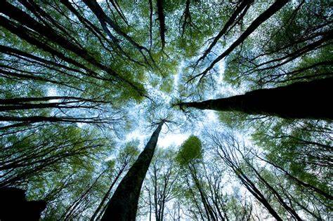
Whakatika Oranga ACC & Injury Prevention Forum
Tāngata Humāria Charitable Trust - CANDICE GATE

Slide 2
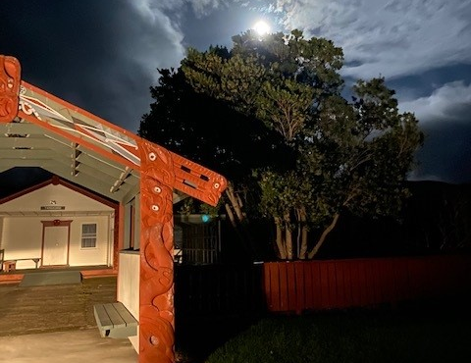
Ko Wai Au?
Ko Wai Tatou
Who am I?
I am Candice Gate and I am my ancestors' wildest dreams.
I am the product of Mokopuna Planning.
Who are we?
We are Tāngata Humāria Charitable Trust
We aim to bridge the gap between the Government’s priorities and the aspirations of whānau, hapū and iwi in Te Tairawhiti.
We advocate & facilitate the voice of whānau, hapū and iwi being heard in the corridors of power, our aspirations are to;
Build a productive, sustainable and inclusive community
Improve the wellbeing of Te Tairawhiti community members
Foster Leadership & Mana Restoration within our people
Community is the fundamental foundation of Māori society. This is the basis for how we engage, how our strengths are viewed and how success is shared. Community / Whānau leading their own development aspirations provides the platform for them to drive improvements in Te Tairawhiti.
This means identifying;
Where the biggest opportunities for impact of whānau wellbeing are
Finding holistic and inclusive ways to support whanau,
Acknowledging whānau and their expertise, enabling them to become self-managing and successful on their own terms
I Hear And I Forget.
I See And I Remember.
I Do And I Understand.

Slide 3
Tangata ako anani te kaenga, te turanga ki te marae, tau ana a person nurtured in the community contributes strong to society
What we know
Forestry has, on average had 5 deaths per year for the past 50 years. Te Tairawhiti accounts for 1 of those 5 per year, the ripples are very evident within our community.
1 in 4 people in Tairāwhiti are dependent on a forestry income, the grip the industry has on our community is undeniable
The forestry industry is the most dangerous sector to work in, in New Zealand. The injury rate is double that of other sectors and the fatality rate is 15 times the overall rate for all sectors, this is disproportionate. This needs to change to prevent further injuries and loss of lives, and for the industry to be sustainable. (https://www.fisc.org.nz/uploads/6/6/2/5/66257655/final-report-independent-forestry-safety-review.pdf)
Maori are 55% more likely to be injured or killed at work and that inequity has been growing consistently over successive years.
The Forestry Industry is dangerous by design and lacks resilience, particularly in Te Tairawhiti.
Forestry is Compliance Heavy, yet Health & Safety Light
Kaimahi & Community are lacking a seat at Decision making tables

Slide 4
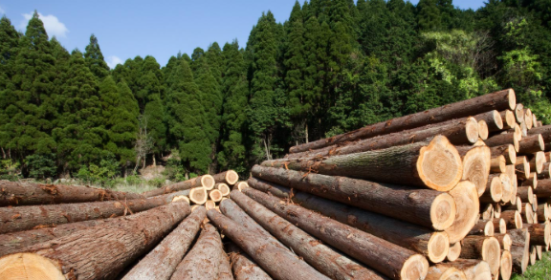
A Karanga from the Kaimahi less KPI’s, more Kia Ora
Addressing NZ’s poor workplace safety record has been ongoing for successive governments.
Following many, many, many a report the identified causes were;
Long-standing failures in safety leadership and governance across NZ’s safety system
Low levels of surveillance
Poor utilisation of available data
Over-reliance on employer self-management of safety risks in the workplace
The Independent Taskforce on Workplace Health and Safety set a target to reduce New Zealand’s workplace injury and death toll by 25 per cent by 2020. This target was not met.
The Independent Forestry Safety Review 2014 had urgent recommendations; these are largely still not met.
When will Kaimahi see meaningful change?
The answer is, When they lead it.
Kaimahi have the most skin in the game and the most lived experience. Its time to let the experts, be the experts
Low hanging fruit initiatives such as noise of machinery has workers giving feedback such as “I can’t hear if I am dead”
They are disengaged, how do we restore their mana?

Slide 5
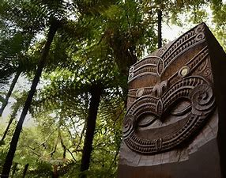
Proactive rather than reactive measures are needed
Who accepts the Risk? Who controls the Risk? Who is exposed to the Risk?
Fatigue – 14-16 hour days are common, physically demanding mahi, exposed to the elements, Whanau issues due to being away so much, fractured relationships, grumpy & tired all the time
Production Pressure –It can look like someone is away, making up for a machine break down, road closed, port full, trucks unavailable
Income Instability – Don’t want to speak up as you may not have a job tomorrow, accept unsafe conditions as they should feel lucky to have a job. Forestry in Tairawhiti is currently like seasonal work.
Dangerous Work– Limited career progression opportunities, the brown faces stay in the high-risk roles, mechanization scares our most experienced as they are not seeing a pathway for themselves.
Public Perception – Dope smoking no hopers who left school at 15, environmental devastation, killed community members, not a career to be proud of
Leadership– Inexperienced Management, Ego at play, Changing roles frequently, many ex police, disengaged workforce
Personal Wellbeing– Mental Health Impacts, low job satisfaction, no help is coming, no hope on the horizon
It is the perfect storm for injuries & death, The statistics tell us so
Kaimahi can spot a tick box exercise from a mile away.

Slide 6
KAIMAHI & Community ARE THE KEY Worker voice at decision making tables – Caring about people & place
Leadership – Mana Restoration / Training / Forestry Future Pathways .
Self Surveillance – Tukana Teina / Doing the right thing always, not just when the auditors are looking
Goal 1– Māngai
(spokesperson, representative, orator, delegate, consul)
A Trained H&S Rep per Crew (US 30264 & 29315)
Injury prevention through increased worker participation and a safe conduit of information to relevant parties.

Slide 7
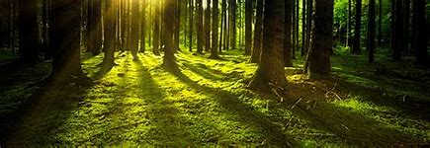
Goal 2 – Mahara (to remember, recollect, bear in mind, know)
Self Management – Holistic aspects of Work Life Balance & Well Being. Whanau involvement.
A wellbeing study acknowledging the person isn’t broken, and looking into the surrounding circumstances / contributing factors to Wellbeing in Tairawhiti Forestry
No more sign your name get the blame mentality.
Injury prevention through understanding the workforce and industry factors to target improvement opportunities

Slide 8
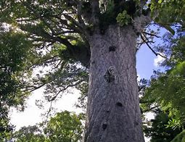
Goal 3 – Mātai (to inspect, examine, investigate, scan, observe, note)
Data Collection – Not a Statistic, but a Story
A specialized Forestry Forensics team
Injury prevention via thorough & accurate investigation outcomes with clear guidance on control measures to prevent reoccurrence

Slide 9
Goal 4 – Manaaki (to support, take care of, protect, look out for - show respect, generosity and care for others)
When the next Kaimahi is killed, not if – Support for Whanau Pani
Greater Union Participation and a bespoke support team to assist whanau pani navigating the systems & structures following a serious injury or fatality.
Addressing the Burden of Injury for Tairawhiti Forestry

Slide 10
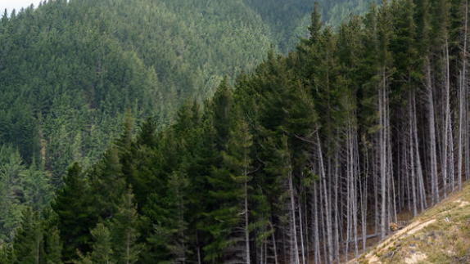
Take home messages
A Karanga from the Kaimahi Less KPI’s, more Kia Ora
Goal 1– Māngai
H&S Rep per Crew
Goal 2 – Mahara
A Wellbeing Study – Forestry Kaimahi
Goal 3 – Mātai
A Specialized Forestry Forensics Team
Goal 4 – Manaaki
Greater Union Participation and a bespoke support team to assist whanau pani
Any Pātai?
(to ask, question, enquire, cross-examine, provoke, challenge.)
Ngā Mihi Tāngata Humāria Charitable Trust

