Slide 1
Whakatika Oranga ACC and the Future of Injury Prevention Sports Injury Prevention
Professor Duncan Reid DHSc
Department of Physiotherapy School of Clinical Sciences, Faculty of Health and Environmental Sciences

Slide 2
The plan
Injury prevention models- framework for the future
Injury in youth
Primary injury prevention strategies- e.g. Futsal
Secondary- Careway
Tertiary- OA research

Slide 3
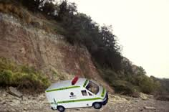
Clinical Practice- need for injury prevention

Slide 4
Four step sequence of injury prevention
1. Establish extent
of injury problem
Incidence
severity
2. Establish aetiology
& mechanisms
of injury
4. Assess the
Effectiveness repeat
Step 1
3. Introduce a
preventative measure
Van Mechelen et al (1992)

Slide 5
Part 1- the size of the problem

Slide 6
NZ ACL surgery Male vs Female
The annual incidence of ACLR for 2009–2016 was 58.2 per 100 000 person-years and was greater in males than in females (72.2 and 44.9, respectively). This represents a
58% increase when compared with the period 2000–2005 (36.9 per 100 000).
The greatest increase was seen in females aged 15–19 years, with the incidence increasing by 120% in
the last decade, compared with 53% in females aged 20–24 years.
Sutherland K, Clatworthy, M Fulcher, M and Young, S. (2019).
Marked increase in the incidence of anterior cruciate ligament reconstructions in young females in New Zealand, ANZ J Surg, 89, 1151–1155

Slide 7
Key issues in clinical practice
Soft tissue injuries are increasing and costly to ACC
Ankle and knee injuries constituted 47% of all netball injury claims for the year 2017 and 66% of the cost of netball injuries to ACC at NZD$18,049,370
Belcher, S., et al (2020)
Ten-year nationwide review of netball ankle and knee injuries in New Zealand. Journal of Science and Medicine in Sport, 23(10):937-942.

Slide 8
Young ACL injury
Table 1 Cause of injury by activity
Sport/activity | N | Sport/activity | N
Rugby Union (and league) | 23 | Motor-cross | 12
Netball | 15 | Snow/Waterskiing | 3
Football (soccer) | 11 | Mountain biking | 2
Hockey | 5 | Trampoline | 2
Basketball | 5 | Badminton | 2
Touch rugby | 4 | Other | 13
Slides/ falls | 3 | Total | 100
Reid, D., Leigh, W., Wilkins, S., Willis, R., Twaddle, B., & Walsh, S. (2015).
A 10-year retrospective review of functional outcomes of adolescent Anterior Cruciate Ligament reconstruction.
Journal of Pediatric Orthopaedics. doi:10.1097/BPO.0000000000000594

Slide 9
Adolescent LBP in rowing
The rowers point prevalence of LBP that specifically occurred during rowing, that was greater than the LBP point prevalence in 17-year-olds (22.3% males and 41.1% females), and adolescents with a mean age of 13.6 years worldwide (12.0% combined males and females)
Higher prevalence of LBP in adolescent male rowers compared to adolescent female rowers,
The adolescent rowers experience moderate levels of LBP intensity
Adolescent male and female rowers reported similar aggravating factors, with ergometer rowing, long row in training session and sweep rowing most likely to aggravate their LBP.
Ng, L., Perich, D., Burnett, A., Campbell, A., & O'Sullivan, P. (2014).
Self-reported prevalence, pain intensity and risk factors of low back pain in adolescent rowers.
Journal of Science and Medicine in Sport, 17(3), 266-270.

Slide 10
Injury incidence in elite rowing
Table 4.6
Level | Participants |  | New LBP | Total Training Hours | Mean Training Hours | Std Dev | 95% CI | Injuries per 1000 Training Hours
 | N | % | N |  |  |  |  |  | 95% CI
Elite | 41 | 54% | 43 | 24120 | 588.29 | 30.28 | 0.297 | 1.78 | (1.782-1.784)
Non-Elite | 35 | 46% | 29 | 19077 | 545.05 | 27.19 | 0.288 | 1.52 | (1.519-1.521)
Total | 76 | 100% | 72 | 43196 | 568.37 | 29.15 | 0.210 | 1.67 | (1.666-1.667)
Newlands, Reid and Palmar 2013 The incidence, prevalence and severity
of low back pain among international representative rowers.
Br J Sports Med 2015;0:1–6. doi:10.1136/bjsports-2014-093889

Slide 11
Dance Injuries
 | Reported Injuries | Self-reported Injuries
Total injuries (n) | 125 | 174
% dancers injured | 86.2% | 91.8%
Injury Type
New | 104 (83%) | 130 (74.7%)
Recurrent | 21 (16.8%) | 43 (24.7%)
- Re injury | 8 (38.1%) | 27 (62.7%)
- Exacerbation | 13 (61.9%) | 17 (39.5%)
Acute | 51 (40.8%) | 77 (44.3%)
Overuse | 74 (59.2%) | 96 (55%)
Injury Location
Head/Neck | 4 (3.2%) | 5 (2.3%)
Trunk | 25 (20%) | 60 (27.5%)
Lower Limb | 85 (68%) | 124 (56.9%)
Upper Limb | 11 (8.8%) | 28 (12.8%)
Not reported |  | 1
Lee, L., Reid, D., Caldwell, J., & Palmer, P. (2017). Injury incidence, dance exposure
and the use of movement competency screen (MCS) to identify variables associated
with injury in full-time pre-professional dancers.
International Journal of Sports Physical Therapy, 12(3), 352-370.
Retrieved from https://spts.org/docs/default-source/v12n3-ijspt/ijspt-12_3-06-lee_abs.pdf?sfvrsn=2

Slide 12
Part 2- Aetiology –contributing factors

Slide 13
Association between new low back injuries and possible risk factors
Table 4.11
Variable | OR | p-value | 95% Confidence Interval
Age | 1.08 | 0.02** | 1.01 | 1.15
Gender | 1.07 | 0.81 | 0.62 | 1.86
BMI | 1.02 | 0.84 | 0.87 | 1.18
Rowing Discipline | 0.79 | 0.37 | 0.48 | 1.31
History of previous LBP | 2.06 | 0.01* | 1.22 | 3.48
MCS score | 1.58 | 0.08 | 0.95 | 2.65
*. Significant at the 0.01 level
**. Significant at the 0.05 level
Newlands, Reid and Palmar 2013 The incidence, prevalence and severity
of low back pain among international representative rowers.
Br J Sports Med 2015;0:1–6. doi:10.1136/bjsports-2014-093889

Slide 14
Relationship between total monthly training hours and number of low back pain cases per month over the twelve-month period.

Slide 15
Injury relationship with dance exposure
Lee, L., Reid, D., Caldwell, J., & Palmer, P. (2017). Injury incidence, dance exposure
and the use of movement competency screen (MCS) to identify variables associated
with injury in full-time pre-professional dancers.
International Journal of Sports Physical Therapy, 12(3), 352-370.
Retrieved from https://spts.org/docs/default-source/v12n3-ijspt/ijspt-12_3-06-lee_abs.pdf?sfvrsn=2

Slide 16
Knee angle- what do you do about this?
Hewitt et al 2007

Slide 17
Movement competency screen (MCS)
5 basic fundamental movement patterns ( plus additions)
Squat
Lunge and twist
Bend and pull
Push up
Single leg squat
Score Max 21
Kritz, Hume and Cronin (2010)
Kritz M. Movement Competency Screen: Information Pack. 2013. (accessed June 2013).

Slide 18
Netball Screening
Whatman, C., & Reid, D. (2017). Movement quality, physical performance and prevalence of overuse injuries in secondary school netball players. New Zealand Journal of Sports Medicine, 44(1), 14-19.

Slide 19
Other research
Reid, D., Leigh, W., Wilkins, S., Willis, R., Twaddle, B., & Walsh, S. (2015).
A 10-year retrospective review of functional outcomes of adolescent
Anterior Cruciate Ligament reconstruction. Journal of Pediatric Orthopaedics.
doi:10.1097/BPO.0000000000000594
McGowan, J., Reid, D., & Caldwell, J. (2017).
Post-operative rehabilitation of anterior cruciate
ligament reconstruction in the skeletally immature child:
a systematic review of the literature. Physical Therapy Reviews.
doi:10.1080/10833196.2017.1364541

Slide 20
KOOS scores
The KOOS scores for key domains of Quality of Life, Sports and Recreation, Activities of Daily Living, Pain and General Symptoms.
100 = no problem 0 = extreme problem. Data are means and standard deviations.
Reid, D., Leigh, W., Wilkins, S., Willis, R., Twaddle, B., & Walsh, S. (2015). A 10-year retrospective review of functional outcomes of adolescent Anterior Cruciate Ligament reconstruction. Journal of Pediatric Orthopaedics. doi:10.1097/BPO.0000000000000594

Slide 21
Association between the total number of reported injuries and risk factors
Independent Variables | Adjusted R Square | B | 95% CI | p-value
Age | -0.016 | -0.001 | -0.235 – 0.233 | 0.992
BMI | -0.013 | 0.039 | -0.141 – 0.220 | 0.667
Gender | -0.014 | -0.125 | -0.817 – 0.567 | 0.720
Major | -0.014 | -0.100 | -0.774 – 0.575 | 0.769
Year of study | 0.008 | -0.272 | -0.714 – 0.169 | 0.222
Total MCS score | 0.022 | -0.081 | -0.186 – 0.023 | 0.125
Mean MCS Score | 0.054 | -0.702 | -1.354 – -0.050 | 0.035*
Previous Injury | 0.016 | -0.685 | -1.646 – 0.277 | 0.160
Lee, L., Reid, D., Caldwell, J., & Palmer, P. (2017). Injury incidence, dance exposure
and the use of movement competency screen (MCS) to identify variables associated
with injury in full-time pre-professional dancers.
International Journal of Sports Physical Therapy, 12(3), 352-370.

Slide 22
Part 3- Interventions

Slide 23
Primary Injury Prevention

Slide 24
Futsal
Since New Zealand Football introduced futsal in 2010, the number of registered players has increased from 700 to more than 21 000 by the end of 2015
Increasing number of injuries accepted by ACC, exact number not known as coded under Soccer/Football!

Slide 25
Part 1 The size of the problem: NZ Situation
.
 | Junior Teams |  |  | High School Teams |  |  | Adult Teams | Total
 | Male | Female | Total | Male | Female | Total | Male
Number of injuries | 53 | 21 | 74 | 15 | 13 | 28 | 29 | 131
Per 1000 player hours (95% CI) | 13.8 (10.5 to 17.1) | 14.6 (9.2 to 20.0) | 14.0 (11.2 to 16.8) | 6.7 (3.4 to 10.6) | 11.1 (6.0 to 17.1) | 8.2 (5.6 to 11.6) | 10.4 (7.0 to 14.1) | 11.4 (9.8 to 13.3)
Body Section*
Head/neck | 9 (2.3) | 4 (2.8) | 13 (2.5) | 4 (1.8) | 3 (2.6) | 7 (2.0) | 11 (4.0) | 31 (2.7)
Upper Extremity | 12 (3.1) | 3 (2.1) | 15 (2.8) | 2 (0.9) | 2 (1.7) | 4 (1.2) | 3 (1.1) | 22 (1.9)
Lower Extremity | 30 (7.8) | 12 (8.3) | 42 (8.0) | 9 (4.0) | 8 (6.8) | 17 (5.0) | 15 (5.4) | 74 (6.4)
Body Part*
Head | 8 (2.1) | 4 (2.8) | 12 (2.3) | 3 (1.3) | 3 (2.6) | 6 (1.8) | 11 (4.0) | 29 (2.5)
Knee | 8 (2.1) | 2 (1.4) | 10 (1.9) | 3 (1.3) | 2 (1.7) | 5 (1.5) | 7 (2.5) | 22 (1.9)
Ankle | 15 (3.9) | 6 (4.2) | 21 (4.0) | 5 (2.2) | 2 (1.7) | 7 (2.0) | 5 (1.8) | 33 (2.9)
Cause of injury*
Non-contact | 7 (1.8) | 2 (1.4) | 9 (1.7) | 0 (0) | 1 (0.9) | 1 (0.3) | 6 (2.2) | 16 (1.4)
Contact | 46 (12.0) | 19 (13.2) | 65 (12.3) | 15 (6.7) | 12 (10.2) | 27 (7.9) | 23 (8.3) | 115 (10.0)
Contact with*
Ball | 25 (6.5) | 12 (8.3) | 37 (7.0) | 6 (2.7) | 5 (4.3) | 11 (3.2) | 8 (2.9) | 56 (4.9)
Player | 20 (5.2) | 5 (3.5) | 25 (4.7) | 9 (4.0) | 6 (5.1) | 15 (4.4) | 13 (4.7) | 53 (4.6)
Fixed object | 1 (0.3) | 2 (1.4) | 3 (0.6) | 0 (0) | 1 (0.9) | 1 (0.3) | 2 (0.7) | 6 (0.5)
Severity of injury*
Able to finish match | 28 (7.3) | 11 (7.6) | 39 (7.4) | 6 (2.7) | 5 (4.3) | 11 (3.2) | 13 (4.7) | 63 (5.5)

Slide 26
Part 2 Aetiology
Hard Surface- indoors
Harder ball
Short time frame for games
No structured warm up

Slide 27
Part 3 Plan an intervention
Theme 1: The use of a warm-up in the recreational futsal environment
Theme 2: The structure of a futsal-specific warm-up
Theme 3: The issue of compliance
The warm-up should be short, three to five minutes, and sharp to reproduce the intensity of game.
The warm-up should consist of futsal-specific movements and should ideally performed as a team rather than individually.
A warm-up should incorporate a ball to engage players and to make it more fun
Tomsovsky, L., Reid, D., Whatman, C., Fulcher, M., & Walters, S. (2020). Futsal FastStart:
The development of a futsal specific warm-up. New Zealand Journal of Sports Medicine, 47(1), 15-19.

Slide 28
Trial Design- quasi RCT
Teams were not randomized to the intervention or control group, but the allocation was based on the geographic separation of both centres to reduce player contamination with the intervention.
Teams based in Dunedin (420 teams) served as a control group and teams in Wellington (458 teams) as an intervention group.
Teams in the intervention group were given information/instruction on how to implement and perform the warm-up programme before their matches.
Teams in the control group were asked to warm up via their usual routine with no formal instructions.
Teams followed over 2 semesters of play

Slide 29
The intervention
Tomsovsky, L., Reid, D., Whatman, C., Fulcher, M., & Walters, S. (2020). Futsal FastStart: The development of a futsal specific warm-up.
New Zealand Journal of Sports Medicine, 47(1), 15-19.

Slide 30
Injury recording chart

Slide 31
Part 4 Evaluation

Slide 32
Results- Futsal
Tomsovsky, L., Reid, D., Whatman, C., Borotkanics, R., & Fulcher, M. (2021). The effect of a neuromuscular warm-up on the injury rates in New Zealand amateur futsal players. Physical Therapy in Sport, 48, 128-135. doi:10.1016/j.ptsp.2020.12.015

Slide 33
Futsal Results
Statistically significant reduction in contact injuries and injuries with the ball

Slide 34
Secondary Injury Prevention

Slide 35
Careway -ECP

Slide 36
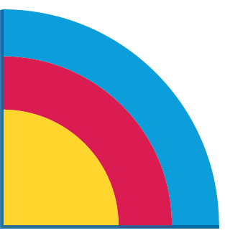
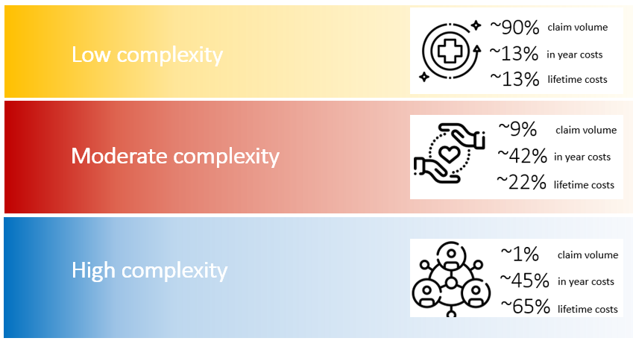
Health Sector Strategy & Value Based Healthcare
ACC aims to empower providers to do what they do best – helping our clients
ACC’s Health Sector Strategy aims to shift ACC from an organisation that pays its providers for specific services, to an organisation that commissions health outcomes for its customers. A key enabler of this is partnering with providers.
Notes:
Talking points
ACC’s Health Sector Strategy aims to shift ACC from an organisation that pays its providers for specific services, to an organisation that commissions health outcomes for its customers. Ensuring they get value based care.
A key enabler of this is partnering with providers.
Our client cohorts utilise services in three primary cohorts – see Red, yellow, blue diagram –
Yellow – low complexity clients, 90% of volume, 13% of yearly cots costs, 13% of lifetime costs e.g. an ankle sprain from netball may use a GP visit, x-ray and some physiotherapy to get back on track.
Red - moderate complexity, 9% of volume, 42% of costs, 22% lifetime costs e.g. a broken leg from rugby, may need some weekly compensation and home help alongside treatment and specialist care but returns to independence and work after a few weeks.
Blue – 1% of volume, 45% yearly costs, 65% lifetime costs e.g. a spinal cord injury or birth injury requiring lifetime support from ACC.

Slide 37
Soft tissue knee and ankle injuries in the NZ context
Impact on ACC clients
ACC receives around 320,000 claims per year for knee and ankle soft tissue injuries
These account for approximately a third of GP claims by volume
As a group of injuries they cost ACC around $250m per year
ACC claim data show significant variation in terms of what clients access by way of services and in their outcomes
The early indications from ECP and the pathway approach are very promising.
A client-centric approach is needed

Slide 38
Overview of the Pilot
MyAccelerated Care Ltd (t/a Careway) have partnered with ACC and selected health providers like yourself, to deliver a four-year Escalated Care pilot project.
The Pilot aims to test innovative and integrated new recovery pathways for people with non-acute knee, shoulder and lower-back injuries.
The Careway pilot will test the impact on people’s outcomes, including:
Faster return to work
Improved utilisation of Voc and rehabilitation pathways
Reduce reinjury rates
more timely access to surgery and rehabilitation
improved equity and access for Maori and pacific
© careway Treatment Protocol Works and Customised Systems and Processes Works

Slide 39
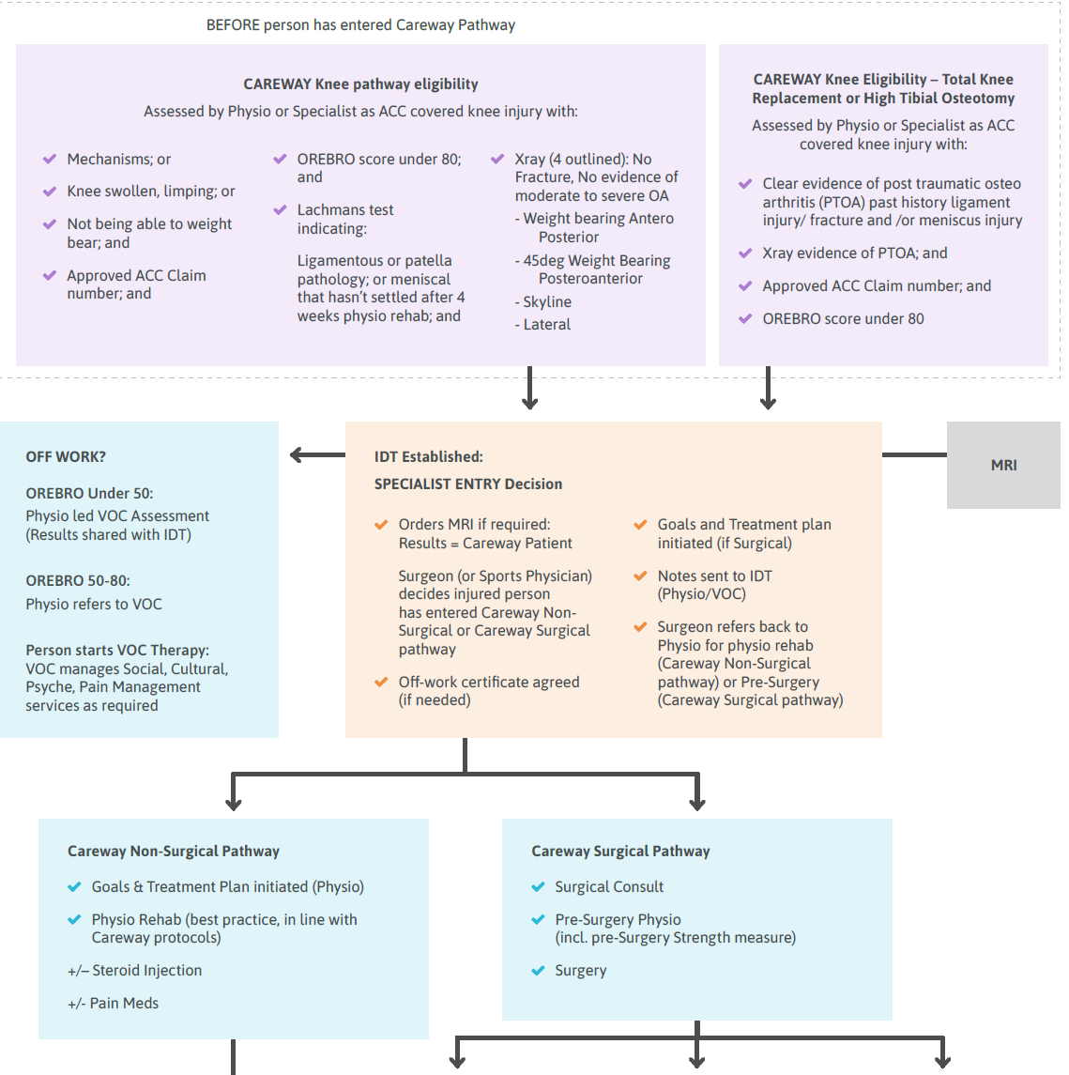
Careway Knee PATHWAY
© careway Treatment Protocol Works and Customised Systems and Processes Works

Slide 40
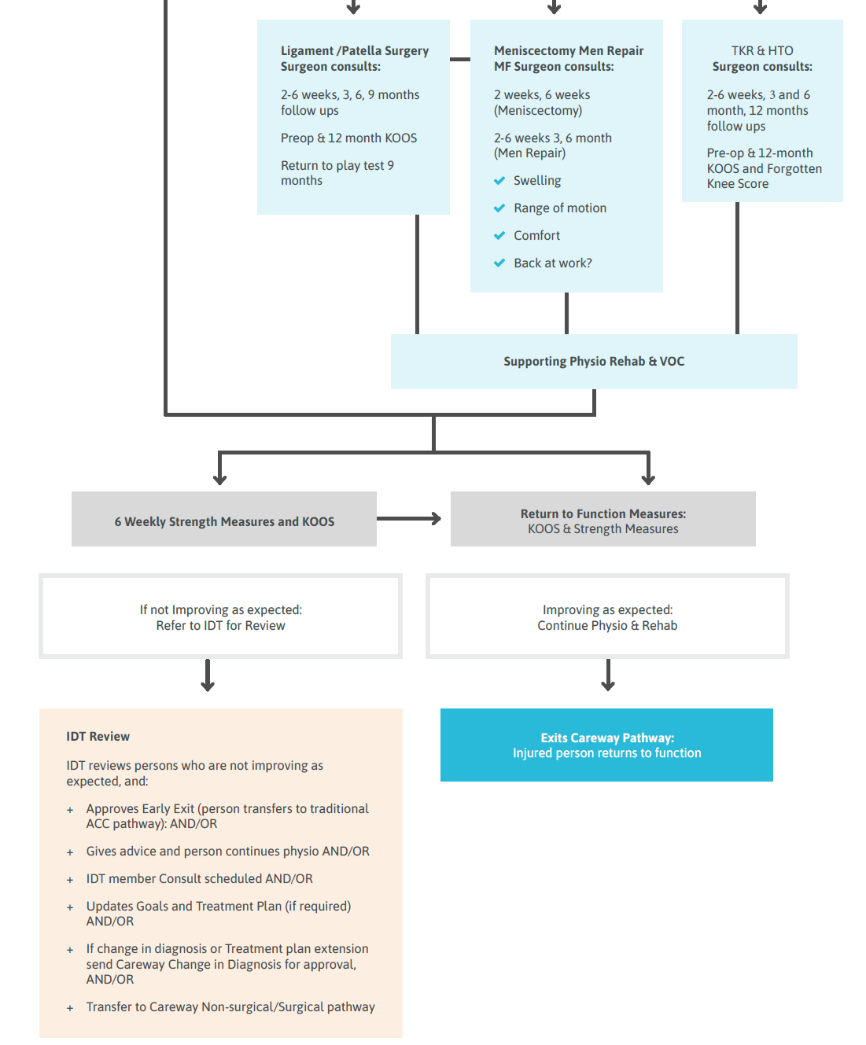
Careway Knee PATHWAY
© careway Treatment Protocol Works and Customised Systems and Processes Works

Slide 41
Pre-surgery strength testing - ACL
Outcome measure | Goal |  | Achieved/ Not achieved |  | Comments
Passive knee extension | Equal to non-injured side- minimum 0 degrees
Passive knee flexion | Greater or equal to 120 degrees
Effusion (instruction included on page 2 of the PDF ‘Knee ACL Pre-surgery strength testing’ – see next slide) | 0 to trace on stroke test |  | Please record as: zero, minimal, moderate or severe
Quads strength | Straight leg raise with no lag |  | Achieved/ Not achieved
 | Single leg squat with good technique |  | Achieved/ Not achieved
Quads strength | 1RM knee extension close to 80% - 90% of non-affected side If the 1RM is too challenging you can use the Single leg press to achieve the same limb symmetry index as above | Unaffected leg outcome Please record in Newton meters or Kgs | Affected leg outcome Please record in Newton meters or Kgs | Limb Symmetry Index % ‘affected leg divided’ by ‘unaffected leg’ x 100 | Comments
© careway Treatment Protocol Works and Customised Systems and Processes Works

Slide 42
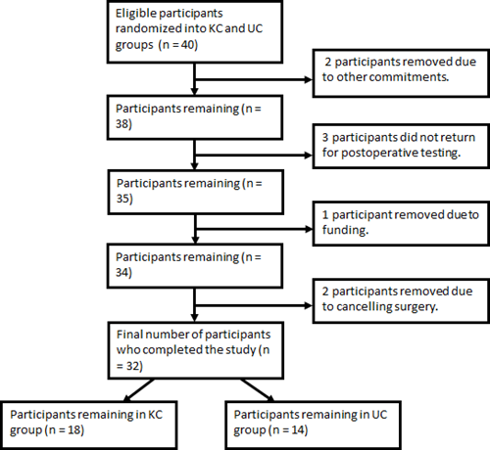
Does targeted pre operative Knee strengthening improve post Op strength post ACL reconstructions?
Potts and Reid, DHSc Thesis 2022

Slide 43
Intervention
Knee Care- 6 weeks of pre op strengthening Knee extension
4 sets 15 reps at 18RM bilateral
2 sets 8-10 reps unilateral 10RM
A range of other exercises, cycling, leg press, squats
Usual Care- at the discretion of treatment physio- current best practice
Measures peak quads torque
Baseline, 6 weeks, 12 weeks post op

Slide 44
Results
Significant increase in peak torque T1 to T1, (26% vs 23%) KC statically better than UC
and less reduction in quads torque post op
Better pre op strength improves post op outcomes.
Good knee strength post op critical to long term health of the knee

Slide 45
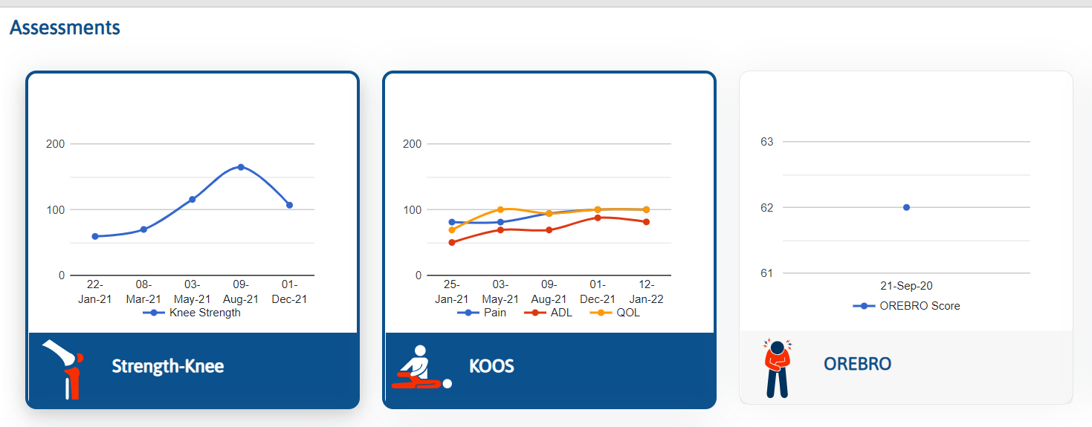
Dashboard Indici PMS
Provide treatment
Complete Physio rehabilitation treatment plan and goals
Complete baseline outcome and strength measures as per the timelines
Benchmarking
Patient motivation
Able to track progress or lack of progress

Slide 46
ACL surgical Knee
Covid

Slide 47
Impact

Slide 48
Impact

Slide 49
Tertiary prevention

Slide 50
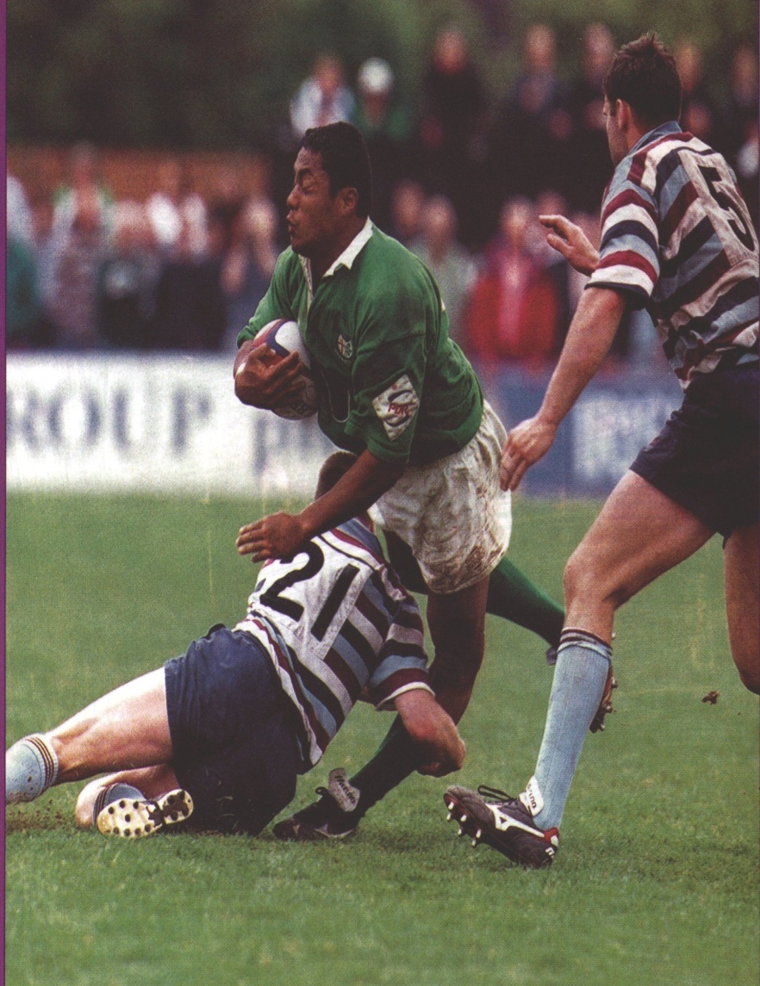
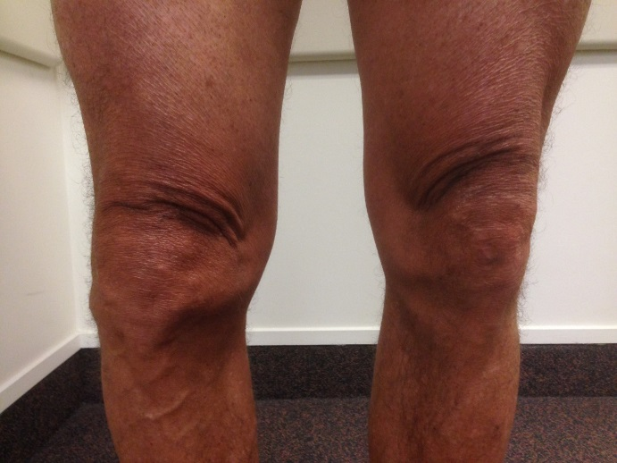
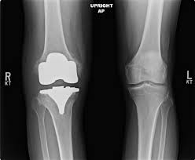
Knee progression

Slide 51
OA post ACL injury –surgery vs non
Kvist, J., Filbay, S., Andersson, C., Ardern, C. L., & Gauffin, H. (2020). Radiographic and symptomatic knee osteoarthritis 32 to 37 years after acute anterior cruciate ligament rupture. The American journal of sports medicine, 48(10), 2387-2394.
Patients allocated to early ACL surgery, performed a mean 5 days after injury, had a lower prevalence of
tibiofemoral radiographic OA at 32 to 37 years after injury compared with patients who never had ACL surgery.
The prevalence of symptomatic OA, radiographic patellofemoral OA, and knee symptoms were similar
irrespective of ACL treatment. Overall, the prevalence of OA after ACL injury was high>

Slide 52
Late stage (surgical) management
In Aotearoa New Zealand in 2019, 8,378 people underwent TKJR and in 2020, it was 8,135 (even with COVID!)
TKJR costs approximately $25k per surgery (approximately, $200m/year)

Slide 53
Osteoarthritis across the life span: Opportunities
Prevention (0-19 years) | Prevention and diagnosis (20-39 years) | Early management (40-59 years) | Late management (60-80+ years)

Slide 54
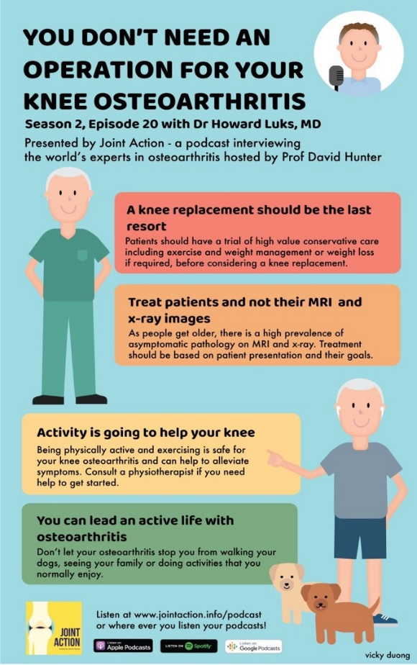
Active (early) management

Slide 55
Pathways to conservative care not utilised consistently
51% of patients referred for physiotherapy management until joint replacement was required.
49 % of the cohort did not receive a physiotherapy referral.
86% of this patient group not made aware of the different interventions available.
94% of cases physiotherapy was not discussed as a treatment option.
(Reid et al., 2014. NZ Journal Physiotherapy)

Slide 56
Management versus treatment
National Osteoarthritis Strategy (Australia, 2018)

Slide 57
“Living a better life post ACL injury”
Phase 1
What are the current experiences and challenges of those living with early OA post ACL injury?
Phase 1 potential methodologies
Survey questionnaire
Or focus groups/hui
Phase 2
What is the most appropriate programme to improve life post ACL injury?
Co design of potential ways to improve outcomes and reduce disability post ACL injury
Phase 2 potential methodologies
Focus groups/hui: Sporting organisations, people with ACL injury, Māori and Pasifika, health care providers, ANZ and ACC
Phase 3
What is the impact/best outcome of the above programme?
Implementation of above programme into target group based on co design findings
Phase 3 potential methodologies
Prospective cohort study- mixed methods
Quantitative measures of QOL, KOOS etc based “my knee pain”
Qualitative measure Focus groups/hui with target group end of year

Slide 58
Conclusion
Injury prevention has challenges but has the greatest impact
Need to invest more at the junior level
Encourage healthy activity
Work at all three levels is required

