Slide 1
A Clash of Values limiting scheme costs or administering a fair scheme?
Hazel Armstrong
ACC Futures Coalition Seminar
29th October 2012

Slide 2
The Woodhouse Report
In 1967, the Woodhouse Report was published.
A bold proposal was put
forward rejecting the old
Workers Compensation
scheme
Triple goals: injury prevention,
rehabilitation, compensation
Replacing a fragmented
and unfair response to
a social problem

Slide 3
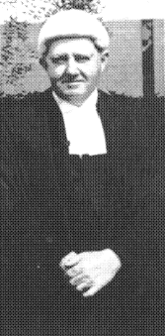
The Woodhouse principles
Politicians on both sides of the House agreed to these five founding principles for a scheme to manage personal injury:
Community responsibility
Comprehensive entitlement
Complete rehabilitation
Real compensation
Administrative efficiency

Slide 4
Community Responsibility
“Everyone was to be looked after- it is the community’s responsibility to do it”.
We all share in sustaining those who become victims of accidents or occupational disease
Injured persons burden is socialised – the cost of injury is spread through levy paying e.g. motor vehicles subsidise motor bike claims and victims of asbestos disease are compensated by levies on all employers in existence today

Slide 5
Complete Rehabilitation
“If the wellbeing of the workforce is neglected, the economy must suffer injury”.
“The process of rehabilitation should be developed and encouraged by every means possible as it has much to offer NZ both in human and economic terms”
“The consideration of overriding importance must be to encourage every injured worker to recover the maximum degree of bodily health and vocational utility in a minimum of time”

Slide 6
Accident compensation legislation implemented 1974
Weekly compensation retained whilst the injured person remained incapacitated and unable to return to pre injury employment
The type and quality of rehabilitation offered varied enormously
Between 1974 and 1998 criteria for incapacity changed (from capacity to perform each and every task to capacity to perform a generic job of same or similar description)

Slide 7
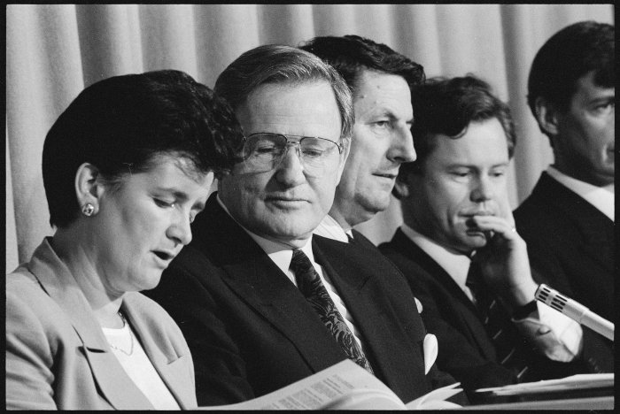
National gets elected in 1990

Slide 8
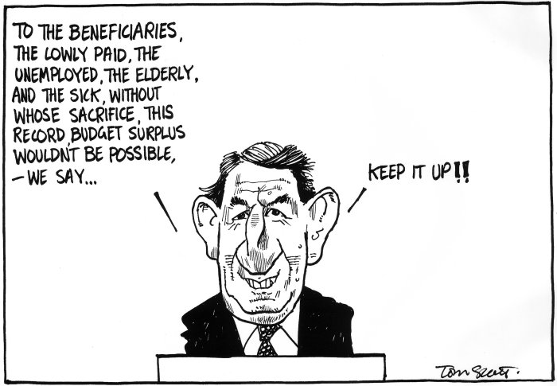
Mr Birch’s “A fairer scheme?”
The Accident Insurance Act 1998 introduced the work capacity test
Rehabilitation to enable the injured person to lead as normal a life as possible given the injury
Rehabilitation was regulated
If deemed fit to work in one job for 30 hours regardless of job availability, compensation ceased
Rehabilitation was limited by regulation

Slide 9
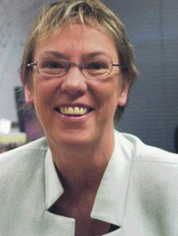
1999: Labour-led Government
State-run scheme immediately restored
Rehabilitation regs repealed
But work capacity testing remained
From 1/4/02 – capacity to work is deemed at 35 hours a week (up from 30)
From 1/10/08 - previous income must be taken into account
Choice of assessors permitted

Slide 10

ACC promoted -What can ACC provide to an injured worker?
 |  |  |  | What happened:
 |  |  |  | Neil lost the use of his legs after being hit by a forklift
ACC covered:
Emergency helicopter, hospital stays, income support, house alterations, travel and accommodation for family member, wheelchair and other equipment, physio, attendant care, car and modifications, career assessments and guiding, job re-training, lump sum payment for continuing impairment

Slide 11

National Elected 2008
AC Act passed
From 1/7/10 – Vocational Independence – deemed at 30 hours per week (reduced from 35)
From 1/7/10 assessor may take previous income into account (previously must take)
No choice of assessor
Only need one job- any job

Slide 12
Case studies
Unrealistic jobs
  Customs Officer in Taumaranui
Significantly reduced income
  Firefighter to basic office worker
  Senior Solicitor – Legal Secretary
Poor matching of skills
  Basic literacy & numeracy, few computer skills yet assessed to be receptionist
Pain, fatigue, medication and current work pattern not taken into account
Courses are short and inadequate

Slide 13
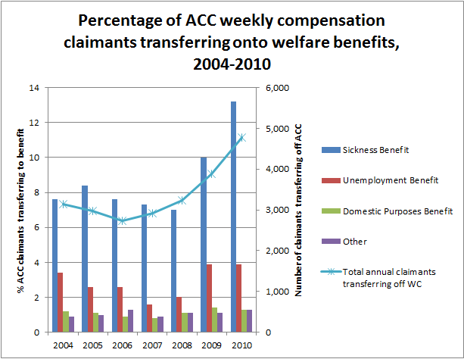

Slide 14
What needs to change?
If vocational independence testing is to stay then:
  Rehabilitation must be real
  Objective evidence of capacity to work
    E.g. through use of appropriate work trials
  Maintaining contact with employer
Pre injury earnings must be taken into account
Jobs must be sustainable in the long term
More than one job option must be identified
Job market must be taken into account
35 hours a week minimum
NZQA linked training
Claimant involvement in duration and type of training
Long term abatement accepted
Literacy, numeracy and computer testing required
ACC must monitor long term outcome for claimants
Choice of assessor reinstated

Slide 15
Realignment with the Woodhouse principles
Community responsibility:
  public good requirement in AC Act becomes a driver for rehabilitation
  Getting real work for injured NZers, reduces numbers on benefits (sickness and Invalids)
  Providing retraining for all injured NZers including those in custody
Comprehensive entitlement
  Using rehabilitation to gain more highly skilled job options for injured NZ workers
Real Compensation
  Incapacitated until evidence shows injured person can sustain work for 35 hours a week or injured person’s earnings are abated while working to maximum extent practicable
Complete rehabilitation
  For better individual outcomes

